Slide 1
Frontline Education
Strategic Decisions with Human Capital Analytics:
Use Case Round Table
DATE: October 25, 2022

Slide 2
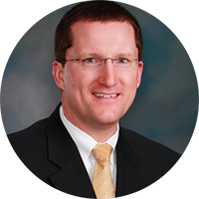
Use Case Round Table
Dr. Adam Cibulka
Senior Manager, Analytics
Frontline Education
Dr. CyLynn Braswell
Advisor, Student Analytics Lab
Frontline Education
Dr. Don White
Student Analytics Lab, Consultant

Slide 3
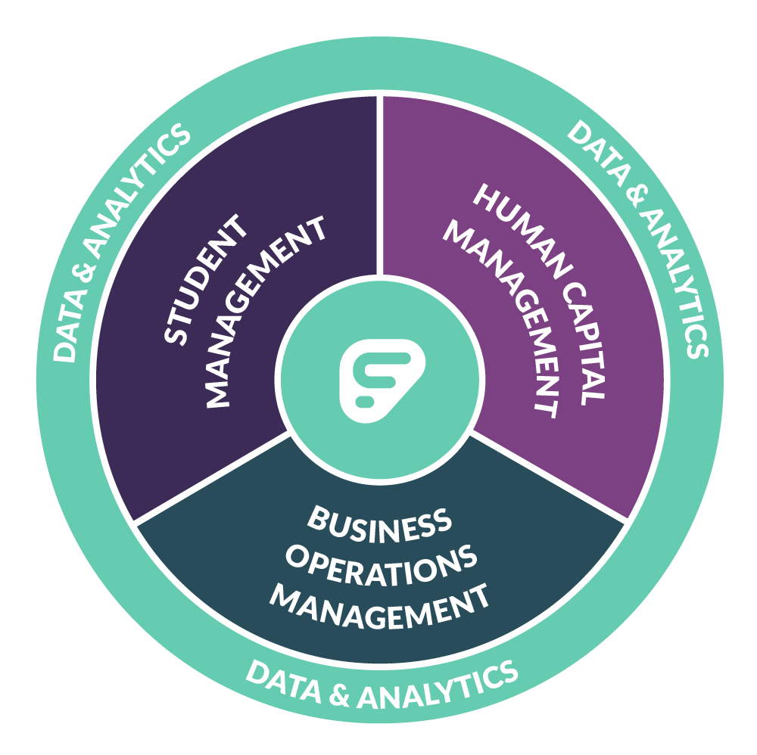
School administration software and services purpose-built for K-12 to support the growth of your people and optimize the management of your processes.
Notes:
So how can Frontline help you achieve greater efficiency, productivity and performance?
We bring solutions for Human Capital Management, Business Operations Management and Student Management into a connected platform. Everything we offer is purpose-built for K-12 to optimize the growth of your people and the management of your processes.

Slide 4
For District Leaders who need to make better, more informed, human capital decisions, Human Capital Analytics ...
Unlocks new & powerful HCM Data
Near real-time analysis with "Out-of-the-box" analytics
Reduces "Time-to-Insight"
Notes:
Why

Slide 5
Moving From Transactional Management to Strategic Human Capital Decision Making
Professional Learning Management
Absence Management
Recruiting & Hiring

Slide 6
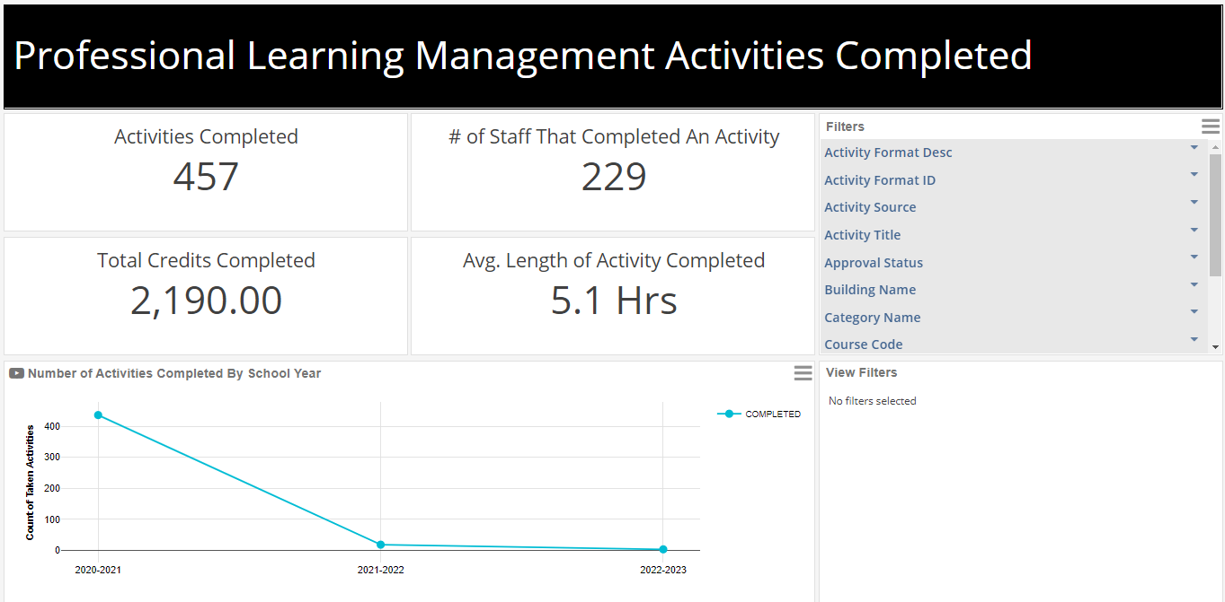
Day 1: Assembled Data, Calculated Results

Slide 8
Questions?
www.frontlineeducation.com

