Slide 1

A Winning Model For Your Budget Presentation
Best Practice Tips & Client Perspective
March 2, 2022

Slide 3
“Excellence is not a destination; it is a continuous journey that never ends.”
Brian Tracy

Slide 4
Why Now?
The Six Critical Elements
Telling Your District’s Budget Story
A District Perspective

Slide 5
Why Now?

Slide 6

A NEW ERA . . . . . .
. . . .brings MANY changes. Your budget communications need to change to meet the new needs, challenges, and overall environment. What may have “worked” in the past is not addressing the current situation.

Slide 7

Things You Don’t Want to Hear
“Well . . . .that’s the way we have always done it”.

Slide 8

Eight (8) K-12 Trends to Watch in 2022*
Addressing Learning & Enrollment Loss
How to Communicate with Stakeholders
Continued Unpredictability of Education Funding
Meeting Social, Emotional, and Mental Health Needs
Maintaining Staff Stability
Internet Access and Cyber Security
Censorship in Schools
Policy Ping Pong
*According to K-12 Dive

Slide 9
More Important Now than Ever Before
Effectively Communicating Your District’s Financial and Operational Information

Slide 10
A FRESH APPROACH
Using relevant and factual data in various formats
Using data to tell a story that is interesting – focused to keep people’s attention
Presenting information that is persuasive and instrumental in guiding the decision-making process
Do you have the necessary information, data, and tools to accomplish these objectives?

Slide 11
Six Critical Elements

Slide 12
Consider the BUD in Budget
BUD | BUD
Balanced | Believable
Understandable | Unique
Dynamic | Deliberate
The six (6) critical elements of an effective budget presentation.

Slide 13
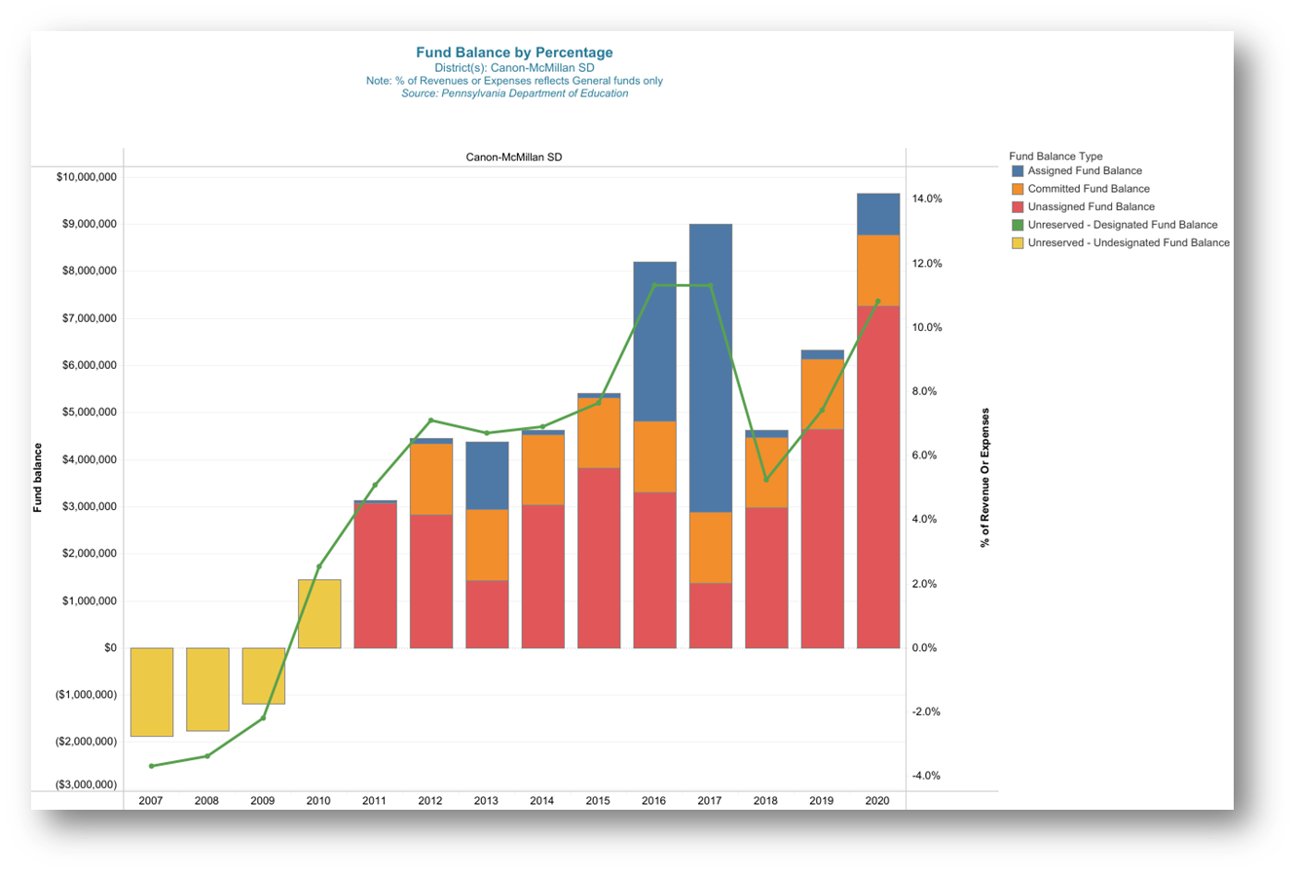
BALANCED
Tell both sides of the story – the good and the not so good
Sharing your vulnerabilities builds trust
Enforces your transparency efforts
Use peer comparisons

Slide 14
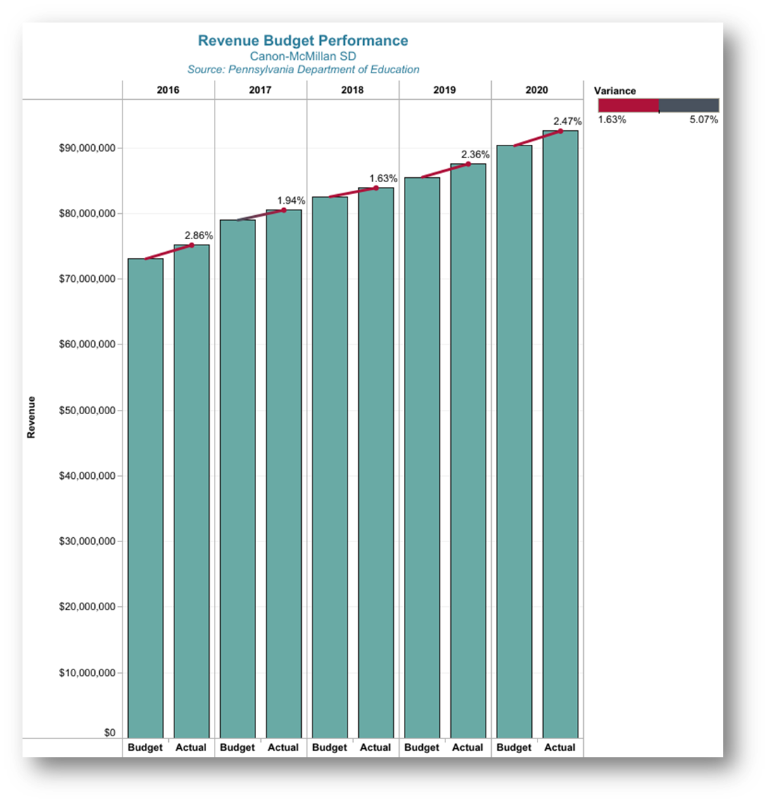
BELIEVABLE
Establishing a baseline of trust
Presentation should be a non-fiction story
Appropriate back-up
Prepared for follow-up

Slide 15
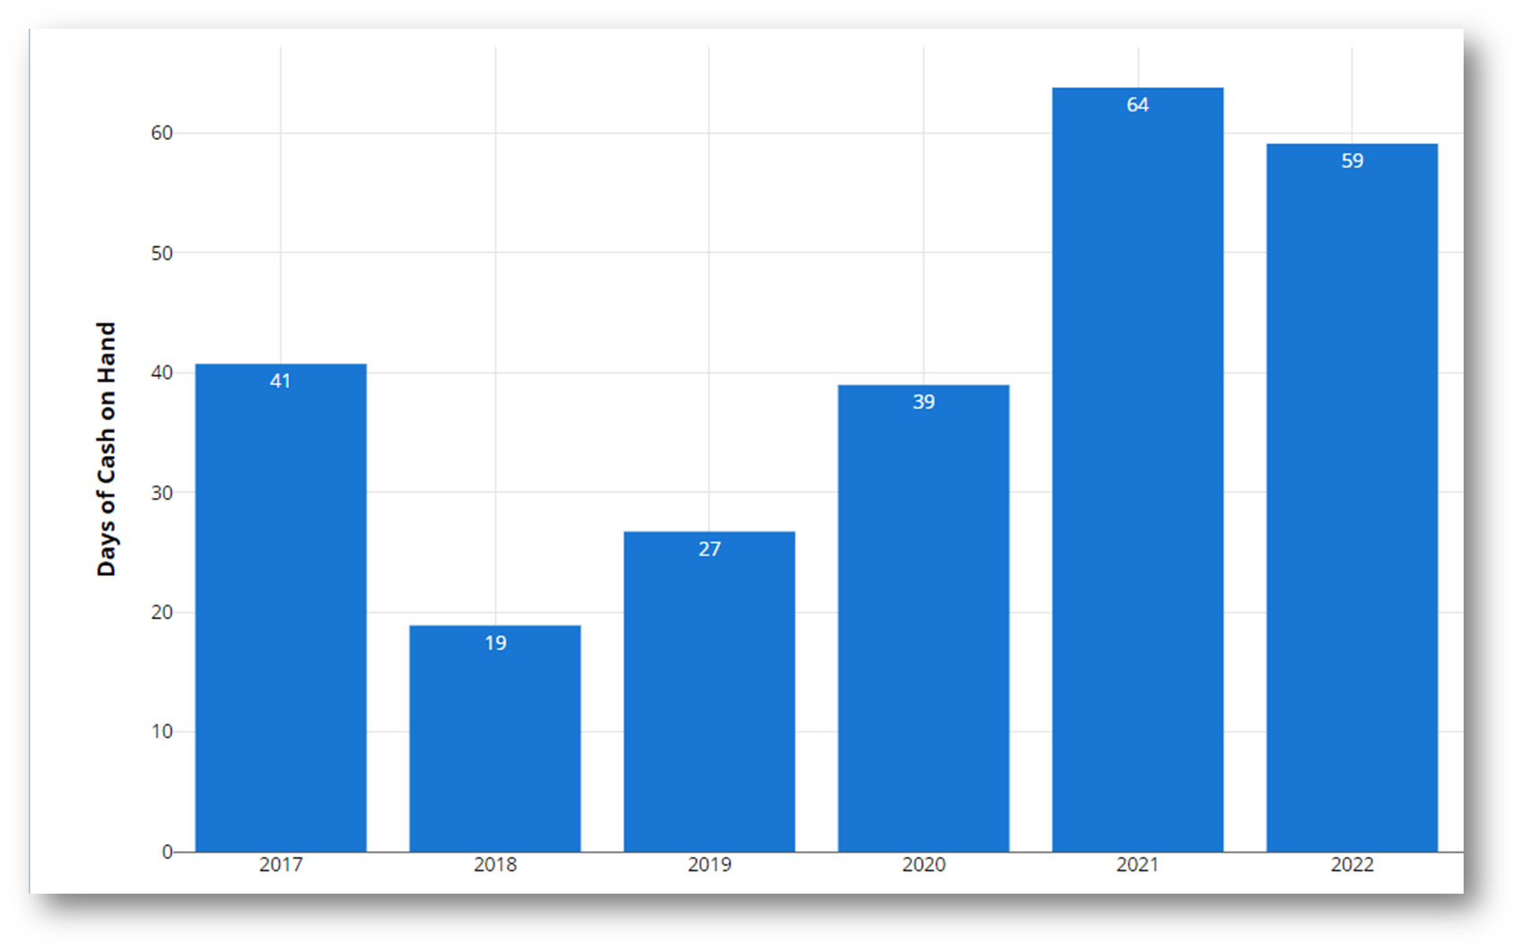
UNDERSTANDABLE
Remember your audience
Their perspective versus your perspective
The “Keep It Simple” rule
Fund Balance Shown as # of Days of Cash on Hand

Slide 16
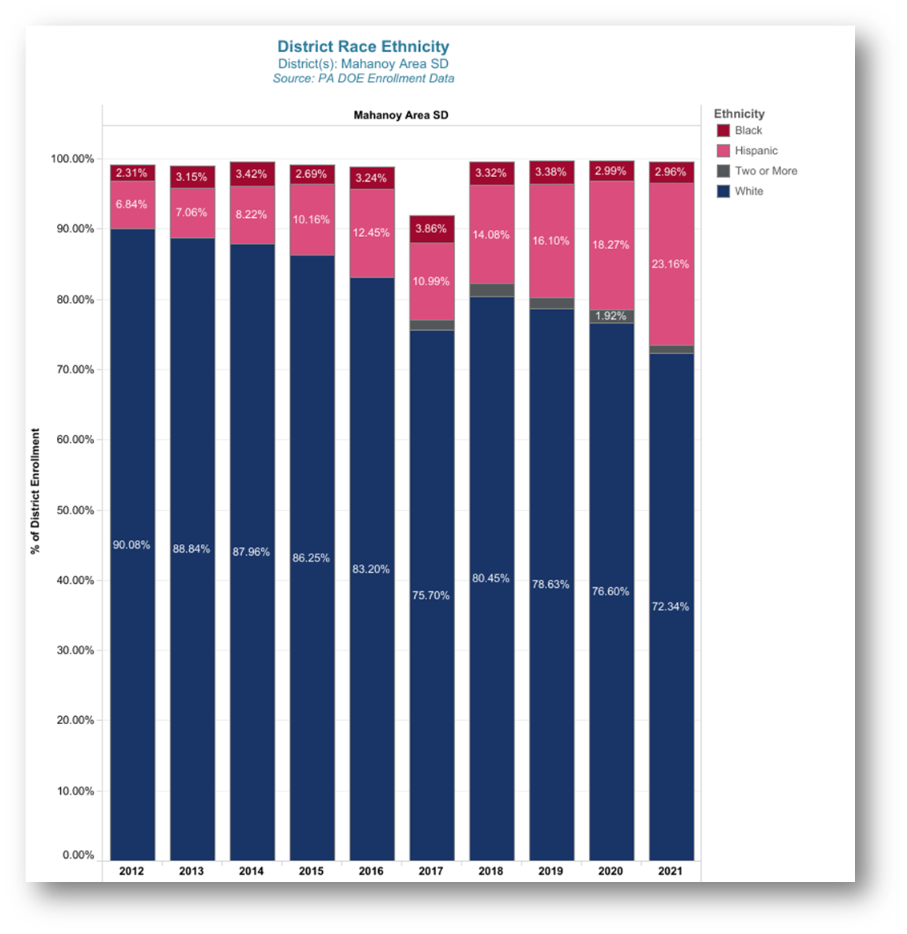
UNIQUE
Your district is unique; your district’s story is unique
Each year is different
Unique but alike – provide fair comparisons
Help them understand the distinguishing characteristics

Slide 17
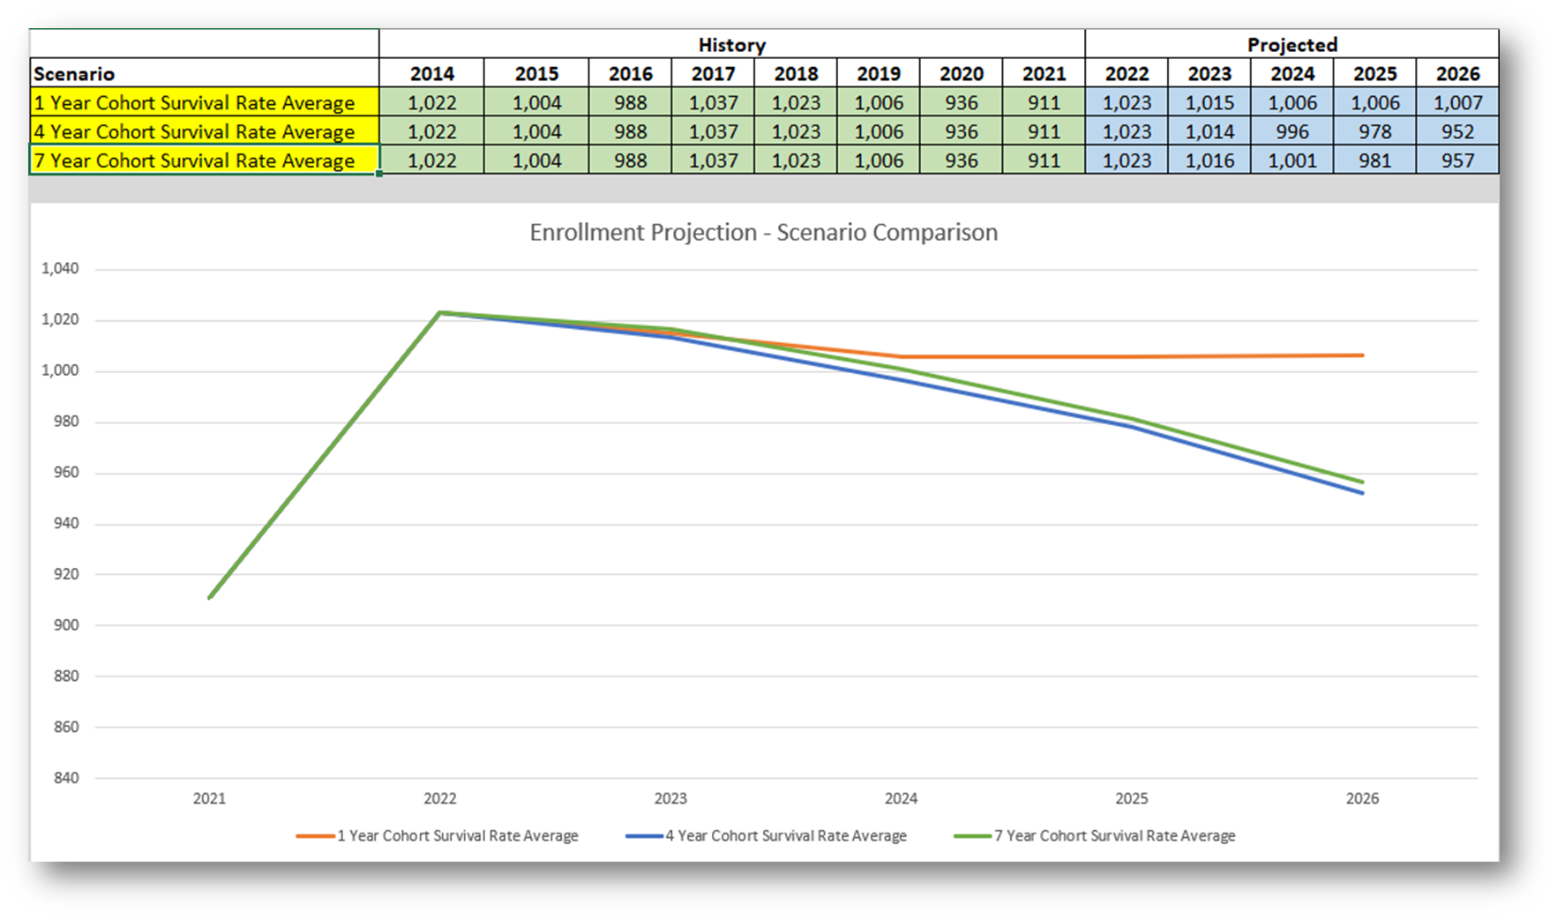
DELIBERATE
A thoughtful and purposeful approach
Plan your message
Meet with key decision makers – team approach
What is your point – what should they do with the information?
Avoid the “data dump”

Slide 18
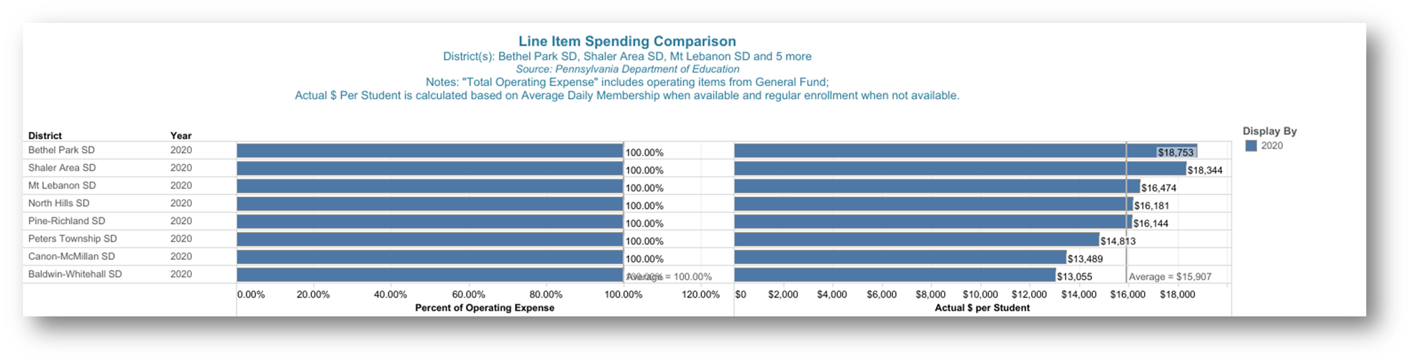
DYNAMIC
Energetic and vibrant
Really?
Yes, really.
Changing to address different audiences and varying circumstances

Slide 19
TELLING THE STORY

Slide 20

A Good Story
A Solid Beginning
A Strong and Substantial Middle
A Compelling Ending
Interesting, Factual, and Readable

Slide 21
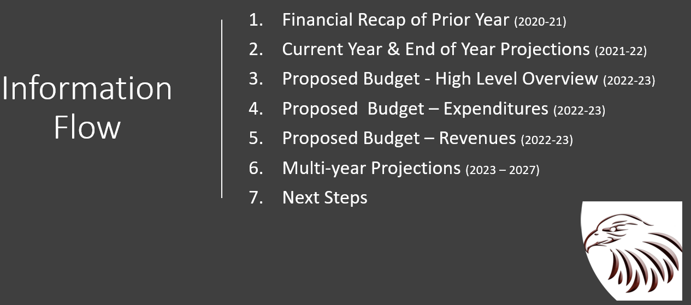
Presentation Flow
Past, Current, Next Year, the Future
  Start with prior year actuals to set the stage
  Move to current year projected results
  Recap of next year’s budget – share overall impact
  More details of next year’s budget
  Multi-year financial projection
  What’s next – now what ??

Slide 22

A FEW MORE TIPS
After the presentation – get feedback
Present throughout the year
Reflect and adjust

Slide 23
Implementing These Concepts
What Might That Look Like?

Slide 24

Sam Kirk, PCSBA
Armstrong School District, PA
A District Perspective

Slide 25
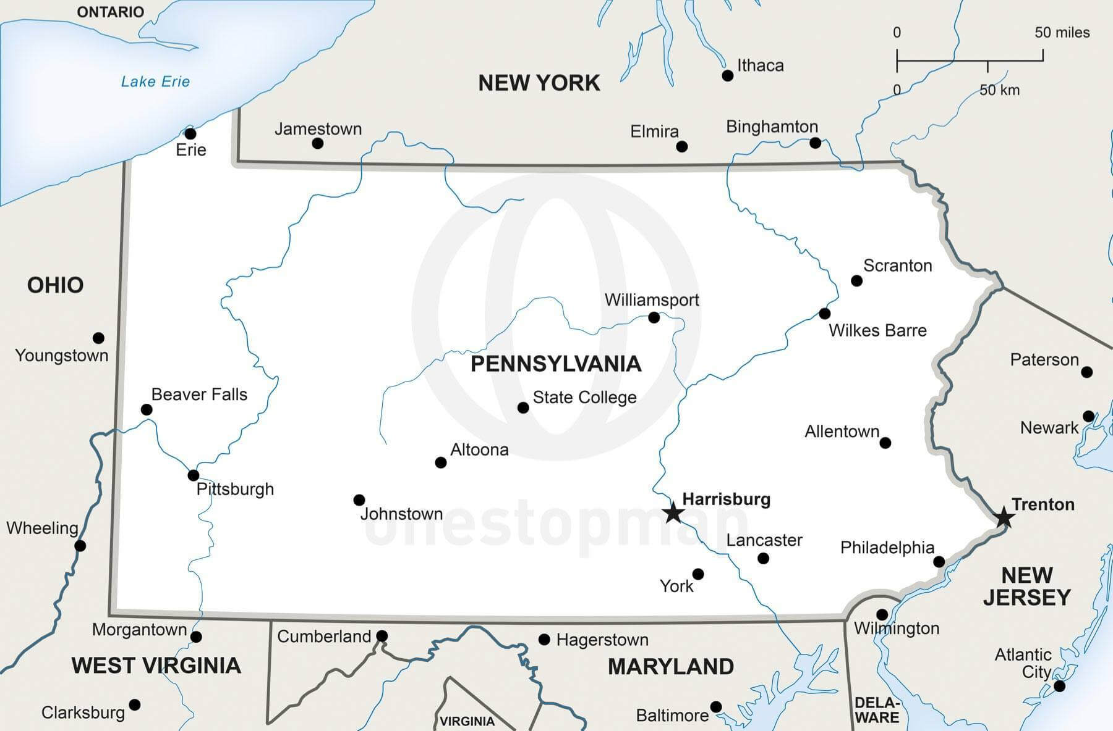
Armstrong School District
Information
8 School Buildings: 6 Elementary and 2 Jr/Sr High Schools
Enrollment: 4,737
Employees: 633
  Administration: 22
  Professional (teachers): 408
  Support: 196
  Classified: 7
Total Square Miles: 437
Located in Western Pennsylvania

Slide 26
2022-23
Proposed Budget and Financial Overview

Slide 27
Information Flow
Financial Recap of Prior Year (2020-21)
Current Year & End of Year Projections (2021-22)
Proposed Budget - High Level Overview (2022-23)
Proposed Budget – Expenditures (2022-23)
Proposed Budget – Revenues (2022-23)
Multi-year Projections (2023 – 2027)
Next Steps

Slide 28
1. Recap of Prior Year (2020-21)

Slide 29

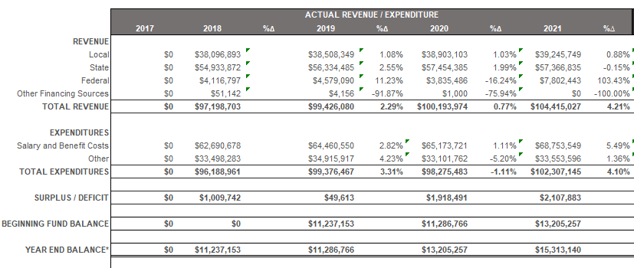
School Year 2020-21:
Pandemic funding was authorized and received
District was remote for 4 months
Money was spent to enhance health and safety protocols
2020-21
Actuals
In 2020-21, revenues exceeded expenditures by $2.1 million

Slide 30
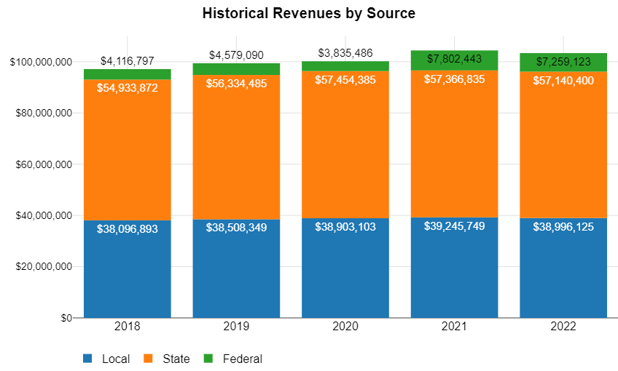
2020-21 Total Revenue: $104,415,027

Slide 31
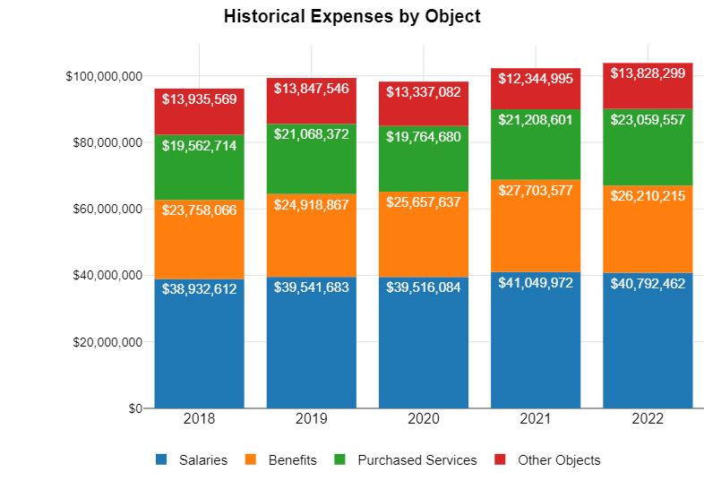
2020-21 Total Expenditures: $102,307,145

Slide 32
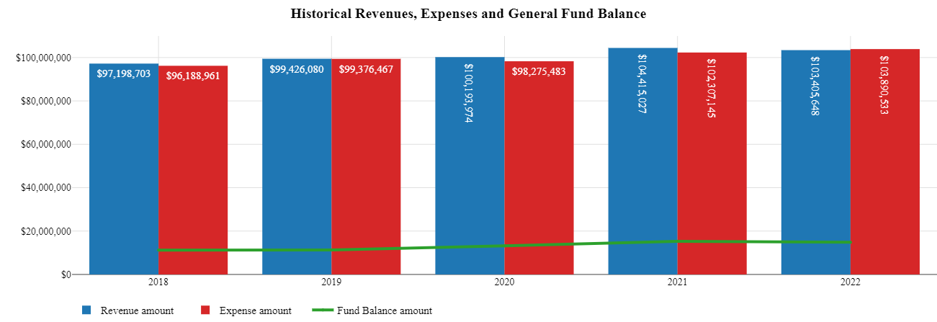
Summary of Revenues, Expenses, and Fund Balance
2020-21 Revenue & Expense
Fund Balance

Slide 33
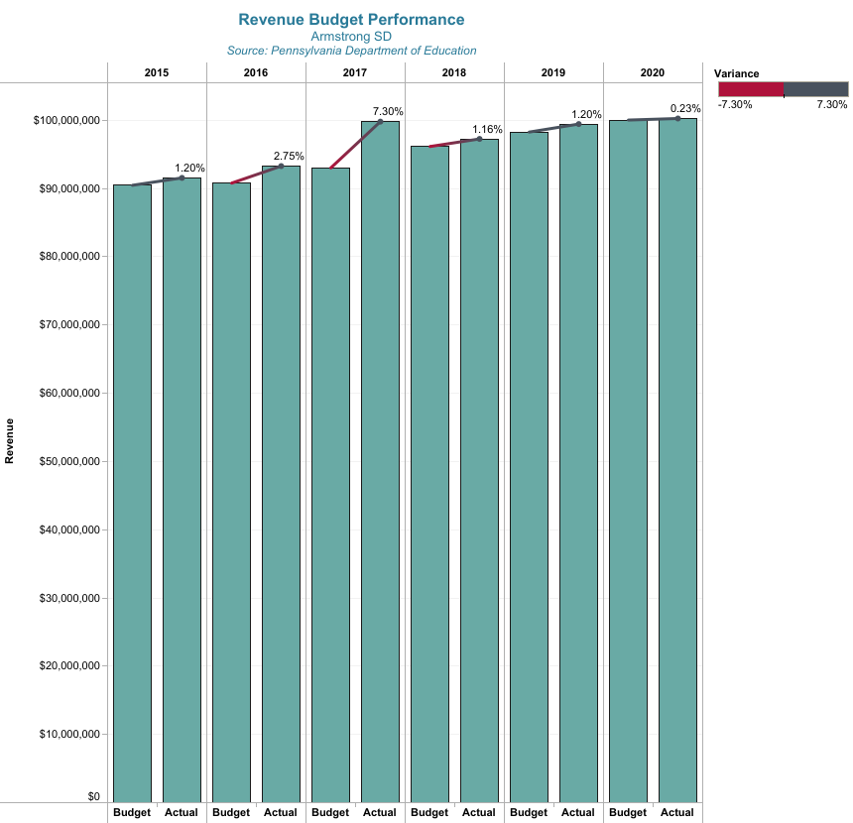
Revenue
Budget vs. Actual
2021 Revenue
 | Amount
Budget | $ 99,881,362
Actual | $ 104,415,027
Variance | 4.5%

Slide 34
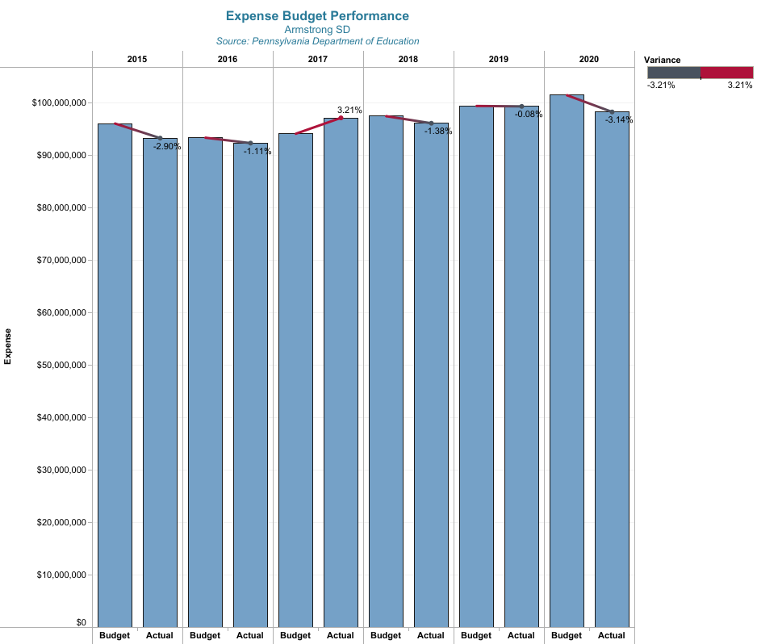
Expense
Budget vs. Actual
2021 Expense
 | Amount
Budget | $ 101,106,427
Actual | $ 102,307,145
Variance | 1.2%

Slide 35
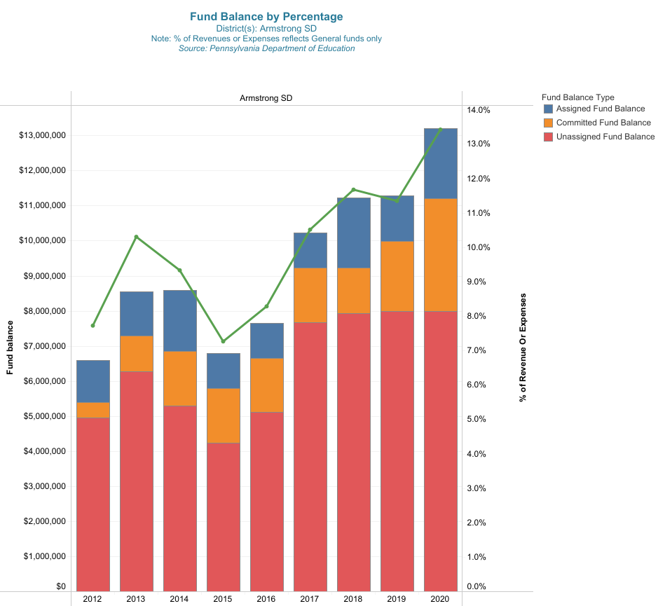
Fund Balance Type | 2012 | 2013 | 2014 | 2015 | 2016 | 2017 | 2018 | 2019 | 2020 | 2021
Assigned | $1,205,956 | $1,250,000 | $1,750,000 | $1,000,000 | $1,000,000 | $1,000,000 | $2,000,000 | $1,300,000 | $2,000,000 | 4,000,000
Committed | $423,266 | $1,025,000 | $1,550,000 | $1,550,000 | $1,550,000 | $1,550,000 | $1,300,000 | $2,000,000 | $3,205,257 | 3,313,141
Unassigned | $4,962,995 | $6,274,108 | $5,296,543 | $4,237,798 | $5,110,460 | $7,677,410 | $7,937,153 | $7,986,766 | $8,000,000 | 8,000,000
TOTAL | $6,592,217 | $8,549,108 | $8,596,543 | $6,787,798 | $7,660,460 | $10,227,410 | $11,237,153 | $11,286,766 | $13,205,257 | 15,313,141
History of Fund Balance By Type

Slide 36
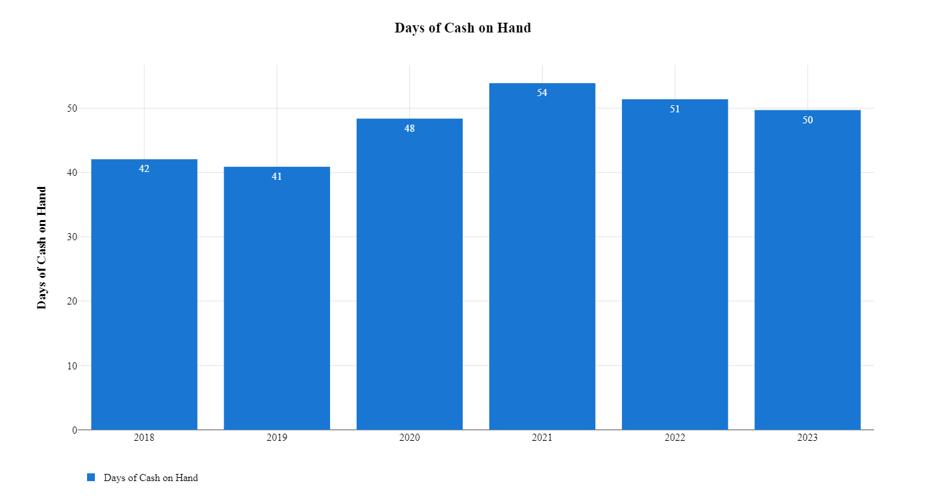
Fund Balance Shown as # of Days of Cash on Hand

Slide 37
2. Current Year – End of Year Projections (2021-22)

Slide 38
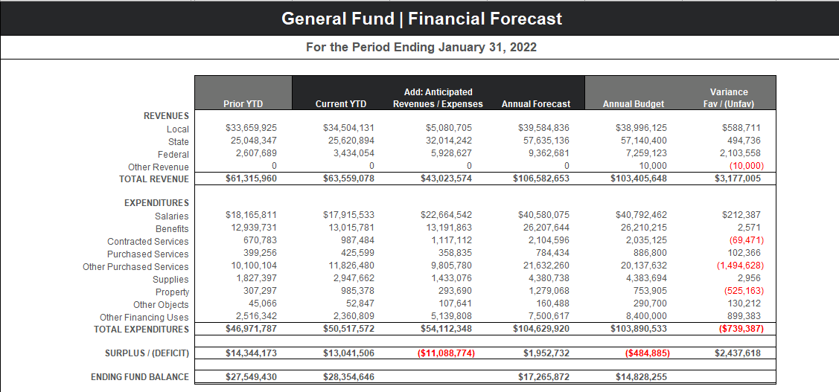
Actuals through 1-31-22 and 5 months of projected amounts based on historical trends
2021-22 end of year projection indicates revenues will exceed expenditures by $1.9 million dollars

Slide 39
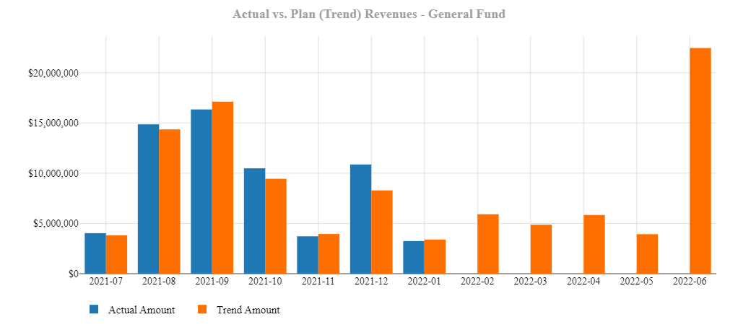
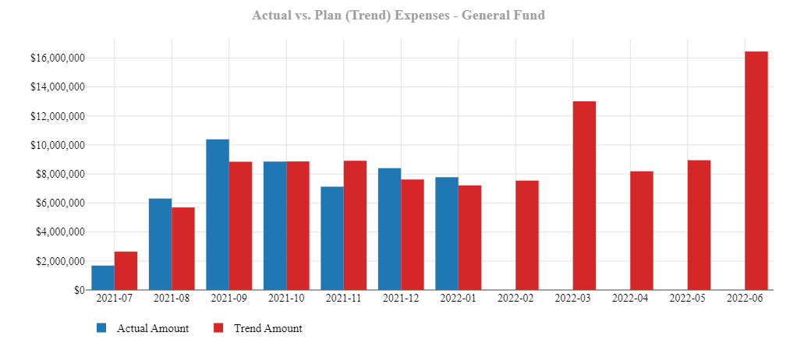
2021-22 Revenues
Actual vs. Trend
2021-22 Expenditures
Actual vs. Trend

Slide 40
3. Proposed Budget – Summary (2022-23)

Slide 41
2022-23
Budget Goals
Tax Rate Increase Below Act 1 Index Limit
Continue Educational Program Improvement in Accordance with Strategic Plan
Address Impacts of Pandemic
  Staffing shortages
  Increased health safety protocols
  Learning loss
  Increased mental health support needs

Slide 42
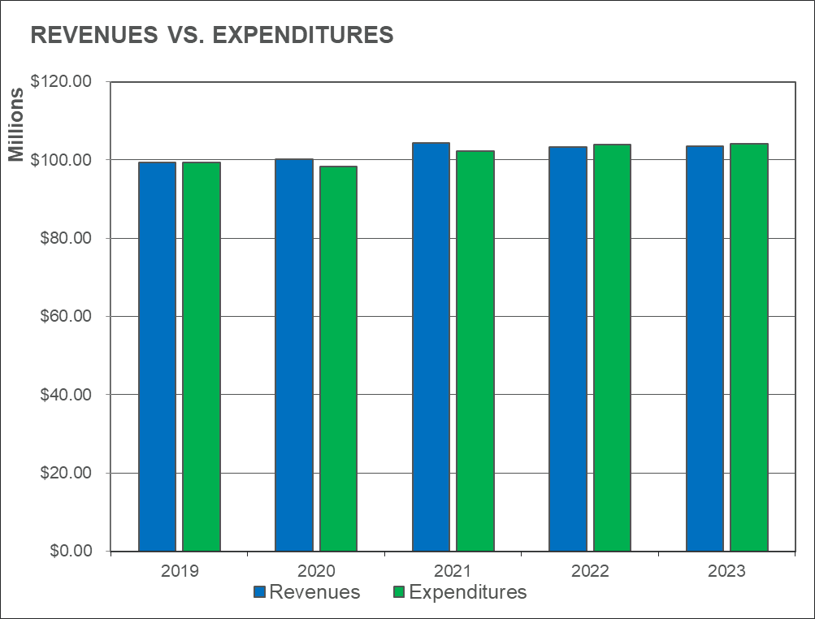
2022-23 Budget Summary
2022-23 Budget
Total Revenue & Total Expense

Slide 43
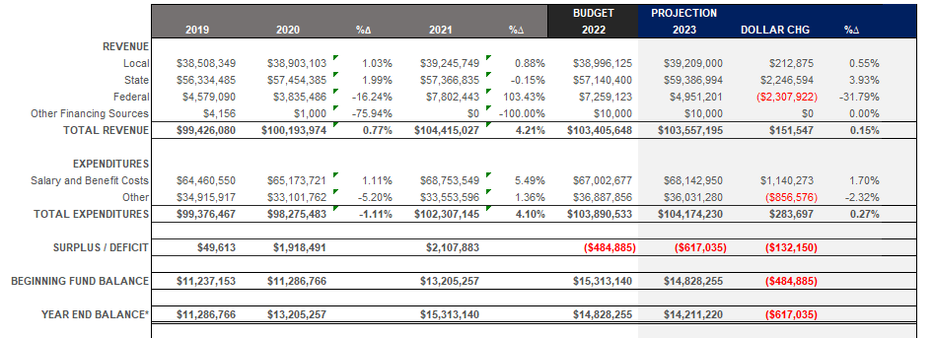
2022-23 Budget Summary
Local Sources Amount Includes a 0% increase in the Real Estate Tax Rate
(Act 1 Index Limit is 3.4 %)
Proposed Budget Balanced by Using $617,035 of Accumulated Fund Balance

Slide 44
4. Proposed Budget – Expenditures

Slide 45
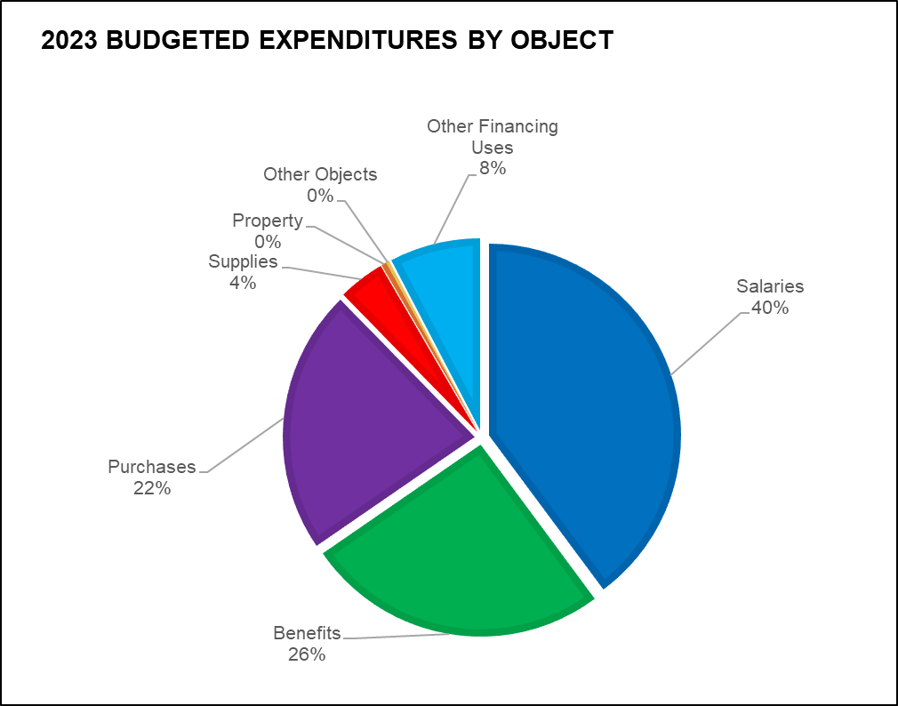
Expenses by Object Code as a % of Total Budget
Salary and Employee Benefits Represent 66% of the Total Expenditure Budget

Slide 46
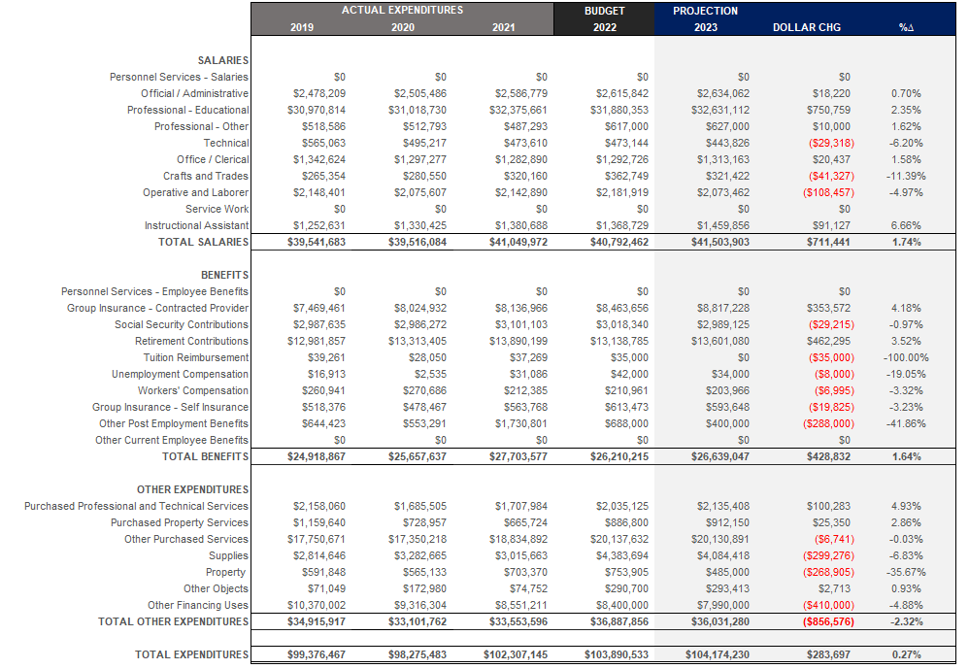
Budget to Budget Comparison by Object Code
$ Change and % Change

Slide 47
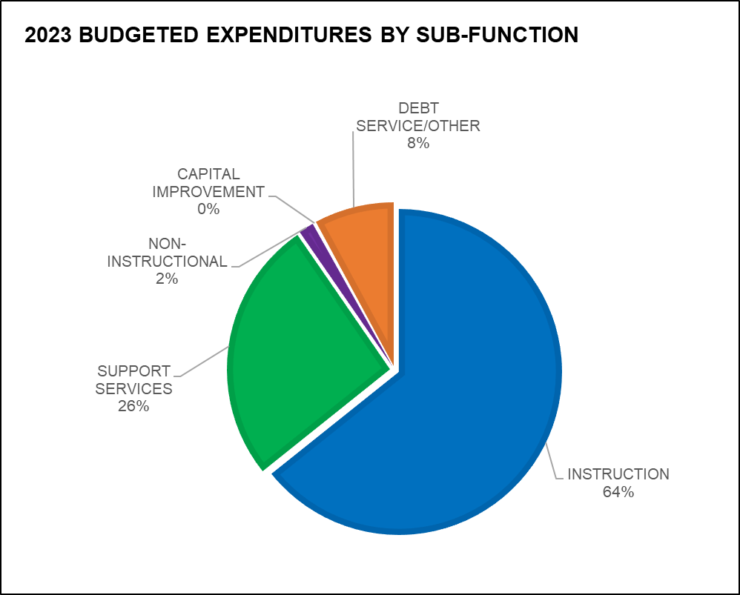
Expenses by Function Code as a % of Total Budget
Direct Instructional Programs and Services Supporting Those Programs Represent 90% of the Total Expenditure Budget

Slide 48
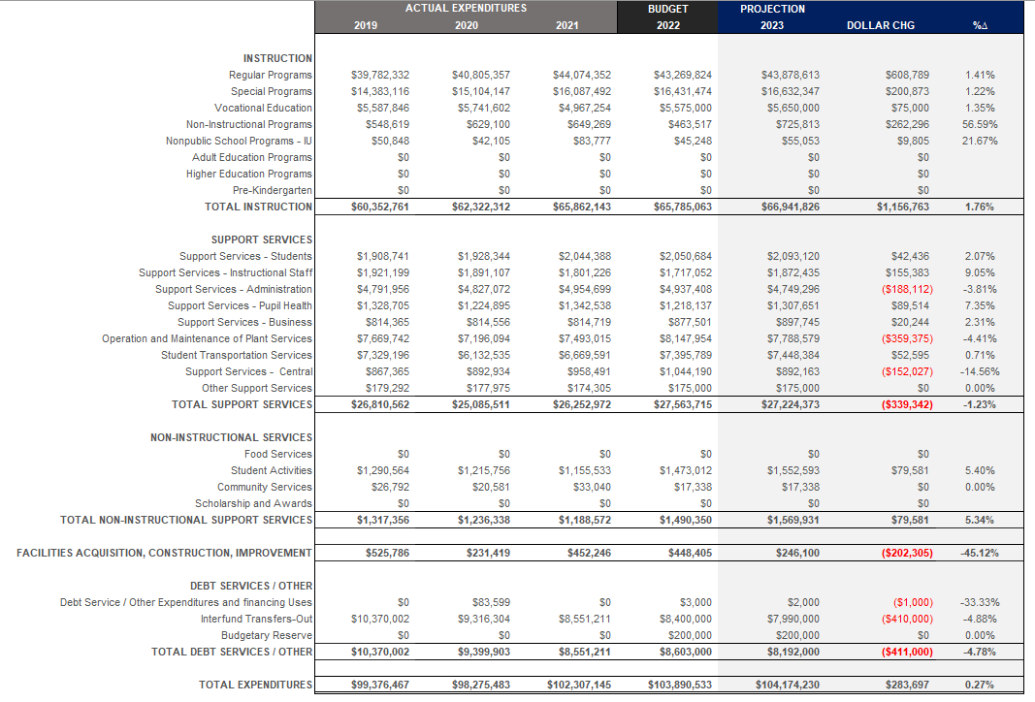
Budget to Budget Comparison by Function Code
$ Change and % Change

Slide 49
2022-23
Budgeted Expenditures Impacted By:
Enrollment Projections
Changing Demographics
Staffing & Compensation Changes
Major Cost Drivers – charter school tuition, special education costs, support services for English Language Learner programs and mental health initiatives
Strategic Initiatives as Listed in District Strategic Plan

Slide 50
Enrollment and District Demographics

Slide 51
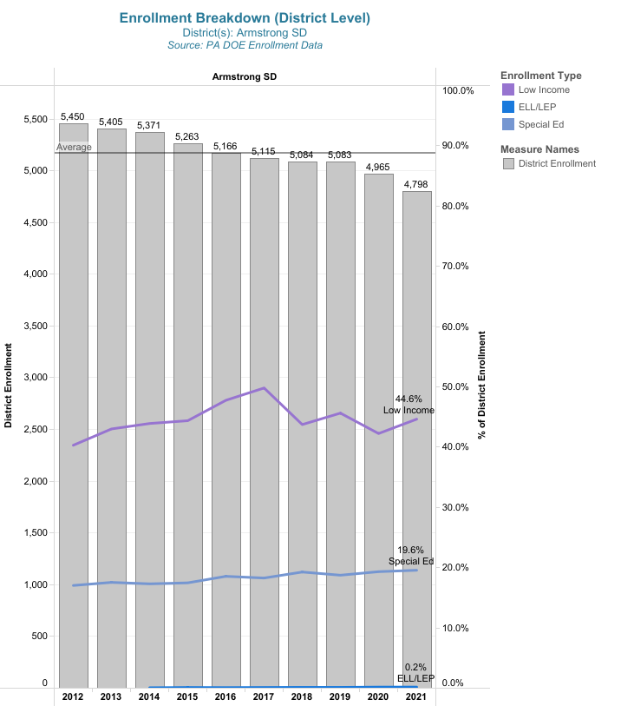
Total Enrollment
10-year History
Low Income: 40% to 45%
Spec Ed: 17% to 20%
ELL: .1% to .2%

Slide 52
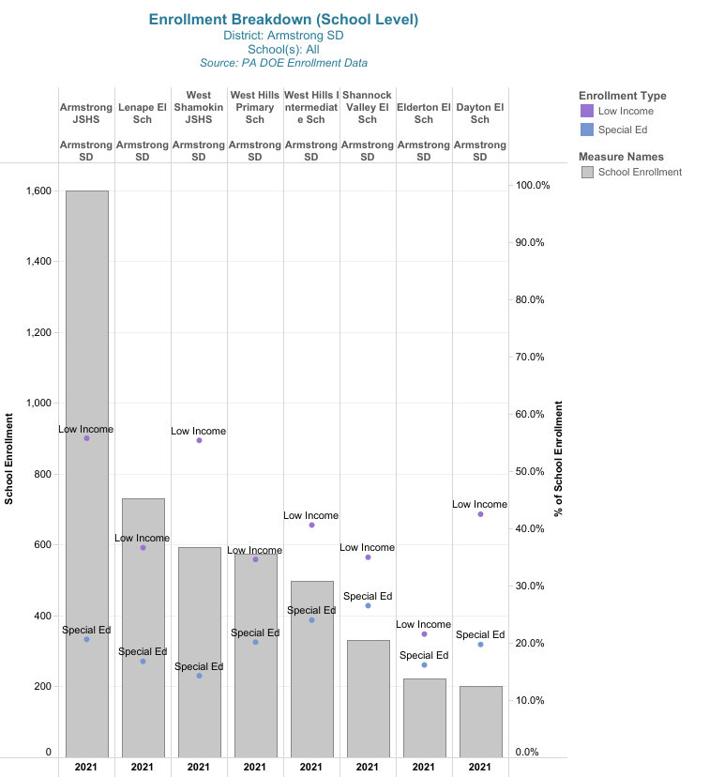
Enrollment Breakdown
by School Building

Slide 53
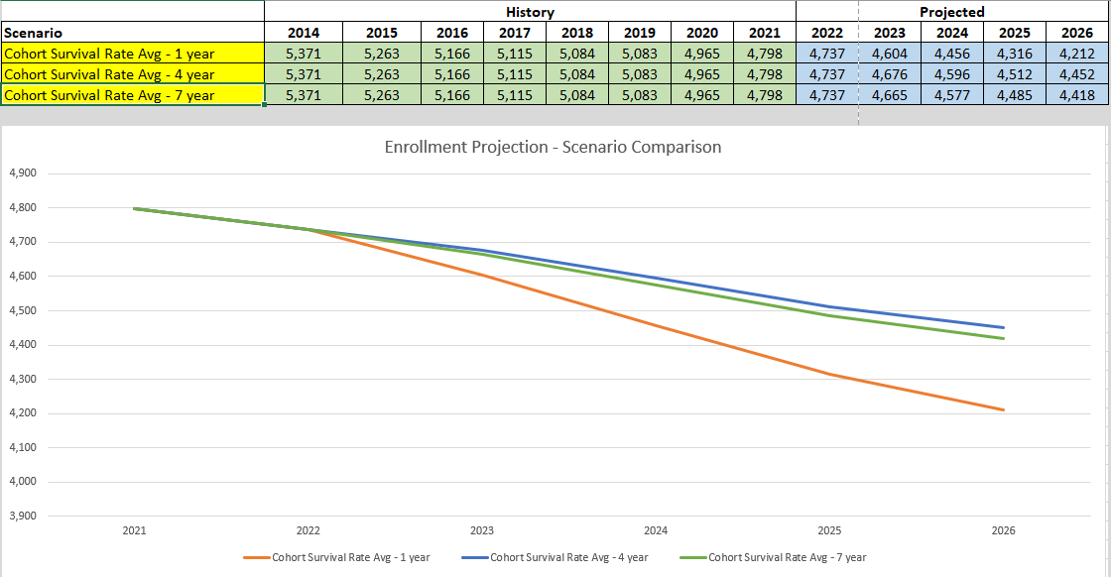
For purposes of financial projections/budgeting – 7-year cohort survival rate average is being used

Slide 54
Addressing Staffing Concerns

Slide 55
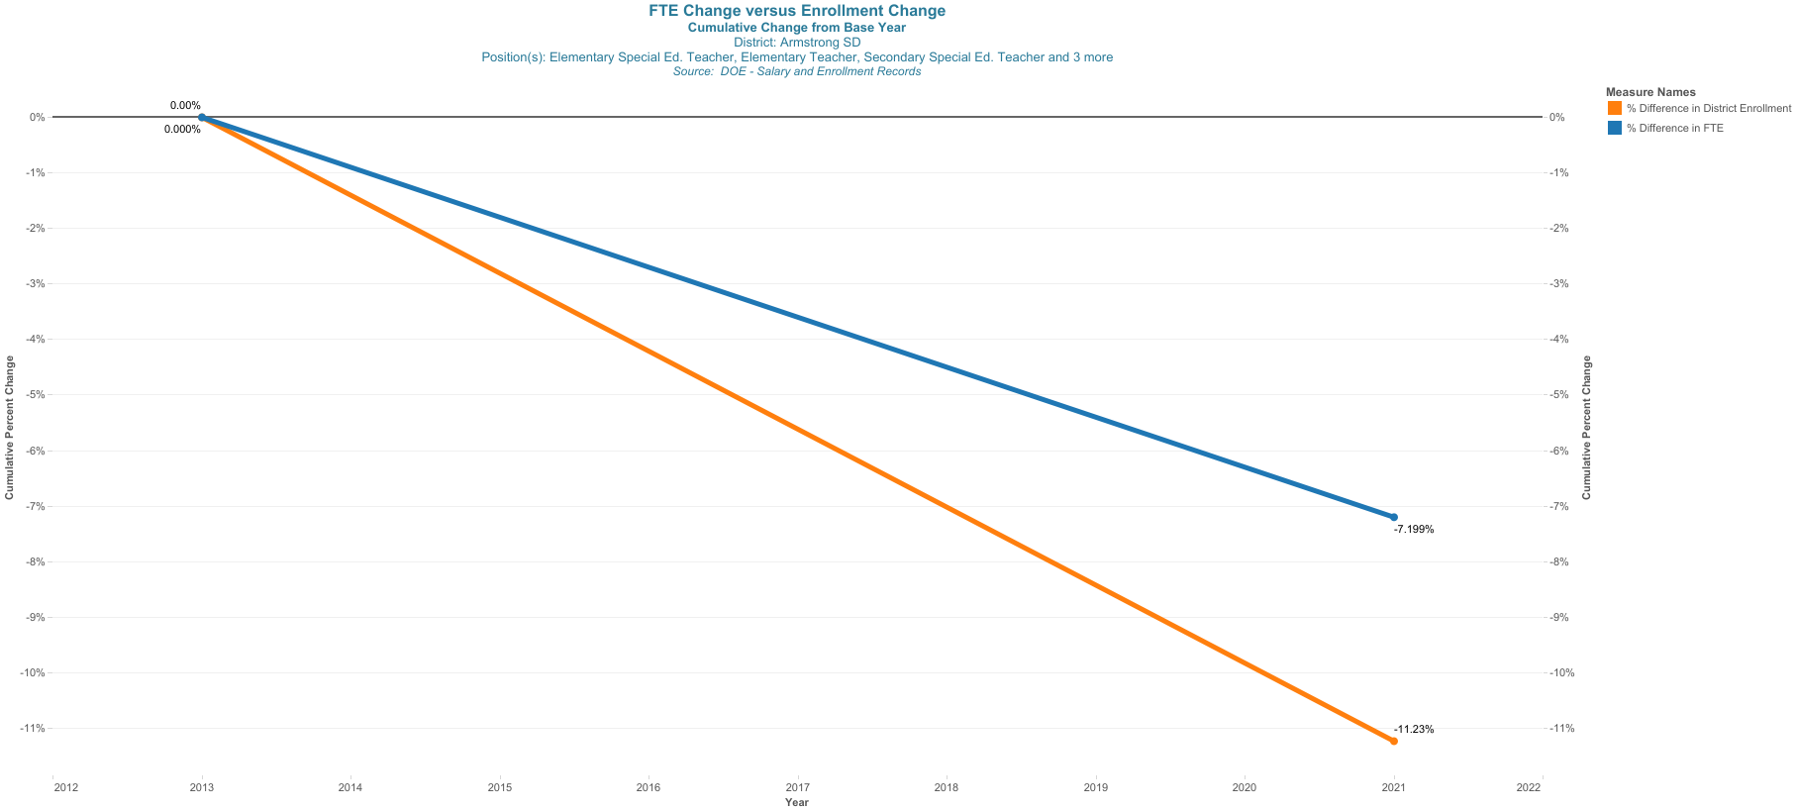
% Change in Enrollment vs. FTE (Professional Staff)
2013 - 2021

Slide 56
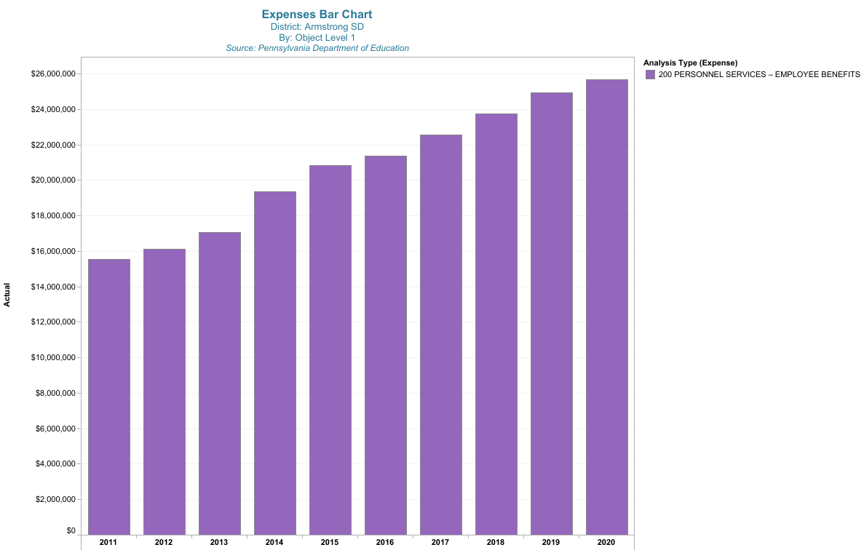
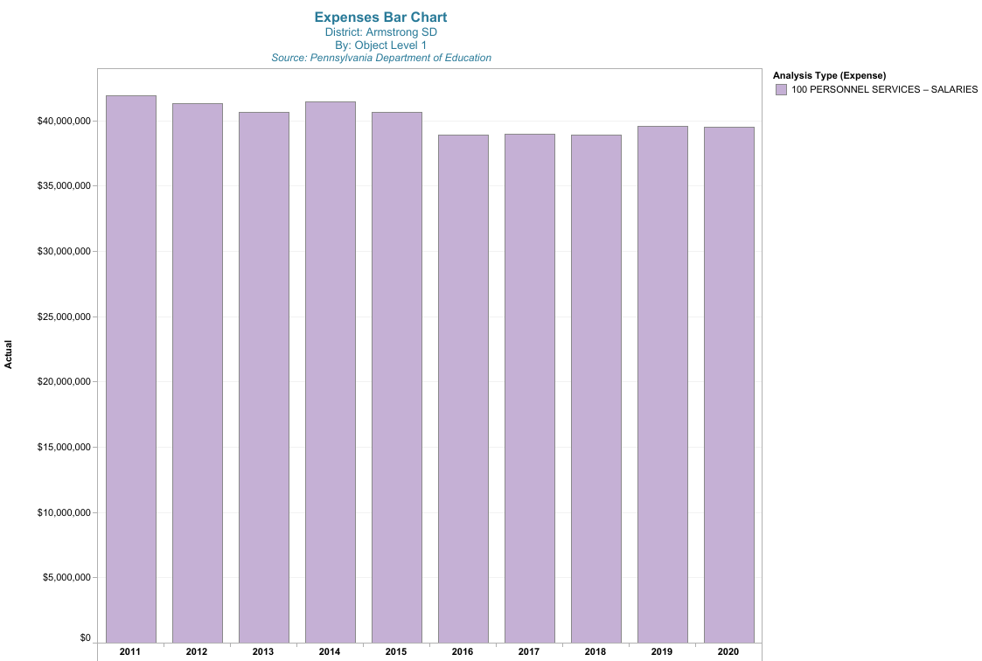
We continue to invest in a salary and benefit package that will attract and retain staff
Total Cost: $65.2 million
Approximately 67% of Expenditures
Employee Benefits
$25.7 million
Employee Salaries
$39.5 million

Slide 57
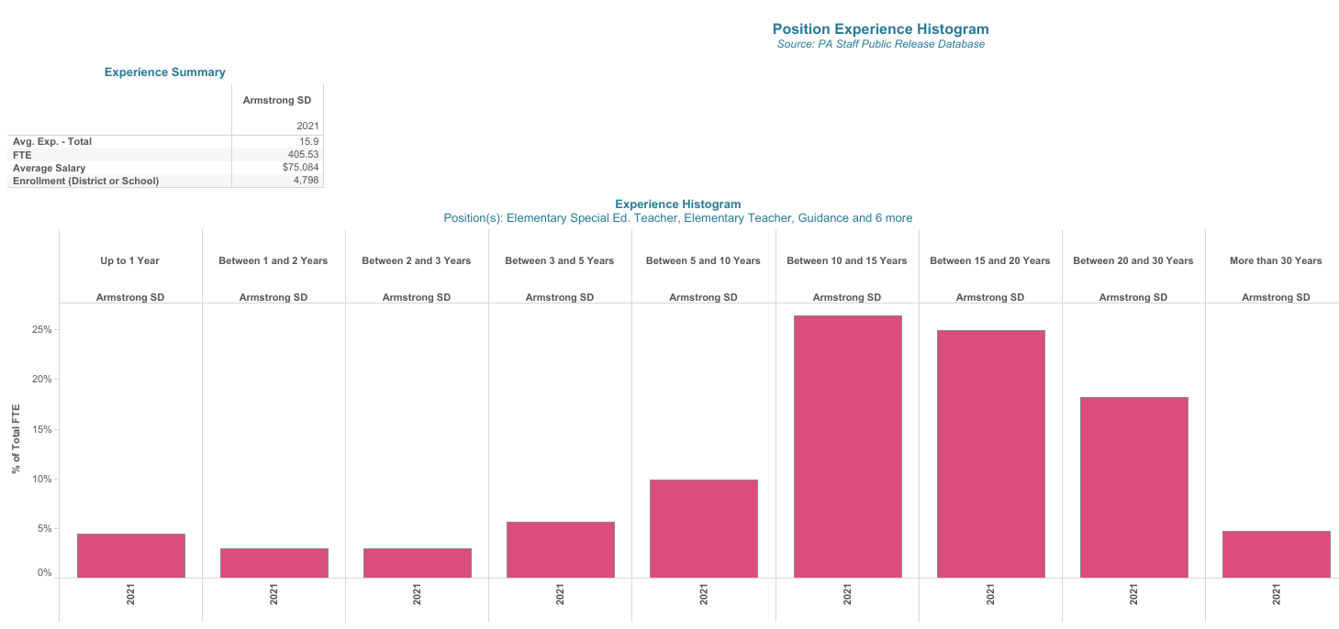
Over 77% of staff have less than 20 years experience

Slide 58
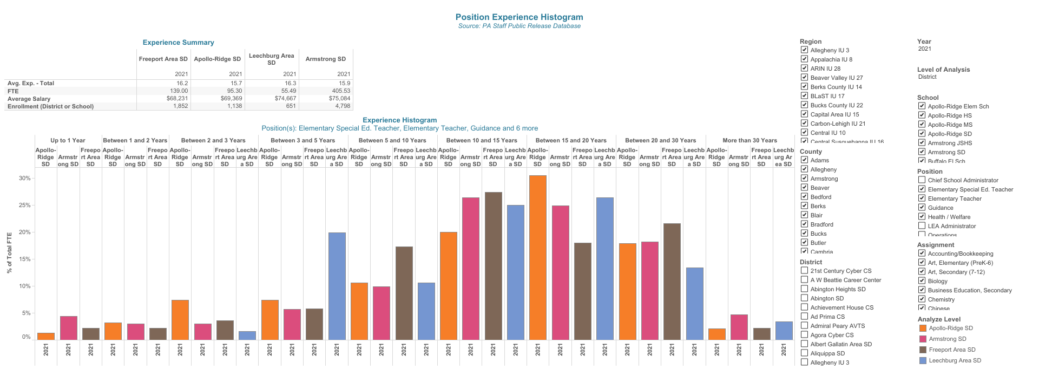
Professional Staff
Average Exp: 15.9 years
Average Salary: $75,084

Slide 59
Major Cost Drivers

Slide 60
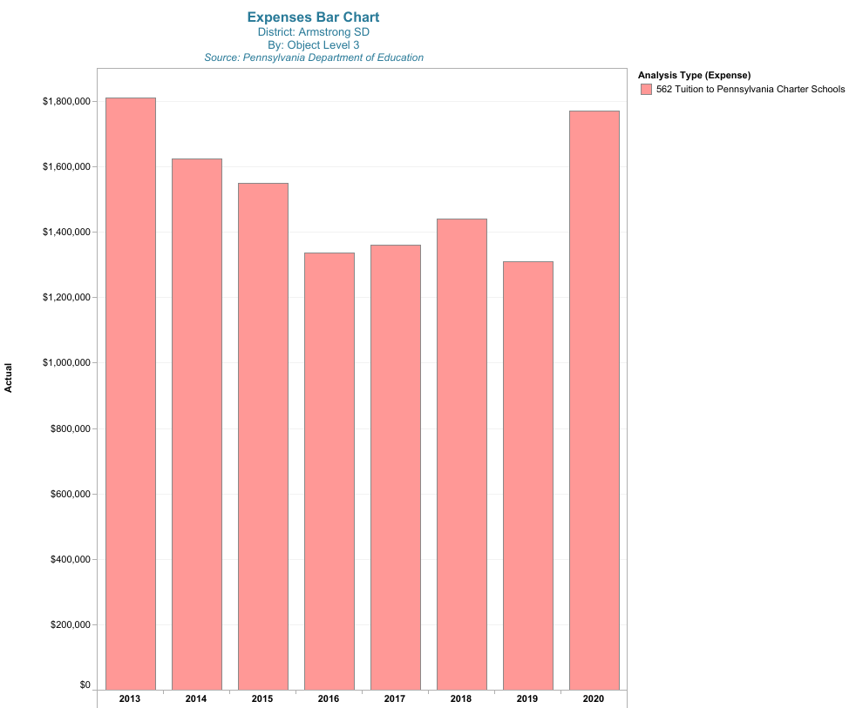
Total Charter School Tuition Costs
2021: $3,418,842

Slide 61
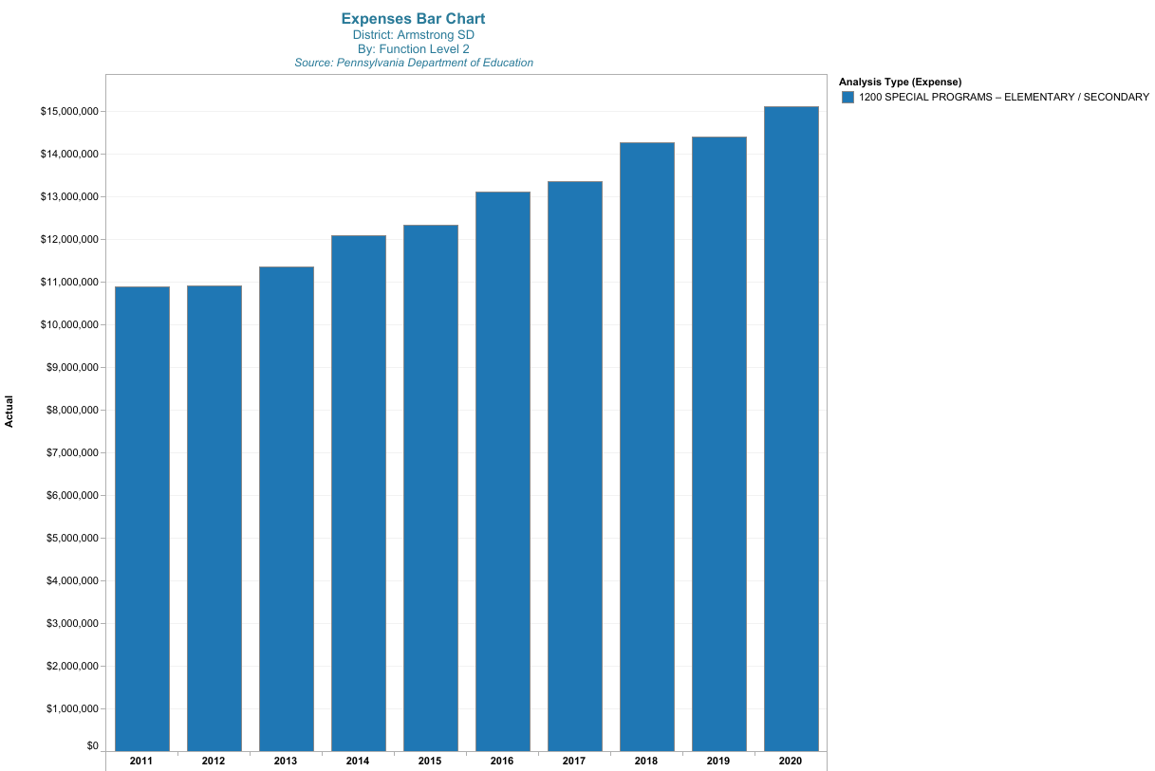
Our Special Ed Spending Over Time
Spec Ed (Function 1200)
From $10.9 million in 2011 to $16.1 million in 2021
(47.7% increase)
Notes:
A factor of students with greater needs? More supports required? A change is special ed laws and regulations over the 11-year period?
How does this compare to the increase in non- spec ed expenses over the same period?
What has the change been in per spec ed pupil spending over the same time period?

Slide 62
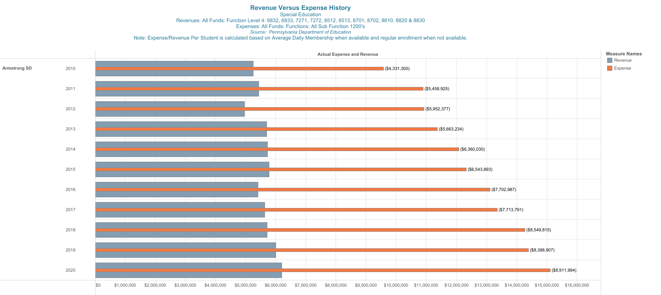
Net Cost of Special Education
2010: $4,331,300
2020: $8,911,994
Increase of 106%

Slide 63
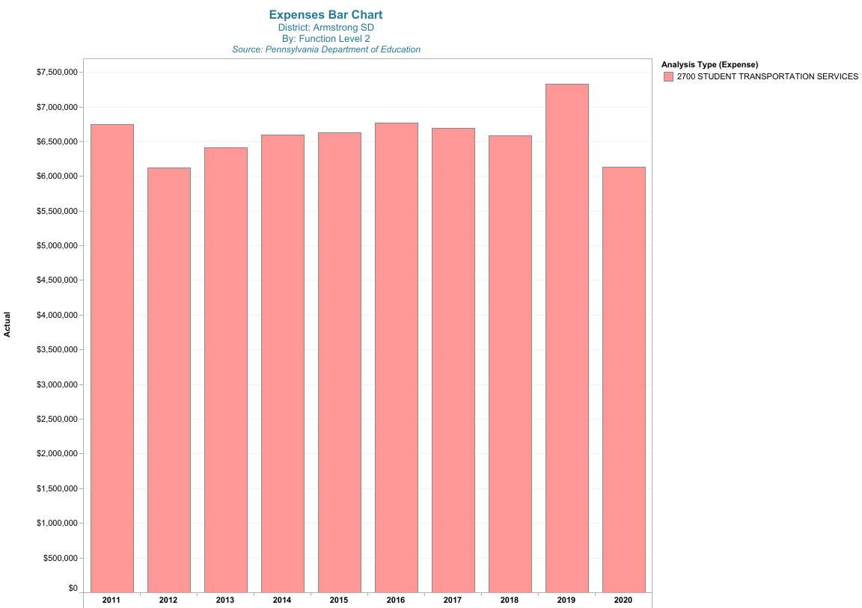
Cost of Student Transportation
$6.7 million in 2011
$6.7 million in 2021

Slide 64
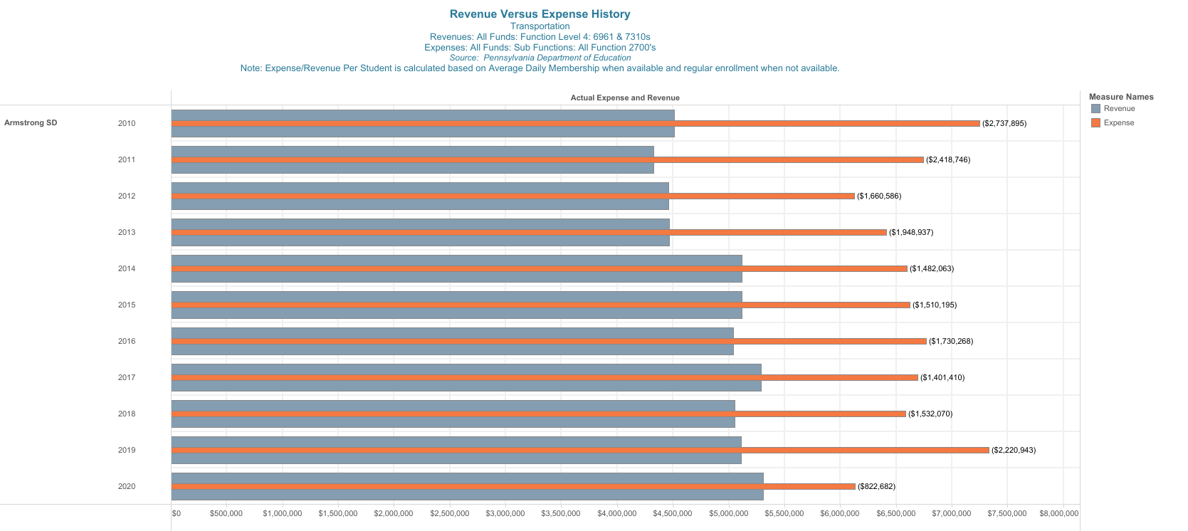
Net Cost of Student Transportation
2010: $2,737,895
2020: $ 822,682

Slide 65
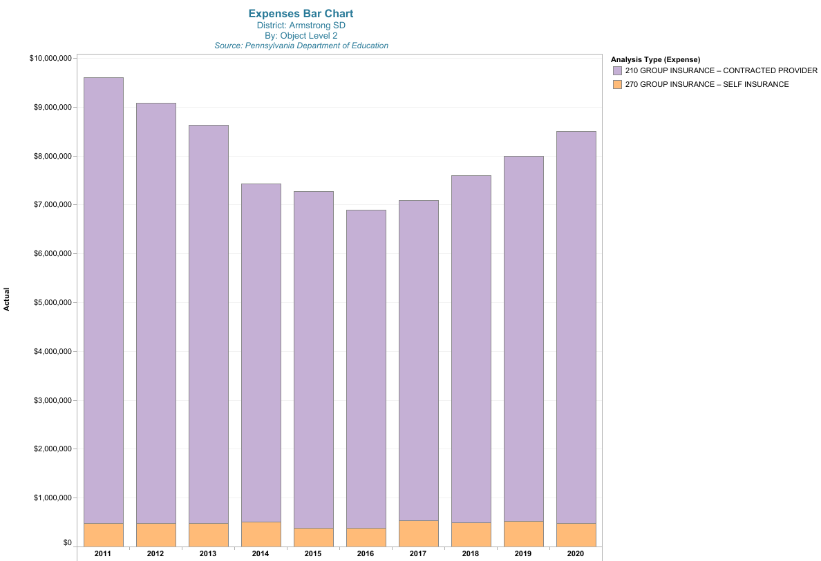
Total Cost of Group Insurance
2010: $9.6 million
2021: $8.7 million

Slide 66
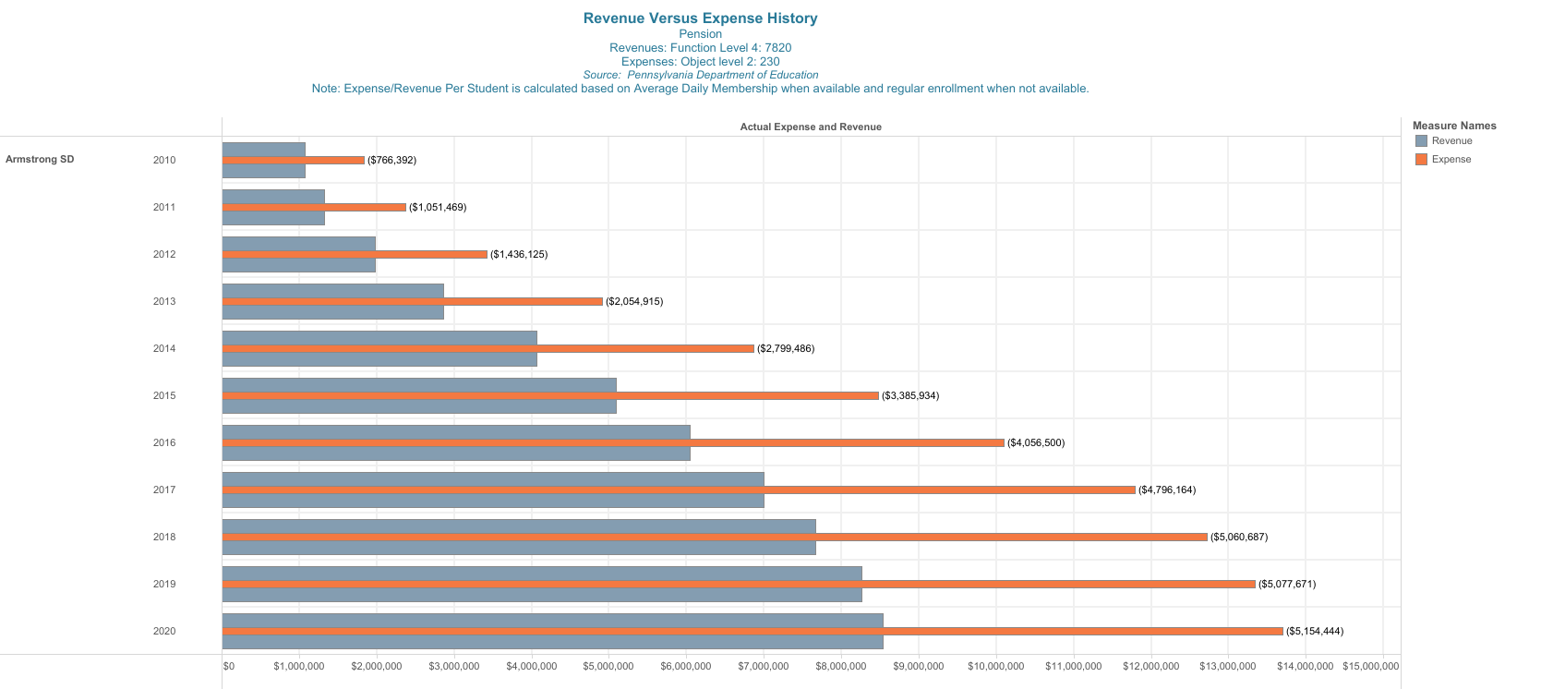
Net Cost of Pension:
2010: $766,392
2020: $5,154,444
Increase of 573%

Slide 67
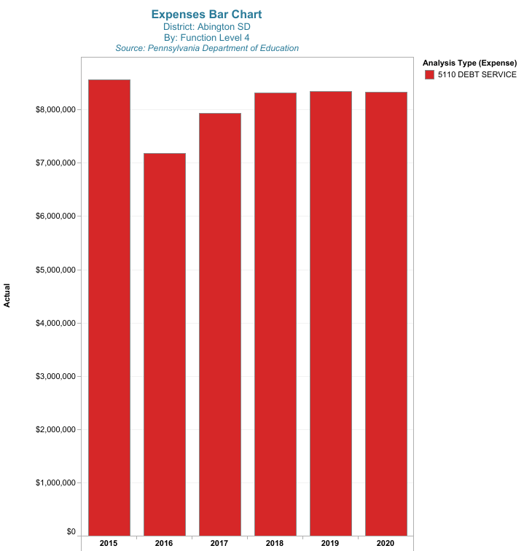
Current Annual Debt Service Payments
$8.3 million

Slide 68
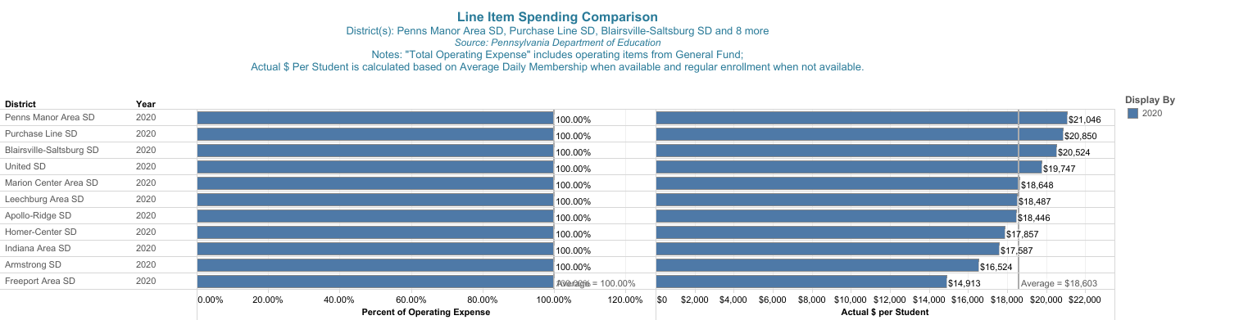
Operating Expenditures Per Student
How are we doing when compared with our peers?

Slide 69
5. Proposed Budget - Revenues

Slide 70
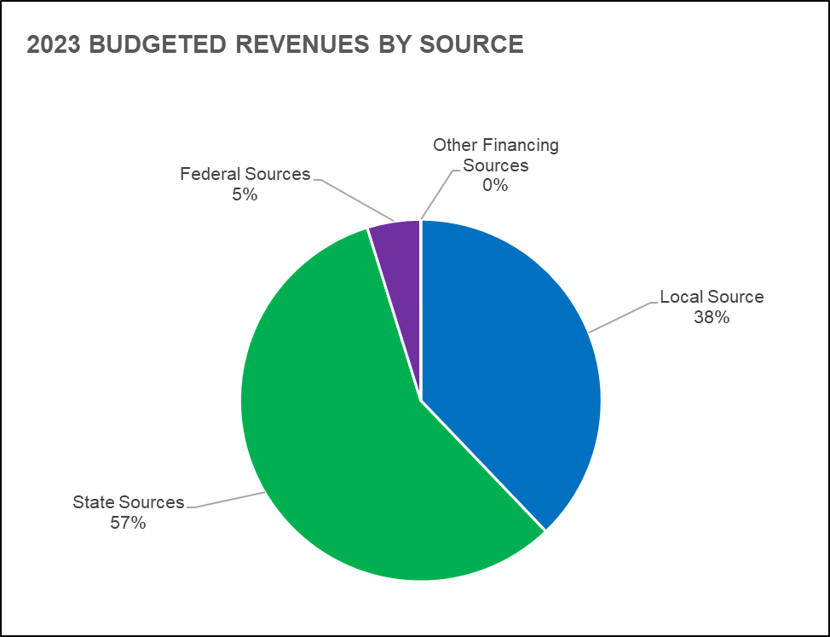
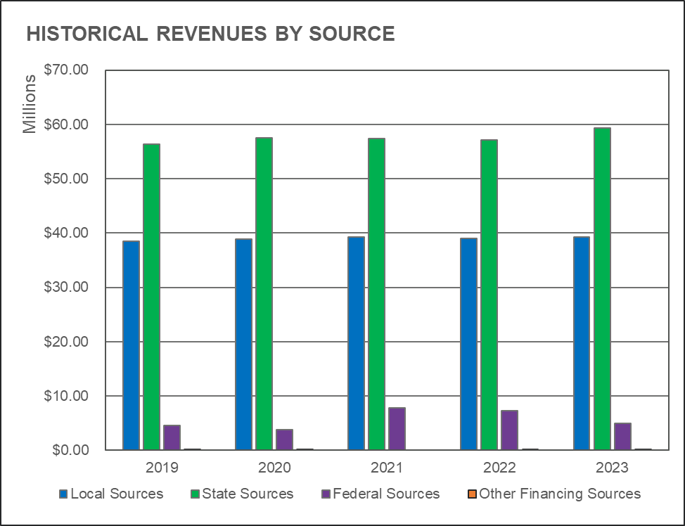
2022-23 Budgeted Revenue by Major Source
Local Sources Represent 38% of Total Revenue Sources

Slide 71
Budget to Budget Comparison
Sources of Revenue

Slide 72
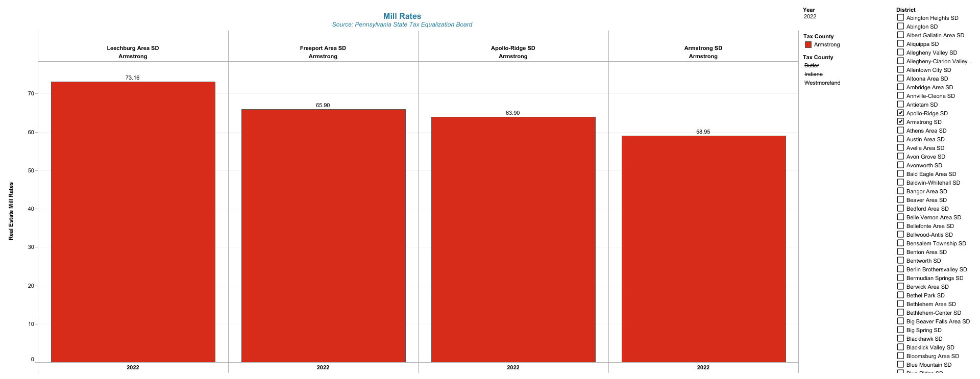
Millage Rate Comparison
How are we doing when compared to our regional peers in Armstrong County?

Slide 73
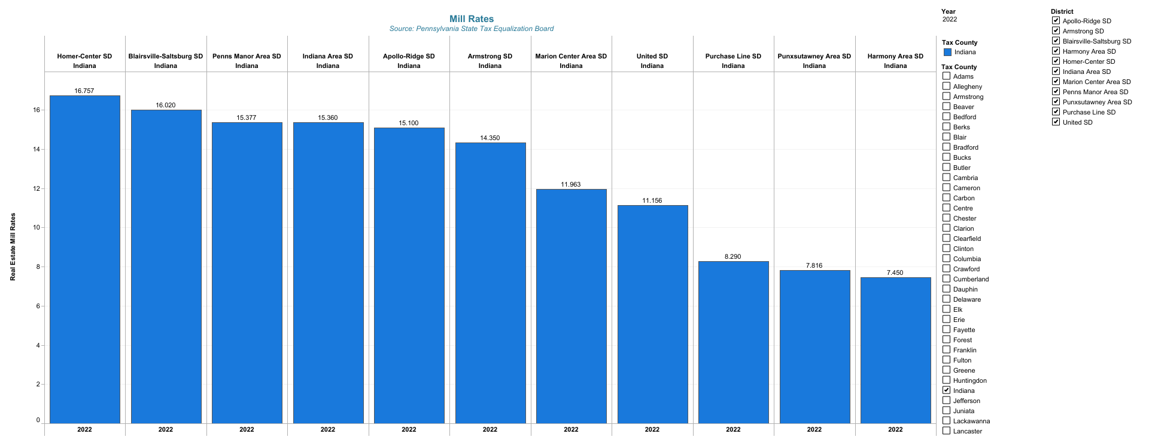
Millage Rate Comparison
How are we doing when compared to our regional peers in Indiana County?

Slide 74
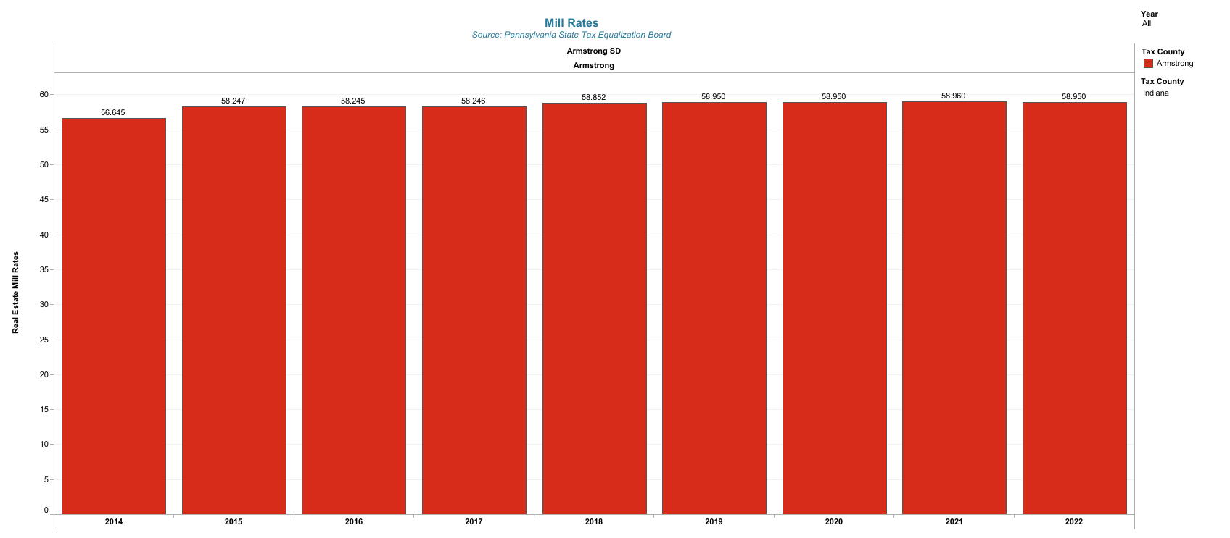
Armstrong School District
Millage Rate History – Armstrong County

Slide 75
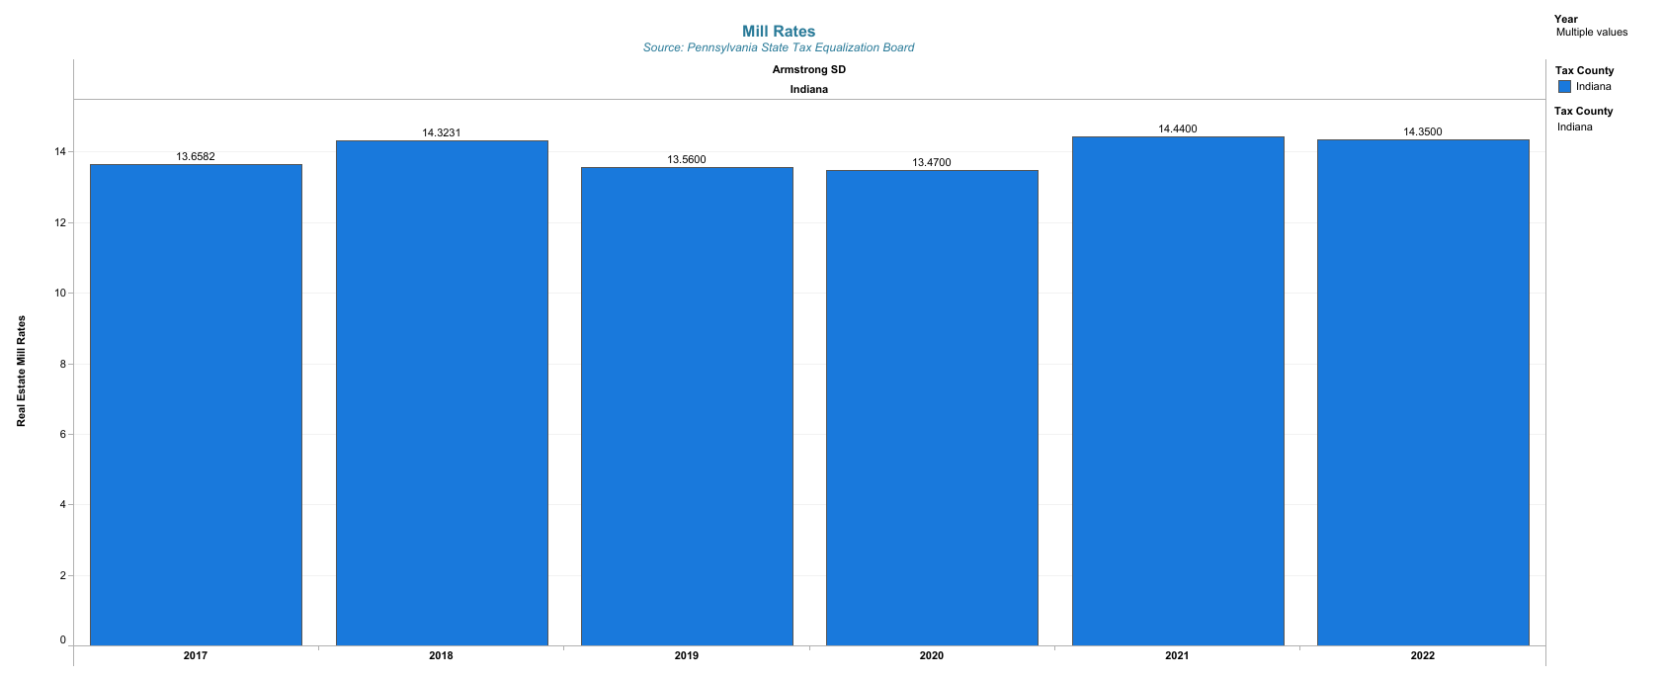
Armstrong School District
Millage Rate History – Indiana County

Slide 76
2022-23
Budgeted Revenues Impacted By:
Pandemic Relief Funding
State Funding Unknowns
Impact of Inflation Rate
Housing Market/Rising Interest Costs

Slide 77
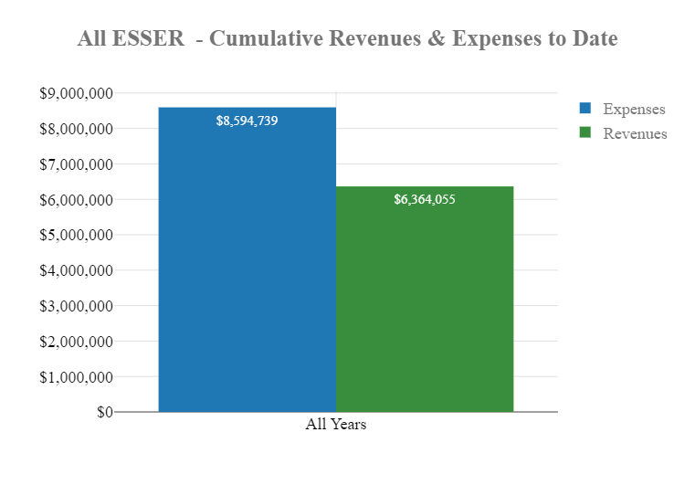
Total ESSER Funding Received and Spent

Slide 78
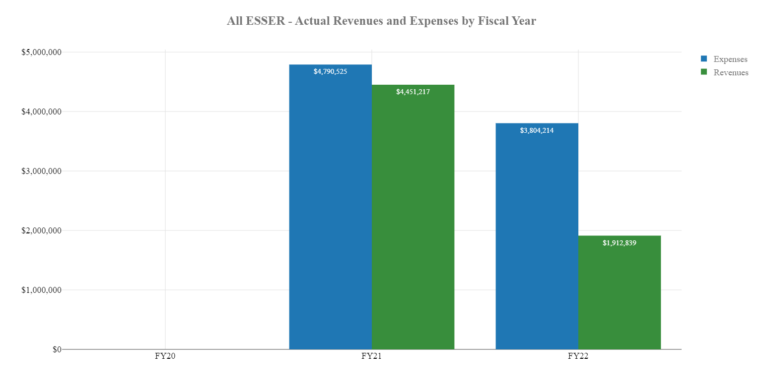
ESSER Funding Recap – Actual Revenue and Expense by Year

Slide 79

State Funding by Revenue Type
State Sources - excluding state reimbursement for social security and retirement

Slide 80

State Subsidy Per Pupil
$4,042 in 2011 and 27% of General Operating Expense
$6,056 in 2020 and 32% of General Operating Expense

Slide 81
6. Five-Year Financial Projections

Slide 82
Five Year Plan Assumptions
Real Estate Tax Rate Increase at 0% per year
Minimal Increases in Assessment Growth and State Subsidies
Pandemic Relief Funding Ends in 2024
No Strategic Initiatives Included
Salaries Projected Using Average of 4 years of Historical Data
Two Percent Increase in Employer Paid Benefit Costs (based on historical data)

Slide 83


5-Year Financial Projection
Total Expenditures by Object Code
5-Year Financial Projection
Total Revenues by Major Source

Slide 84
5-Year Financial Projection Based on Assumptions Outlined on Previous Slide
Note the Increasing Gap Between Revenues and Expenditures

Slide 85

5-Year Financial Projection
Total Expenditures, Revenues, and Fund Balance

Slide 86
7. Next Steps

Slide 87
Next Steps
Continue to Monitor State and Federal Funding Developments
Continue to Monitor Current Year End Projection
Review Staffing Projections
Continue to Monitor Enrollment Changes
Present Budget For Final Approval June 6, 2022

Slide 88
Contact Us
webinars@frontlineed.com
Visit Us
https://www.frontlineeducation.com/
Sam Kirk, Director of Finance and Operations for Armstrong School District (PA)
skirk@asd.k12.pa.us
Stan Wisler, Strategic Account Advisor for Frontline Education
swisler@frontlineed.com

