Slide 1

Financial Planning in uncertain times
February 15, 2022

Slide 3


Clint McLain
Assistant Superintendent of Finance and Operations
New Braunfels ISD
Travis Zander, CPA
Senior Analytics Advisor, Team Lead
Frontline Education

Slide 4
01
Multi- Year Plan
Baseline Forecast
Review Staffing
Review Enrollment
Establishing a Budget Calendar
02
03
04
05

Slide 5
MULTI-YEAR PROJECTION PLAN
CIRCLE GRAPICS, FIRST AND THIRD ARE MEANT TO BE CUT OFF
HISTORICAL
BUDGETARY
DIRECTIONAL
5 years of historical actuals highlight performance, trends and assist with future assumptions.
Revenue/Expenditure variables known. The current year and years 1-2 will be more accurate in terms of projected ending cash balances.
Assumption results compound into year 3. Unfavorable conditions may signal an early warning and opportunity to execute a course correction plan. Years 4-5 establish direction - overall financial trajectory.
Notes:
Research what has happened in the District? Are you new to your role?
Have you Historically Over budgeted in certain area’s and under in others?
We all know ESSER is coming to an end.
Clint: Do you have a plan?

Slide 6
Multi-Year Analysis
Trend Analysis
Projection
“What if” Scenarios
Link Strategies
Link the analysis performed with shot-term and long-term analysis
Historical Actuals/ Budgets
Educated Estimates;
Decision Band Approach;
Financial Gap Analyis
Budget Adjustments/ W/ YTD Actuals + Projections
Notes:
Clint: Was your board used to getting a multi-year Plan?

Slide 7
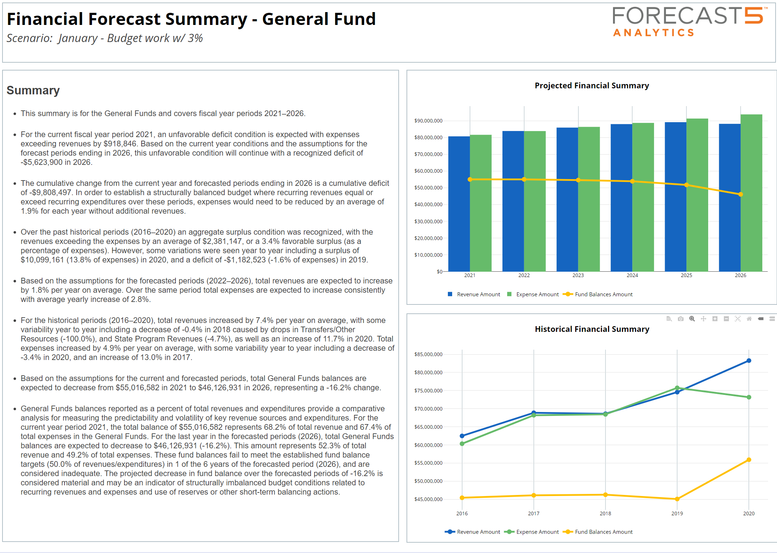
Baseline Forecast
Include data points here that focus on highlighting the direction the district anticipates their financials shifting in its current situation.
Acknowledge how these variables impact the district’s financial future as well as the impact of other non-salary & benefit line items.
Report may include:
3-5 year forecast
Any projected change to revenues or
non-salary & benefit line items
Fund balance expectations
Notes:
What are some keys to getting started in building your plan?
Stay out of the weeds!
Focus on Trends
We all have vacancies, how do those play into your plan

Slide 8
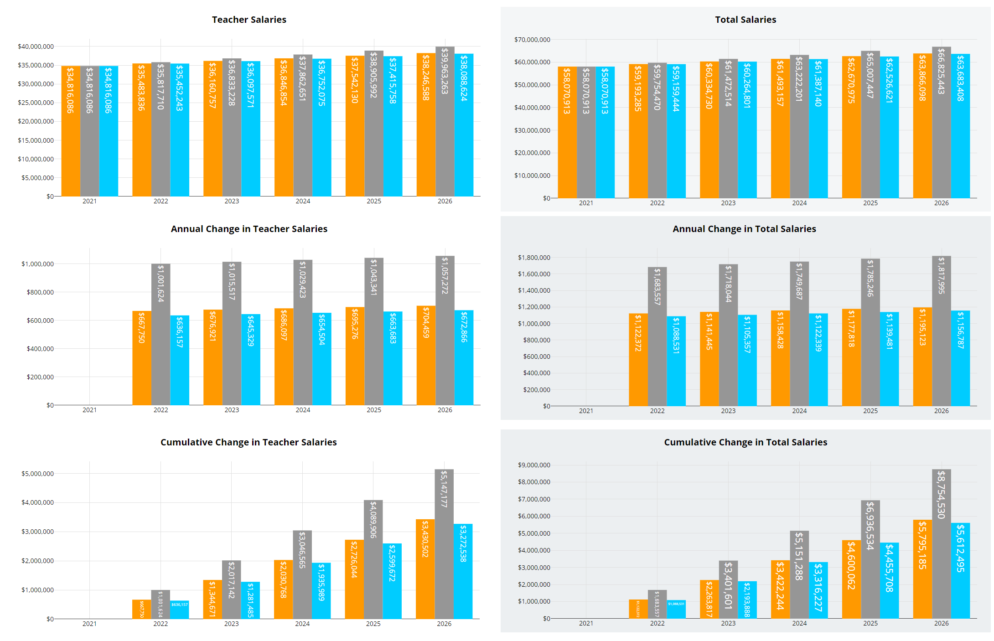

Impact of Salary & Benefit Costs
Include data points here that focus on telling your current story. Make sure stakeholders understand the salary & benefit cost drivers.
Demonstrate how these variables impact the current forecasted future prior to any contract changes.
Report may include:
Total Teacher Salaries
Full Insurance Medical
Salaries & Benefits by Major Areas
Package Contributions
Notes:
75-80% of your budget lives here
Run Crazy scenarios so you can understand the impact (what if we did do that 10% raise)

Slide 9
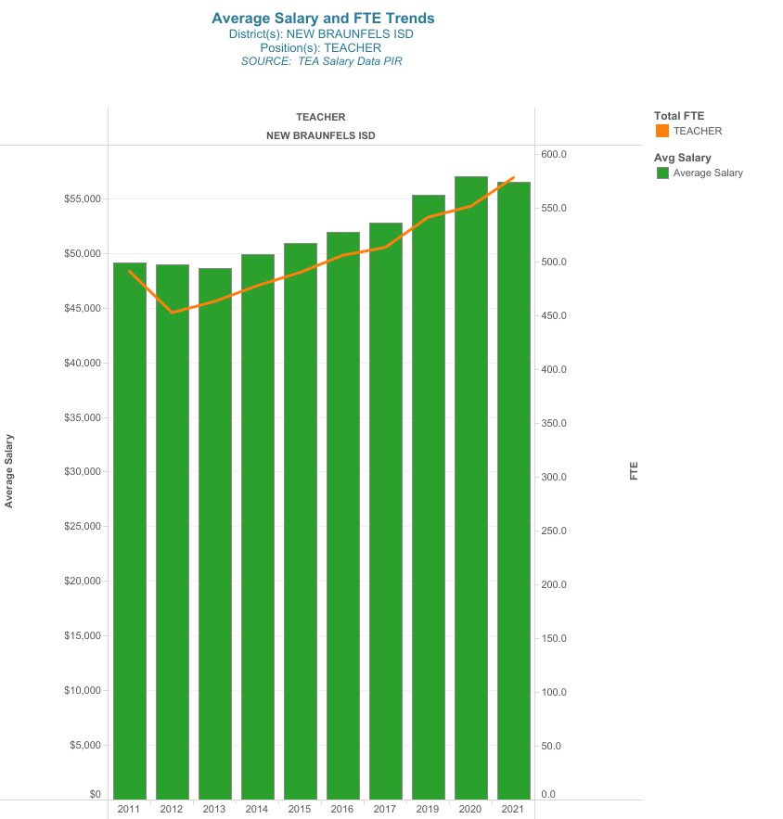
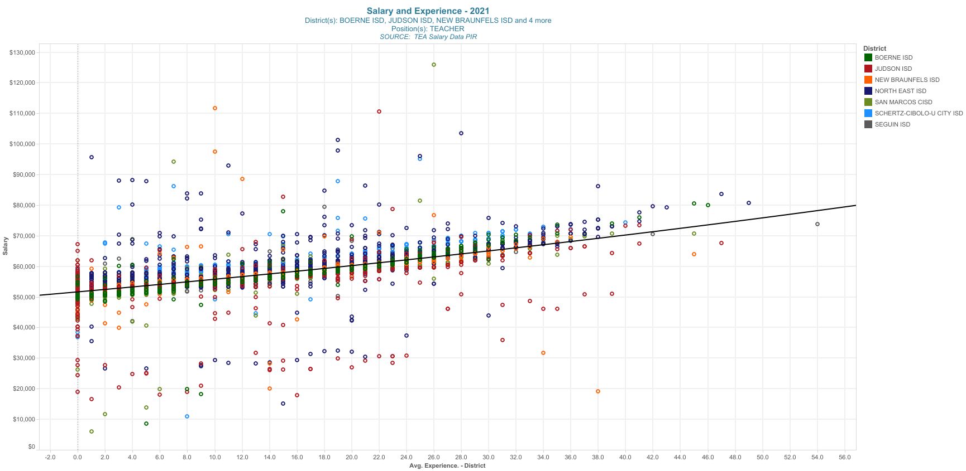
Salary & Experience
Include data points here that focus on the experience of your staff. Demonstrate how these variables impact hiring decisions, voting pools in the union, differentiated compensation levels and experience gaps.
Report may include:
Position control
Experience histograms
Peer comparison analysis
Position level analysis
Salary analysis
FTE count per activity
Trend analysis
Notes:
Each District will look different. Do you have gaps in your experience bands?
Does the district have a goal for higher (new teachers, 5 Years Experience, etc?)
More new teachers = increased teacher training costs

Slide 10
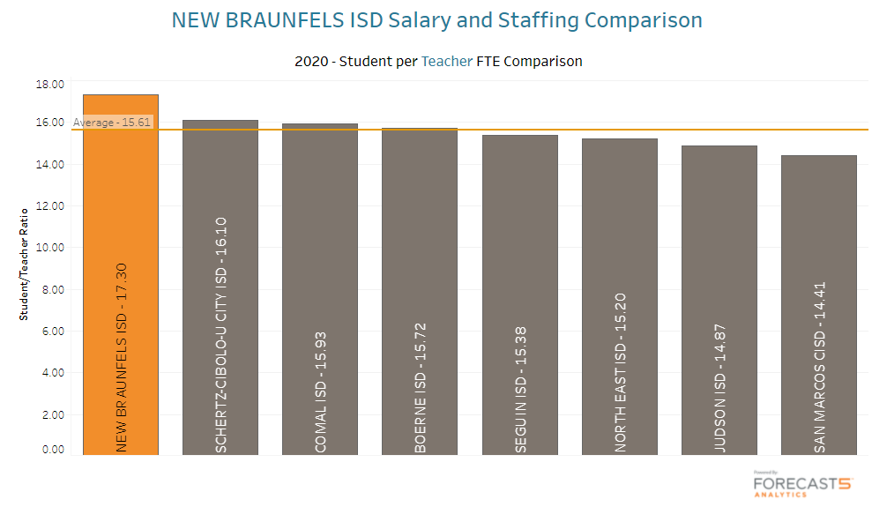
Staffing Levels
Include data points here that focus on various FTE position areas.
Demonstrate how these variables compare against staff levels and impact hiring decisions.
Report may include:
Trend data
Relationship between FTE counts & average salary
Retirement history
Low-experience & low-cost new hire history
Notes:
Staffing ratios MATTER! How many students per staff do you have? Are you competitive with neighboring Districts?
Are you willing to have a higher ratio to increase compensation?

Slide 11
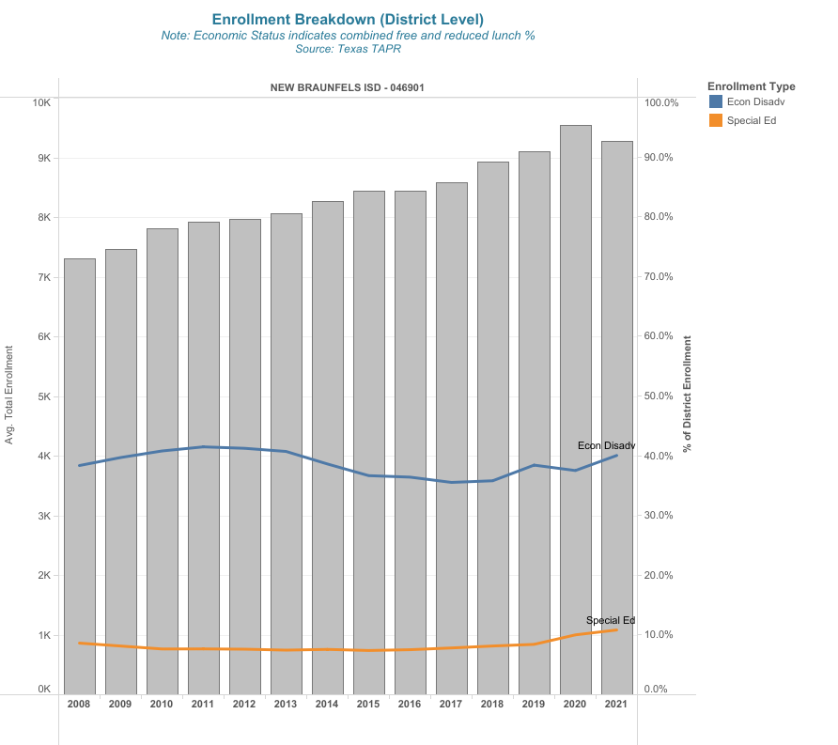
Enrollment
Include data points here that focus on enrollment trends. Demonstrate the direction of the trend, how it is affecting staffing levels, type of increase for low income students and how high cost students affect staffing needs and expenses.
Report may include:
Enrollment trends
Enrollment breakdown trends
Live birth data
Notes:
What are your enrollment trends? Have you looked at subpopulations and how that affects staffing?

Slide 12
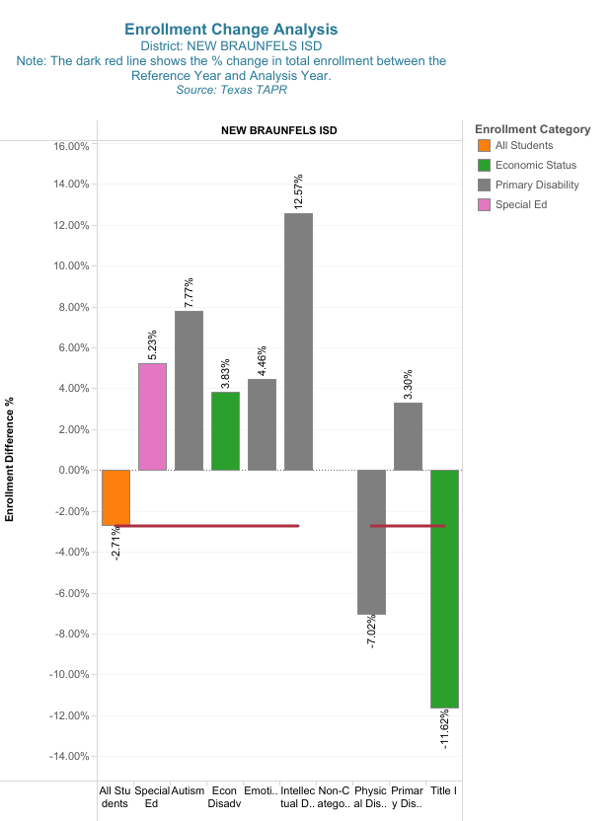
Enrollment Breakdown
Do changes to certain subgroups effect funding?
Special Education Funding
  Subgroups?
Title I Funding
  Low income
Enrollment vs Attendance based?
  Excess absences from COVID
Early Grades Declines
  Pre –K/ Kindergarten enrollments down
Notes:
Does your District receive federal funding for local groups?
Do local funding formula funding programs are effected by subpopulation change.
In Texas we’re funded by attendance, COVID has had an impact on ADA.

Slide 13
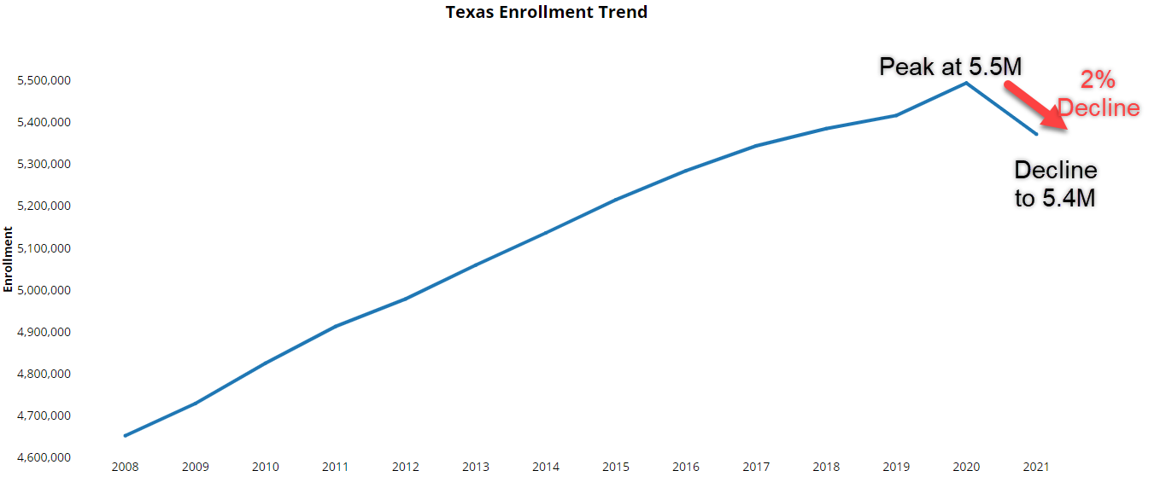
Texas Statewide Example
All Students Enrollment
Notes:
What are the Trends in your state? Across the country we saw a decline in enrollment.

Slide 14
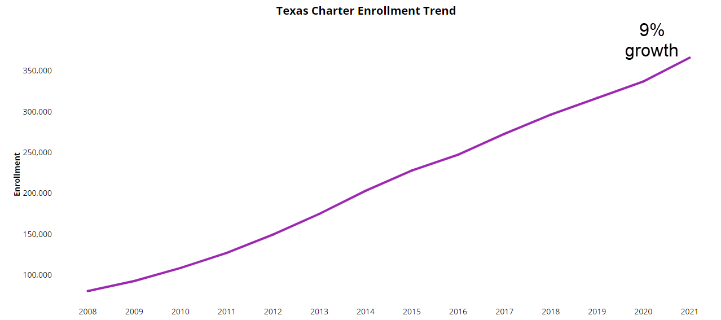
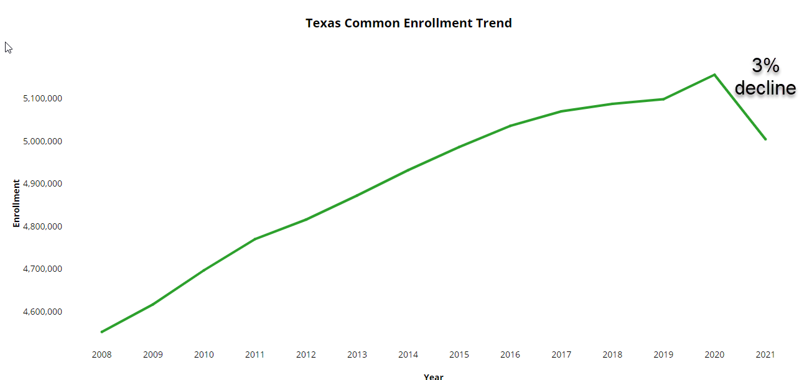
Common Vs Charter
Charter
Common
Notes:
While Local School saw a decline, charter schools saw growth. Is parent choice expanding in your area?

Slide 15
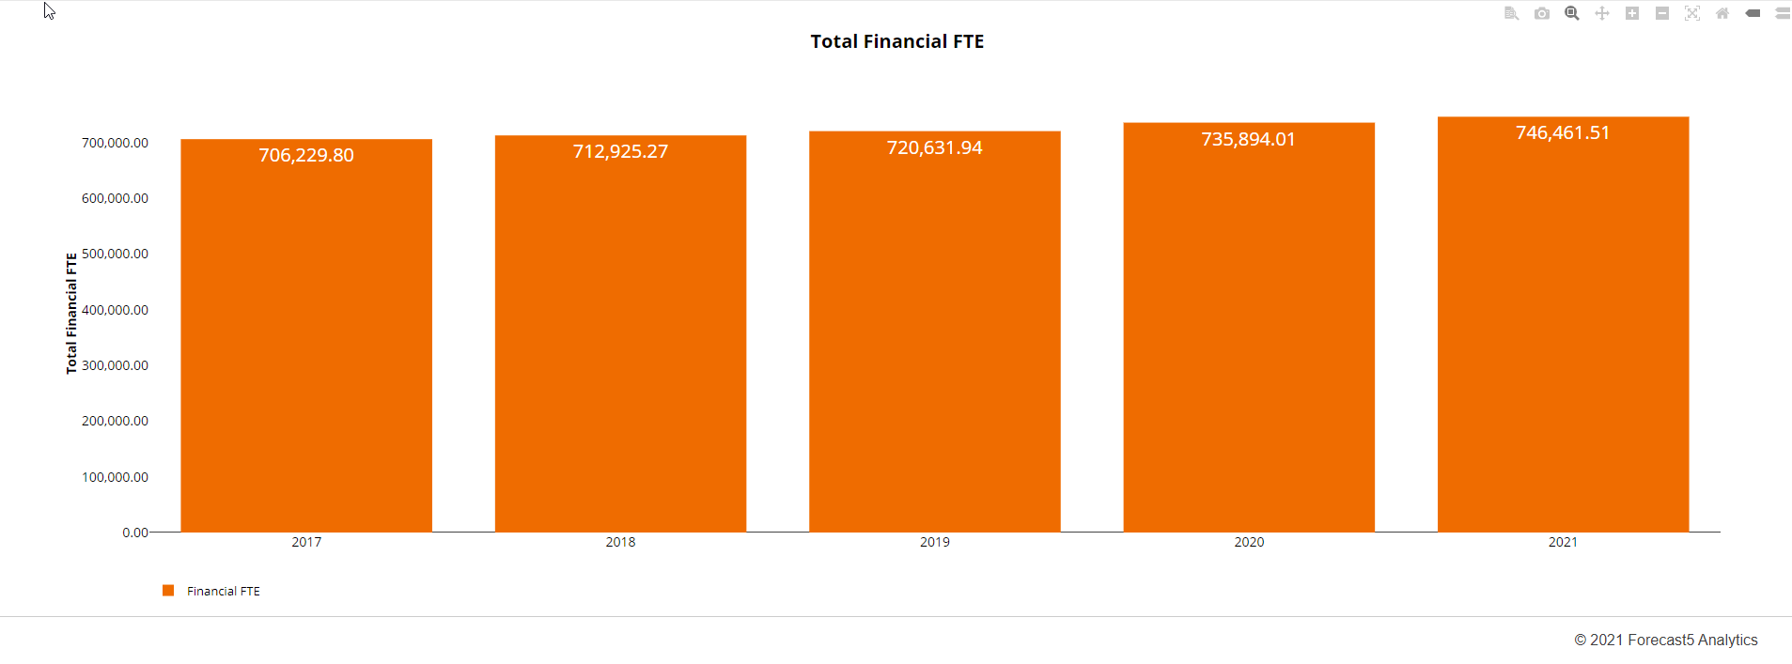
Texas Statewide Financial FTE
Staffing has increase 1%
Notes:
Are you monitoring your staffing?
Clint: When ESSER funds run out do you have a plan?

Slide 16
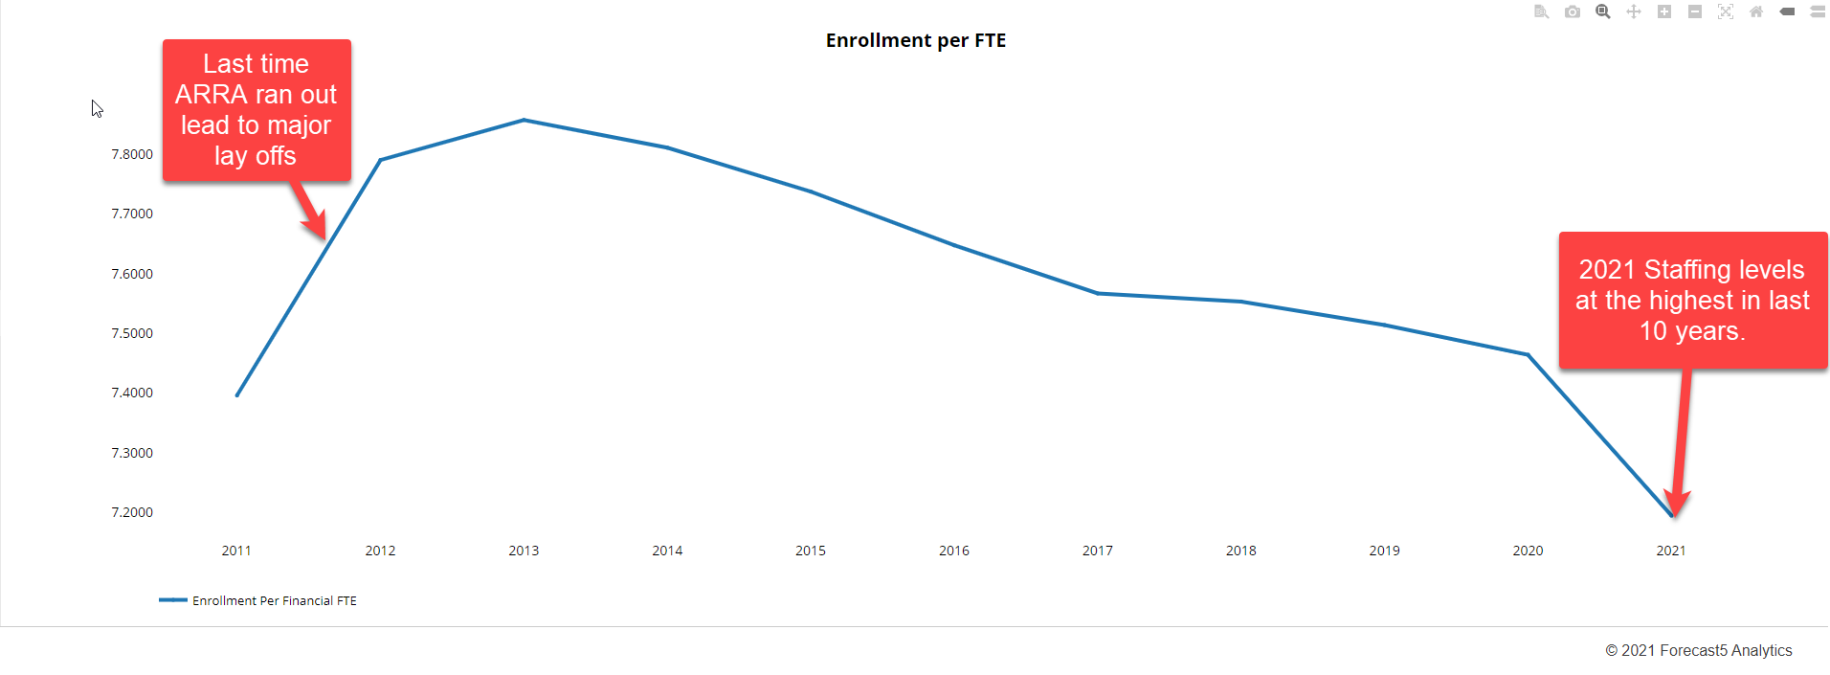
Texas Statewide Enrollment per FTE

Slide 17
Budget Calendar
Month/Year | Description
November 2021 | New course offerings – submitted to the Cabinet (due November 12th)
December 2021 | 13th Board budget workshop #1 – Budget calendar approved 13th Regular board meeting
January 2022 | 10th Board budget workshop #2 – State of district, fiscal outlook and demographic enrollment projections, priorities discussion 10th Regular Board meeting Per pupil allotments for campus budgets released (due February 11th.) Dept staff requests and major purchase requests released (due February 11th.) Attendance projections for campuses
February 2022 | 14th Board budget workshop #3 – Revenue assumptions #1 14th Regular Board meeting Initial campus staffing
March 2022 | 7th Board budget workshop #4 – Student teacher ratios, class sizes, campus staffing and debt structure, priorities discussion 7th Regular board meeting Campus staffing finalized Preliminary draft budget (no personnel) presented to the school board By 3/31, Admin review of building/facilities maint. & renovation priorities
April 2022 | 11th Board budget workshop #5 – Revenue assumptions #2, funding per student, peer data comparisons and salary increases, priorities discussion, draft budget 11th Regular board meeting Budget projections to include staffing and new course offerings By 4/22, complete Superintendent review of preliminary budget, personnel requirements, facility requirements, and projected revenue By 4/29, estimated certified values from Appraised districts
May 2022 | 9th Board budget workshop #6 – Revenue assumptions #3, salary comparisons, proposed pay increases & budgets, priorities finalized, draft budget 9th Regular Board meeting Adoption of 2022-2023 employee compensation plan By 6/1, complete near final budget draft
June 2022 | 20th Public Hearing on Budget 20th Regular Board meeting Board adoption of 2022-2023 General Fund, Debt Service and Food Service budgets By 6/7, advertise in the local paper for Public Hearing for 6/20 Board meeting
Notes:
Have a plan to communicate and share it with your community.

Slide 19
Make financial decisions with the future in mind

Slide 20
Access trends and benchmark against peers

Slide 21
Connect your data to optimize student learning

Slide 22
Location matters

