Slide 2
Benchmarking Student Performance
Dr. Adam Cibulka – Sr. Manager Student Analytics
Chris Ryan – Sr. Analytics Advisor

Slide 3
Introducing Frontline Analytics
Student Analytics from current SIS and district data
Comparative Analytics using state level data
Financial and Budgeting Analytics with current finances
Location Analytics with student and district resource data

Slide 4
Analytics Solutions For K-12 Education
Develop budgets, create projections, and model scenarios
Analyze data to quickly generate new perspectives on organizational performance.
Connect student data sets for insights, reporting, and custom dashboards.
Add a geovisual perspective to make more informed decisions.

Slide 5
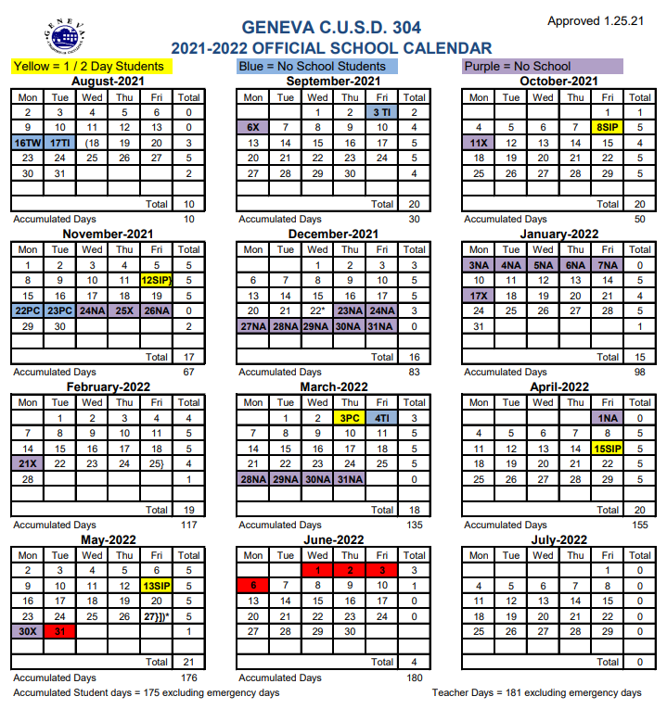

Slide 6
Connect Your Data To Optimize Student Learning
Student performance and progress monitoring across learning environments
Next grade, college, career, and military readiness assessment
Student-level identification of those falling behind for intervention planning
“Blind spot” identification to ensure equity and access
Benchmarking across school buildings, grades, and student groups
Notes:
What are seeing in the field with our current users?
How do we see districts using analytics?
Attendance
Discipline
Course Grades
Benchmarking across school buildings, grades, and student groups
NWEA Map
I-Ready
Whats the communication to the School Board right now?
College and Career Readiness
Whats the second half of the year beginning to look like and looking toward the end of the year?
Integration – what data can be brought together?

Slide 7
Questions?

Slide 8
Thank you!
Notes:
https://www.frontlineeducation.com/analytics-software/student-performance-data/

