Slide 1
A Culture of Caring
Suicide Prevention for Schools

Slide 2
Theodora Schiro, M.Ed. and Steve Schiro, M.Ed.
Presenters

Slide 3
A Culture of Caring
What School Leaders Need to Know About Suicide Prevention

Slide 4
Suicide is a large and growing public health problem.

Slide 5
In 2017 over 3,000 youth ages 10-19 died by suicide.

Slide 6
How You Can Prevent Suicide

Slide 7
How You Can Prevent Suicide
Webinar Goals:
Overview of youth suicide: statistics and scope
of problem
Prevention, Intervention, and Postvention:
successes and challenges
How school culture influences suicide prevention
How to develop and implement comprehensive prevention policies and plans

Slide 8
Beyond suicide prevention training

Slide 9
Warning Signs

Slide 10
Upstream Prevention

Slide 11
Prevention starts early

Slide 13
Trauma Informed Schools

Slide 14
ACEs
Adverse Childhood Experiences

Slide 15
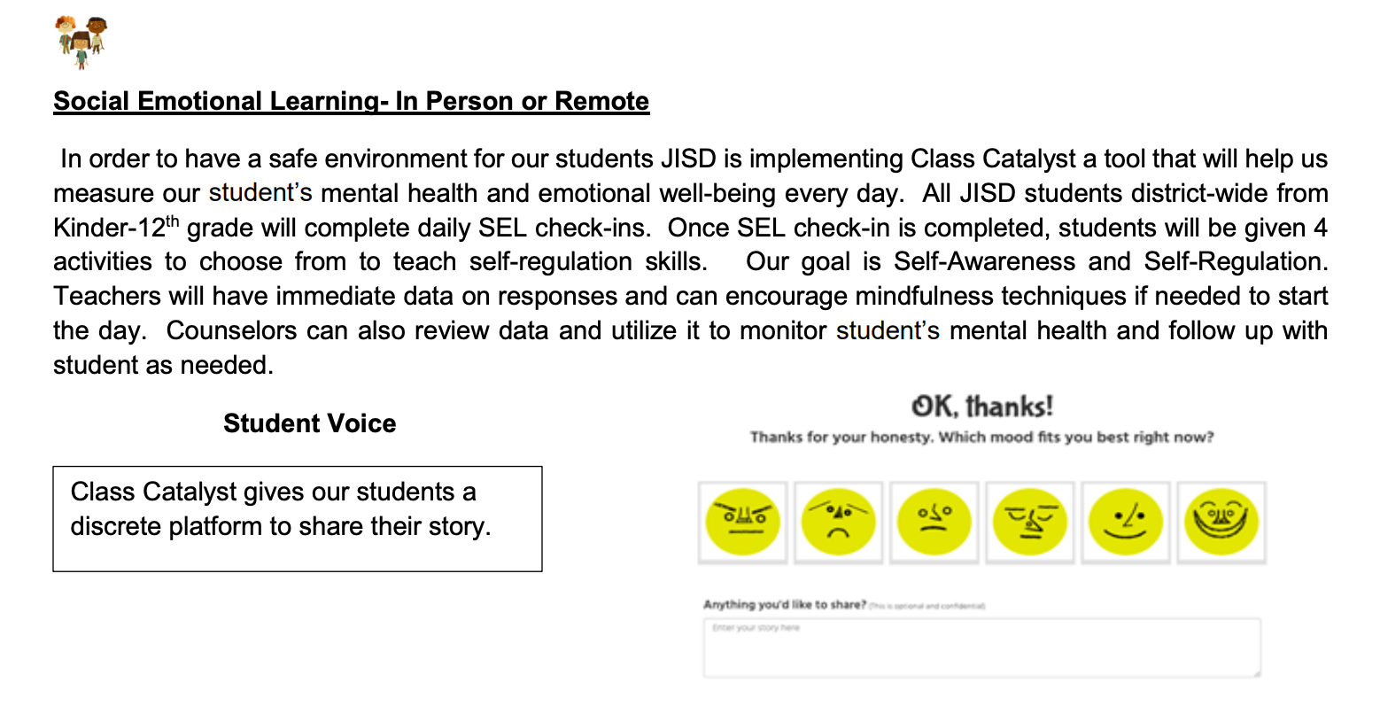
SEL
Social Emotional Learning

Slide 16
School Counselors
School counselors and other site-based mental health professionals play a vital role in prevention.

Slide 17
Knowing a child’s history makes a difference.

Slide 18
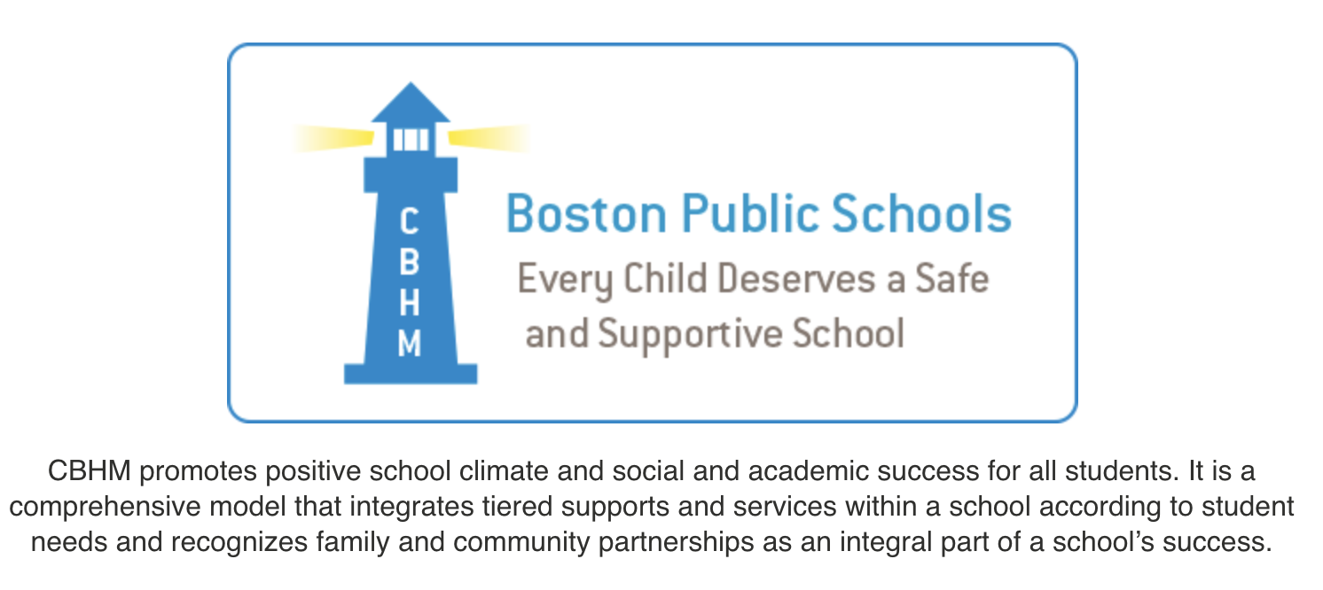
Comprehensive Behavioral Health

Slide 19
Changing the role of school psychologists

Slide 20
A Culture of Caring
Emotional well-being and connectedness

Slide 21
Connectedness
Positive and supportive social relationships and community connections can help buffer the effects of risk factors in people’s lives.

Slide 22
What’s Your Plan?
Be prepared
to act.

Slide 23
Model School District Policy on Suicide Prevention
Schools must have a complete crisis plan for suicide in place that addresses
Prevention
Intervention
Postvention

Slide 24
Let the students in on the plan

Slide 25
Freedom High

Slide 26
RESOURCES

Slide 27
Suicide Prevention may be a matter of a caring person with the right knowledge being available in the right place at the right time.

Slide 28
CONTACT US
Theodora Schiro
www.Theodoraschiro.com
Steve Schiro
sschiro65@gmail.com

Slide 29
Q+A

