Slide 1
Talk Data to Me
A Data-centric Approach to Managing Absences In the Wake of a Pandemic
Webinar to start promptly at scheduled time, you will not hear any audio or see screen changes until then
DATE: April 15, 2021
HOSTED BY: Conrad Kraybill – Director, Product Management
SPOTLIGHT: Kevin Agnello – Sr. Data Analytics Engineer
1
Notes:
Karlie

Slide 2
Today’s Presenters
Conrad Kraybill
Kevin Agnello
Conrad has worked at Frontline and partnered with districts for over 13 years, with a current focus on helping the product management team manage strategic initiatives across the entire Frontline portfolio of Products.
Conrad and his family hail from Reading, PA with three young children which has made adjusting to a more virtual world quite the learning experience.
Kevin is a Sr. Data Analytics Engineer for Frontline Education. He is a former high school mathematics teacher, holds two Master's Degrees in the Education field, and is working on a dissertation toward a Ph.D. in Educational Psychology.
Kevin and his family live in Stonington, CT. He has a one-year-old daughter and another daughter due next month.
Notes:
Kevin
Member of the Data Analytics and Reporting Team and is responsible for the aggregation, testing, and maintenance of the data that supplies the Absence Management and Recruiting and Hiring Institute Reports
Author of a monthly blog series titled “Talk Data to Me”, available on the Frontline blog, which discusses data trends found in Frontline solution data, relates them to broader K-12 discussions, and interprets them as actionable insights to enhance your Frontline, and overall educational, experience.
Assists in the data analyses for white papers and reports published by the Frontline Research and Learning Institute

Slide 3
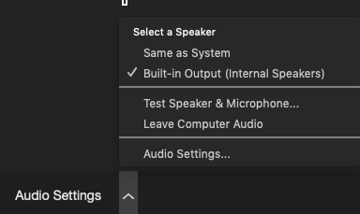
Housekeeping
You can select Audio Settings in the bottom, left of your screen to adjust your audio.
There are 3 icons on the bottom of your screen.
Chat
Raise Hand
Q&A
Please use the Q&A feature to ask questions.
Notes:
Given the current climate, by now you are all likely Zoom experts. So we have just a few features to point out about today’s webinar before we get started.
All lines will be muted during our session. If you have any questions, please use the Q&A feature. We will answer questions throughout the session whenever possible, but may also choose to hold some until the end to allow for expanded conversation and discussion. We will open up the lines at the end of our call to allow anyone who would like to speak an opportunity to do so. So, as we progress through our call today, please jot down any comments, tips or tricks of your own that you may wish to share with everyone at the end. If you’re not one for public speaking, no worries! During the Q&A session you can drop those in the Q&A box and we will read them to the audience for you.

Slide 4
Talk Data To Me
A Data-centric Approach to Absence Management In the Wake of a Pandemic
7K
K-12 Organizations
4M
Employees
195M
Absences
Today’s Takeaways
The Dataset
Trends through the pandemic
What can we expect moving forward?
What actions can districts take proactively?
Data-set is comprehensive enough that the Center for Research and Reform in Education at Johns Hopkins University has declared it to be representative of national trends.

Slide 5
Trends Through the Pandemic
Notes:
Karlie
Kevin is a Sr. Data Analytics Engineer for Frontline Education. He is a former high school mathematics teacher and holds a Master's Degree in Educational Curriculum and Instruction, a Master's Degree in Educational Psychology, and is working on a dissertation toward his Ph.D. in Educational Psychology.
Kevin
Member of the Data Analytics and Reporting Team and is responsible for the aggregation, testing, and maintenance of the data that supplies the Absence Management and Recruiting and Hiring Institute Reports
Author of a monthly blog series titled “Talk Data to Me”, available on the Frontline blog, which discusses data trends found in Frontline solution data, relates them to broader K-12 discussions, and interprets them as actionable insights to enhance your Frontline, and overall educational, experience.
Assists in the data analyses for white papers and reports published by the Frontline Research and Learning Institute

Slide 6
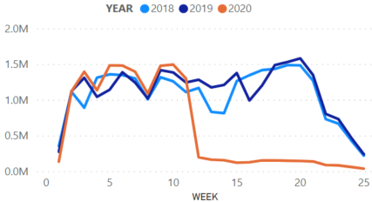
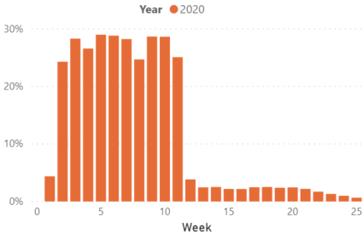
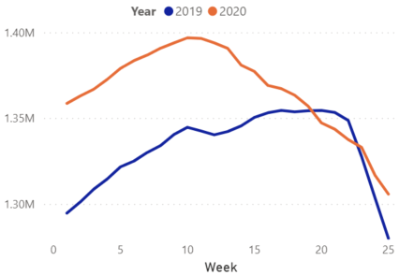
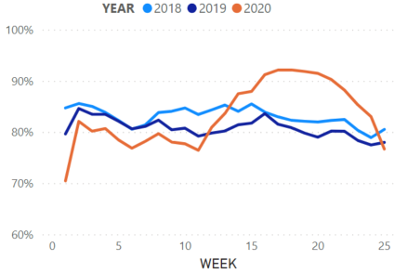
Initial COVID-19 Impact: Spring of 2020
Absences
Working Sub %
Following the mid-March Federal Emergency Declaration…
Absences requiring a substitute plummeted as schools began to close
% of active subs who are filling jobs (Working Sub %) fell about 90%
Pool of active substitutes began falling
Fill rate spiked
Active Subs
Fill Rate
Notes:
In general,
absences requiring a substitute plummeted. There was a 90% decrease the week after the emergency declaration as compared to the week before the declaration.
Fill rates skyrocketed... I suppose there were still enough subs available and willing to work to be able to fill the little amount of absences there were to be filled
The active sub population typically steadily increases throughout the school year until the summer months begin. But, immediately following the emergency declaration in March, the sub pool began decreasing steadily and continued to do so into the summer months
Working sub % typically operates in the 25-30% ranges, but this % dropped to about 2-3% in the weeks following the emergency declaration. But remember, fill rates were skyrocketed even though a very small percentage of the sub pool was actually working.

Slide 7
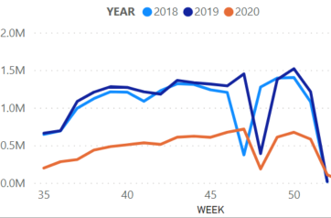
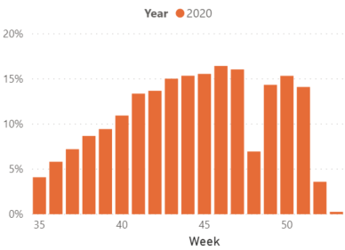
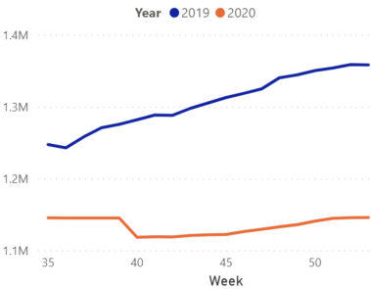
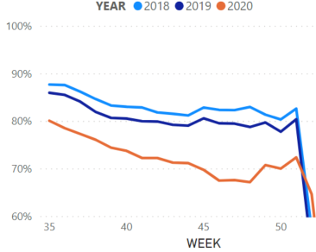
COVID-19 Impact: Fall of 2020
Absences
Working Sub %
As schools began to open fully or on a hybrid basis…
The absence trend returned to "normal", but totals remained significantly below "normal“
Working Sub % rose, but attained only about half of “normal”
Pool of active subs remained low, plateaued
Fill rate trend returned to “normal”, but remained lower than previous years
Active Subs
Fill Rate
Notes:
In general,
As more districts had in person learning than we saw in the Spring, the absence trend over time returned to normal. There were increasing amounts of absences up to Thanksgiving with peaks around the Holiday season. But, the number of absences remained at about 50% of previous school years.
Similarly, the fill rate trend over time returned to normal. It typically starts high in the fall and decreases up until the holiday season. That happened again this past fall, but fill rates consistently operated about 10% below "normal"
The available sub pool remained low (about 80% of what it was in Fall 2019).
The working sub % increased from 2-3% we saw in the spring up to 13-17%.
The combination of the smaller available sub pool, the smaller % of susb working, and the increasing absence numbers should explain the consistently lower fill rate

Slide 8
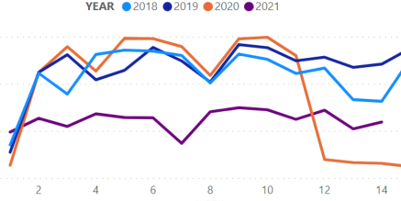
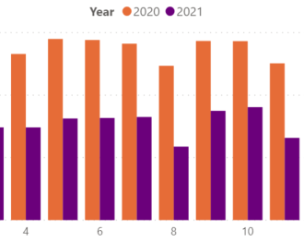
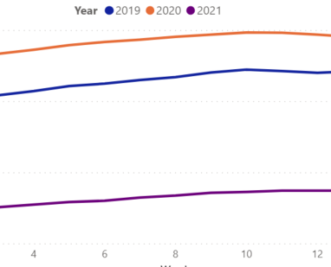
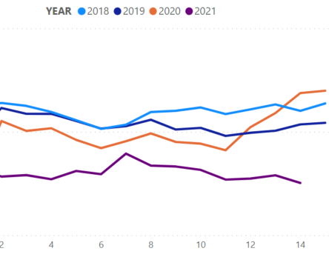
COVID-19 Impact: Spring of 2021
Absences
Working Sub %
Throughout this spring…
Absences and Working Sub % continue to track at about 50% of “normal”
Pool of Active Subs has climbed, but slowly and remains well below expected levels
Fill rates have leveled out and remain consistently below expected level
Active Subs
Fill Rate
Notes:
This spring resembles last fall. Districts across the country all have different operating models. Some are open full time. Some of virtual full time. Some are hybrid. Some switch back and forth.
In general,
All four metrics continue to trend lower than previous years.

Slide 9
What can we expect moving forward?
Notes:
Karlie
Kevin is a Sr. Data Analytics Engineer for Frontline Education. He is a former high school mathematics teacher and holds a Master's Degree in Educational Curriculum and Instruction, a Master's Degree in Educational Psychology, and is working on a dissertation toward his Ph.D. in Educational Psychology.
Kevin
Member of the Data Analytics and Reporting Team and is responsible for the aggregation, testing, and maintenance of the data that supplies the Absence Management and Recruiting and Hiring Institute Reports
Author of a monthly blog series titled “Talk Data to Me”, available on the Frontline blog, which discusses data trends found in Frontline solution data, relates them to broader K-12 discussions, and interprets them as actionable insights to enhance your Frontline, and overall educational, experience.
Assists in the data analyses for white papers and reports published by the Frontline Research and Learning Institute

Slide 10
What can we expect moving forward?
It’s impossible to predict the future, but the trends in the data lead us to believe that…
1
Absences requiring a substitute will continue to rise and return to normal levels as schools re-open
2
Active Sub Pool is growing, but needs to continue to do so more rapidly
3
Increase substitute engagement to increase working sub %

Slide 11
What actions can I take?
Notes:
Paul

Slide 12
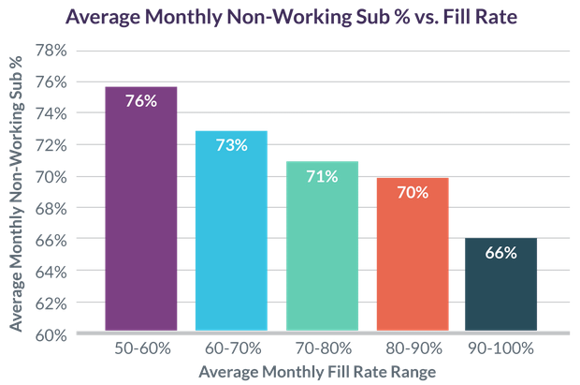
What actions can I take? Focus on substitute engagement
Data from the 2019-2020 school year confirms the relationship between non-working substitute % and fill rate.
Notes:
Finally, the most recent data from the 2019-2020 school year once again confirms the connection between non-working substitute percentage and fill rate.
Here is where the connection between fill rate and non-working substitute percentage becomes strikingly clear. As the chart above shows, in districts with an average monthly non-working substitute percentage of 76%, only about half of all teacher absences were filled. Yet in districts where the average monthly non-working substitute percentage was just 10% lower, nearly all absences were filled. This shows that even a slight increase in substitute engagement can have a big impact on fill rate.
Source: https://www.frontlineeducation.com/blog/talk-data-to-me-why-substitute-engagement-matters-more-than-ever-this-year/

Slide 13
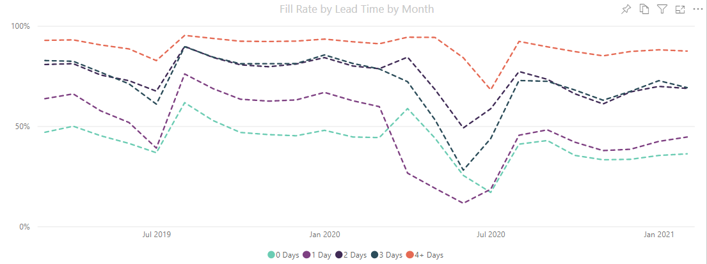
What actions can I take? Focus on absence “lead time”
More lead time increases fill rate
Communicate with your teachers
Focus particularly on planned absences (e.g., PD, conferences, field trips, etc.)
Notes:
There are several action steps to take:
Know the data. The metrics discussed above, and many others, are available through the Frontline Research & Learning Institute’s National Employee Absence & Substitute Data Report. In addition, if you use Frontline Absence & Time, you can access interactive, in-product tools to track your district’s data and compare it to national, state, and like-district benchmarks.
Use the resources. Check out these resources from Frontline Education on why substitutes work in your district (or not) and changing perceptions of substitute teaching.
Make sure you have the right tools. Making it easy for substitutes to find and accept jobs is vital. That means catering to communication preferences. Data from a recent survey of substitutes tells us that when it comes to receiving absence notifications, substitutes prefer to receive notifications through a mobile app rather than text message, phone call, or internet browser by a ratio of 4:1. Better yet, a seamless mobile experience makes it quicker and easier for teachers to enter absences and alert substitutes about jobs — and data shows that the sooner an absence is recorded in the system, the more likely it is to be filled by a substitute.
Source: https://www.frontlineeducation.com/blog/talk-data-to-me-why-substitute-engagement-matters-more-than-ever-this-year/

Slide 14
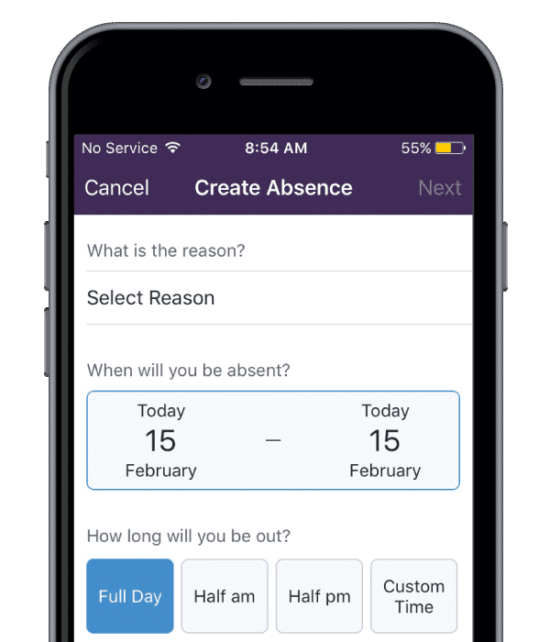
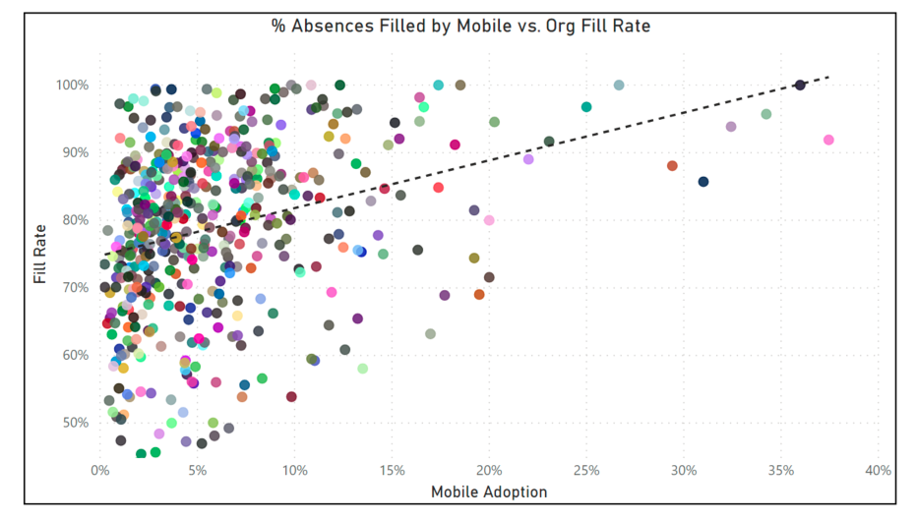
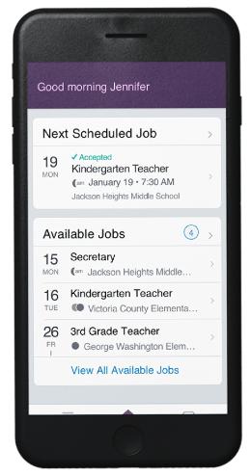
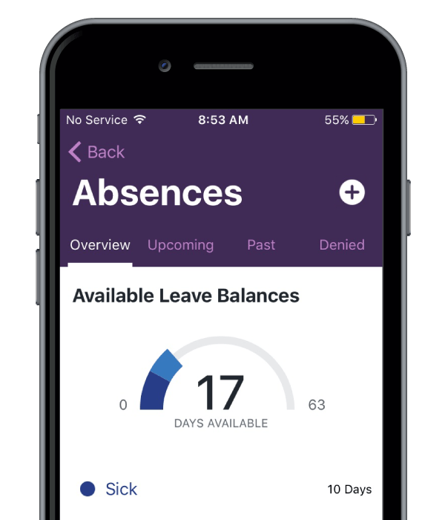
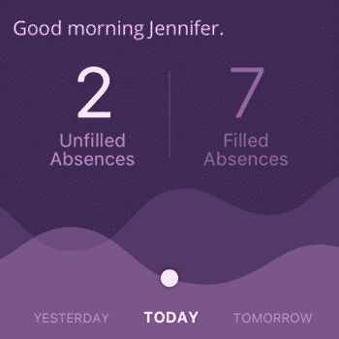
What actions can I take? Embrace mobile
ADMINS
SUBS
STAFF
Notes:
NEED MORE INFO

Slide 15
Key Takeaways
Notes:
Paul

Slide 16
Key Take-Aways
A Data-centric Approach to Absence Management In the Wake of a Pandemic
Spring of 2020, Absences requiring a substitute plummeted as schools began to close
Fall of 2021 Fill rate trend returned to “normal”, but remained lower than previous years
Active Sub Pool is growing, but needs to continue to do so more rapidly
Focus on Lead Time
Focus on Substitute Engagement
Embrace Mobile Solutions

Slide 17
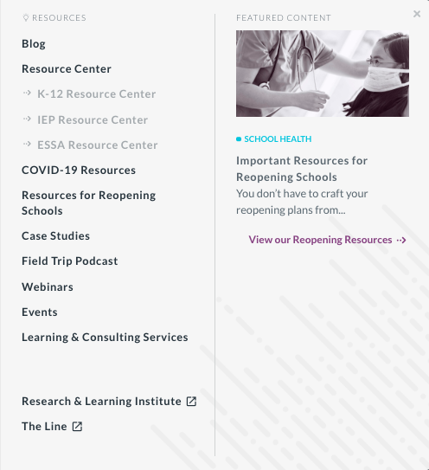
Resources:
Frontline Research and Learning Institute
Institute Report – General Info
Changing Perceptions: Substitutes as Educators
National Employee Absence & Substitute Report
Annual Report: 2018-2019 National Absence and Hiring Trends
“Talk Data To Me” blogs
Reasons for Teacher Absences in 2020
Why Substitute Engagement Matters More Than Ever This Year
Absence Management During Covid-19
Other Resources
Why Substitutes Work in Your District (or Not) – and What You Can Do About It
The Line by Frontline Education
Frontline Education Blog

Slide 18
Questions
Notes:
If there are features that we highlighted that you are nott currently using, please reach out to our support team. They will be happy to help you enable them.

