Slide 1
Setting Up Your Teachers for Success
How to Support Teachers for 21st Century Student Learning and Leadership

Slide 2
Introduction
Lori B. McEwen, Ph.D.
www.lorimcewen.com
Twitter: @lorimcewen
LinkedIn: linkedin.com/in/lorimcewen
lori@lorimcewen.com
©2021 Frontline Education Confidential & Proprietary

Slide 3
Outcomes
The importance of creating or revising an exemplary educator profile that mirrors and supports the 21st century student.
How to provide educators with career development and advancement opportunities that support stellar education opportunities for students.
Strategies for using these tools to provide enticing advancement opportunities to retain educators.
©2021 Frontline Education Confidential & Proprietary

Slide 4
What Is your Theory of Action?
Portrait of the Graduate
Portrait of the Educator
Portrait of the System
©2021 Frontline Education Confidential & Proprietary

Slide 5
Vision of a Graduate
What is it we want all students to know and be able to do? What skills and competencies must they possess for success in college, career and civic life?
©2021 Frontline Education Confidential & Proprietary

Slide 6
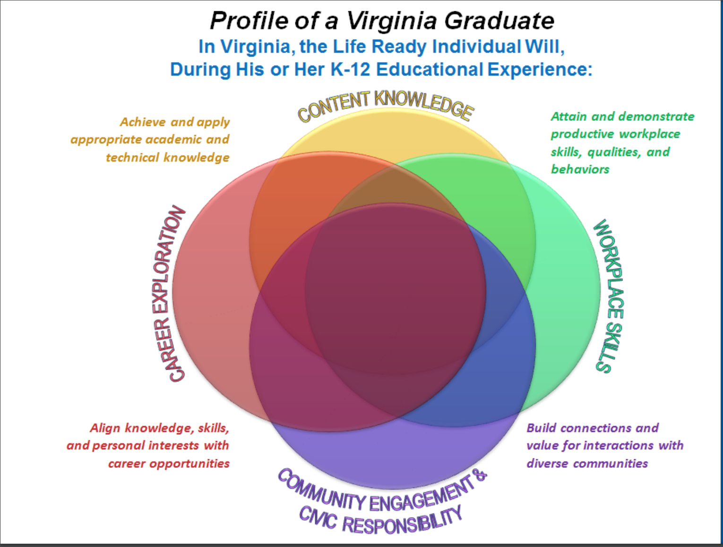
©2021 Frontline Education Confidential & Proprietary

Slide 7
©2021 Frontline Education Confidential & Proprietary

Slide 8
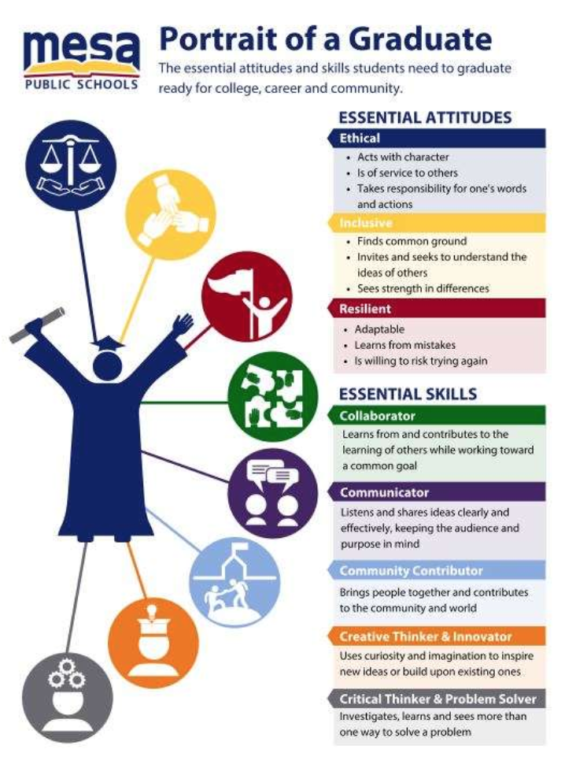
©2021 Frontline Education Confidential & Proprietary

Slide 9
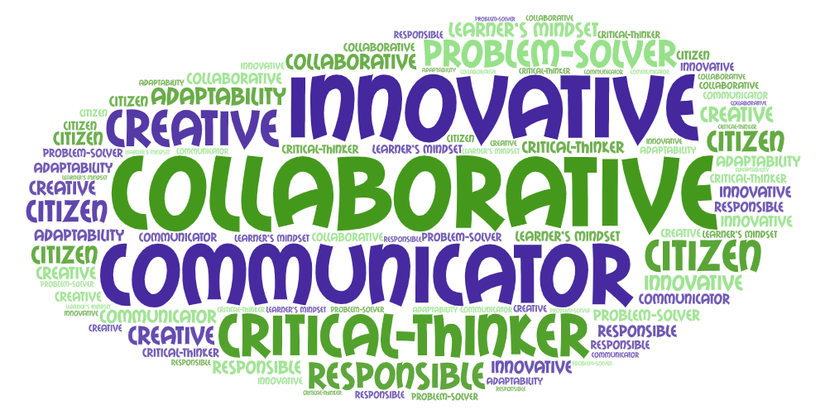
http://portraitofagraduate.org/resource-hub/gallery
©2021 Frontline Education Confidential & Proprietary

Slide 10
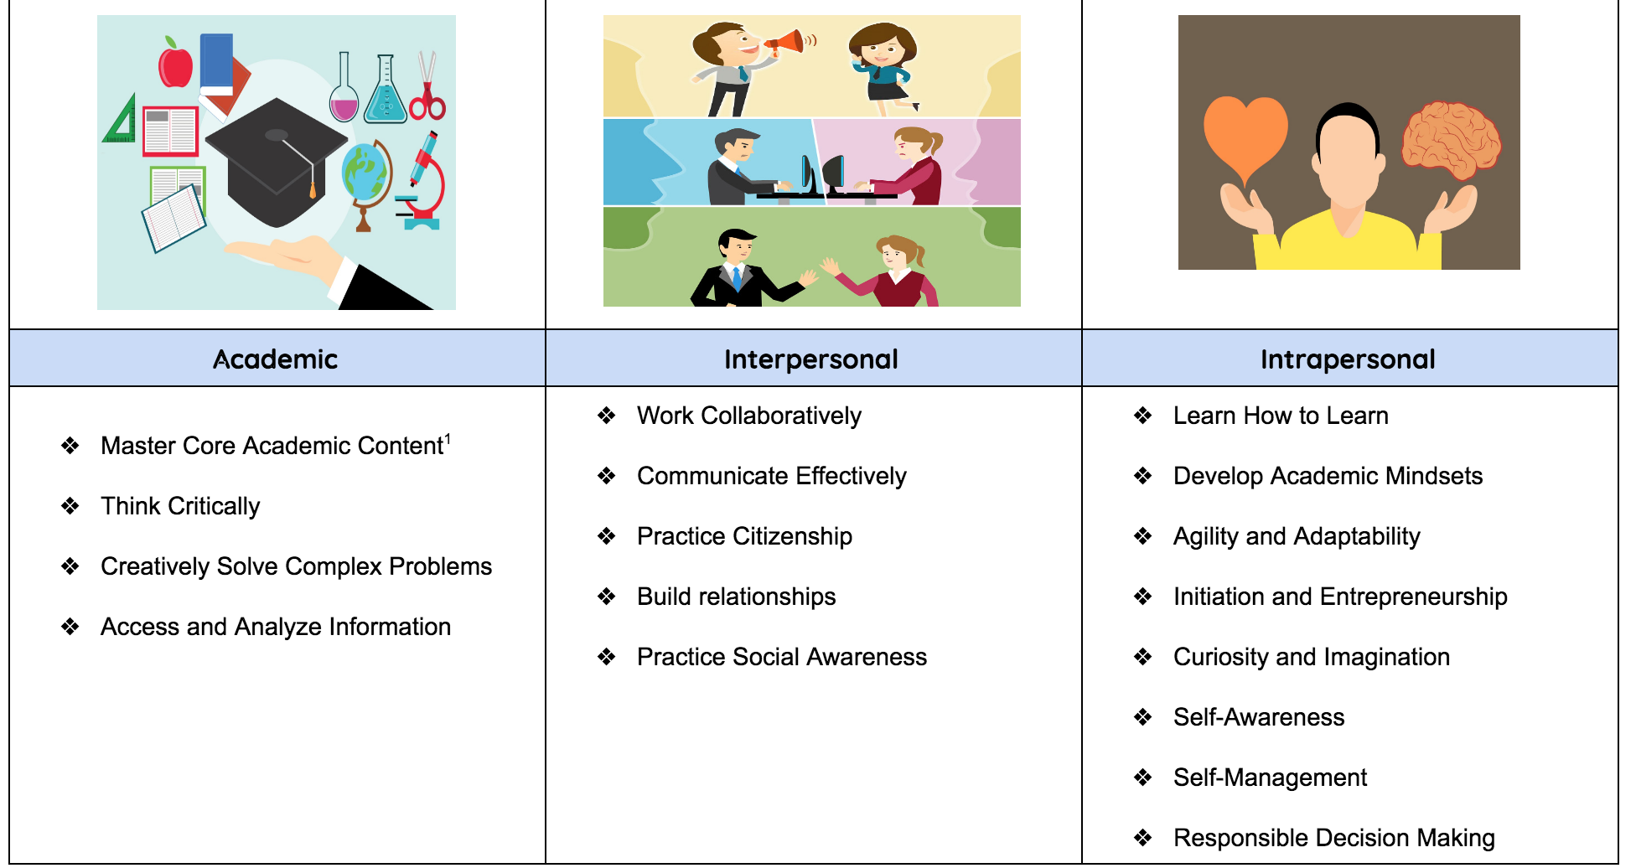
Sources: New Pedagogies for Deep Learning; Hewlett’s Deeper Learning Competencies; Tony Wagner’s Seven Survival Skills; CASEL

Slide 11
Portrait of an Educator
What are the essential skills, attitudes, attributes and dispositions necessary to create schools and classrooms of deep and joyful learning?
©2021 Frontline Education Confidential & Proprietary

Slide 12
What Is your Theory of Action?
Portrait of the Graduate
Portrait of the Educator
Portrait of the System
©2021 Frontline Education Confidential & Proprietary

Slide 13
Portrait of an Educator...
©2021 Frontline Education Confidential & Proprietary

Slide 14
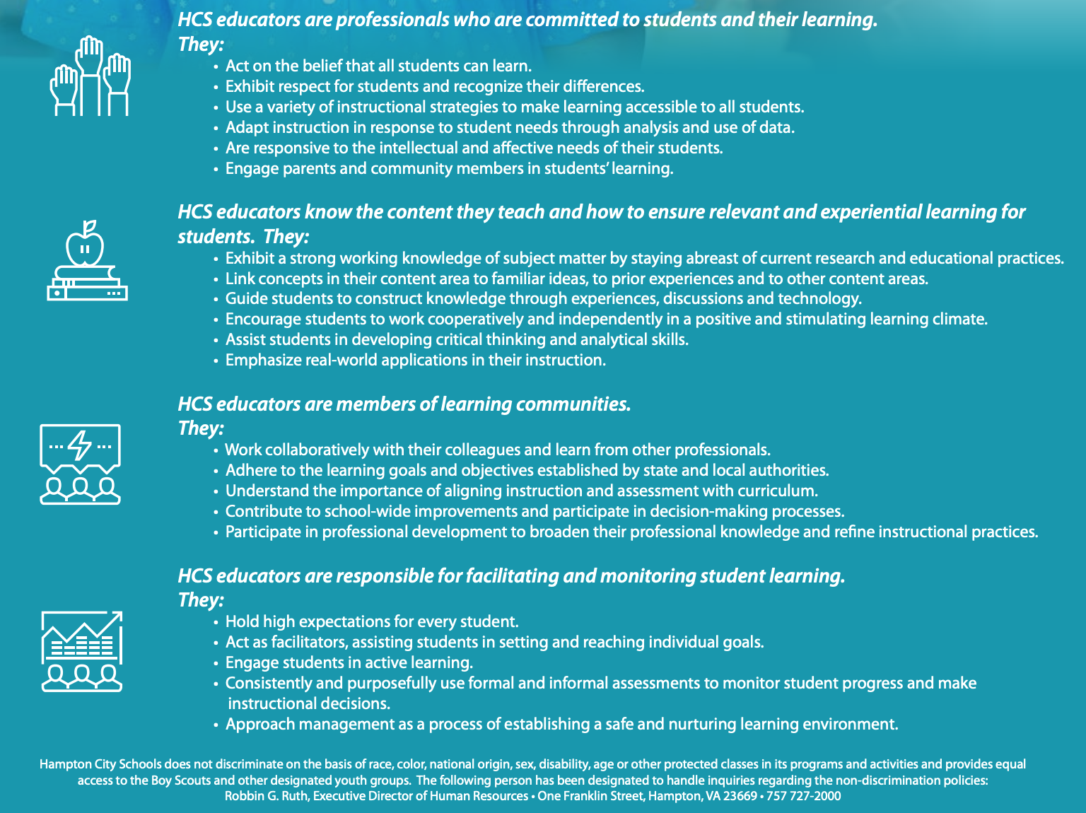
©2021 Frontline Education Confidential & Proprietary

Slide 15
Cleveland Metro Schools (global studies)
OUR TEACHERS WILL BE:
• Confident, self-advocates who take ownership of learning and have a vision for their future.
• Highly effective and creative collaborators, critical-thinkers, problem-solvers, and communicators using civil discourse.
• Community-minded, culturally-competent leaders who champion diversity.
• Innovators with compassion for self, others, and the global environment.
OUR TEACHERS WILL:
• Provide students opportunities to identify, examine and take action on issues of local and global significance to improve human conditions via service learning projects.
• Facilitate students’ investigation and engagement in rigorous and relevant academic work linked to real and current world issues through key anchor performance tasks.
• Foster and maintain a student-driven community characterized by high levels of engagement, motivation, service, collaboration, and respect for self and others.
• Prepare students to acquire the knowledge, skills, and disposition necessary to matriculate successfully to college and career.
• Understand the potential of technology in the classroom and effectively incorporate digital content within the content area.
• Develop professional knowledge of competency-based education and its key assessment features including anchor performance tasks, exhibitions of learning, and competency scoring rubrics.
• Create and reflect on professional anchor tasks that (1) provide clarity on how to design their course materials ensuring the instructional vision is integral to student learning in all courses; (2) result in coherence in pedagogical practices among teachers; and (3) establish a shared language about instructional practices.
OUR TEACHERS WILL EXPERIENCE:
• Interaction, exploration, and networking with key community partners, and organizations and businesses with a global emphasis.
• Local, regional, national or international travel.
• Facilitating service projects and expeditionary learning opportunities that draw together students’ personal experience and intellectual growth to promote self-discovery and efficacy.
©2021 Frontline Education Confidential & Proprietary

Slide 16
Portrait of a Learning Organization
What are the essential conditions under which innovative, collaborative, analytical educators thrive?
©2021 Frontline Education Confidential & Proprietary

Slide 17
What Is your Theory of Action?
Portrait of the Graduate
Portrait of the Educator
Portrait of the System
©2021 Frontline Education Confidential & Proprietary

Slide 18
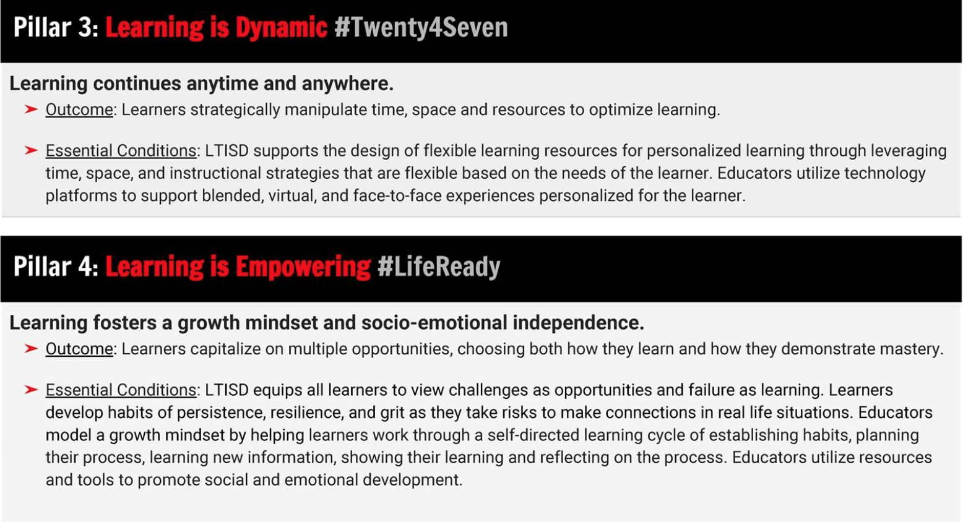
Lake Travis--essential conditions
©2021 Frontline Education Confidential & Proprietary

Slide 19
What Is your Theory of Action?
Portrait of the Graduate
Portrait of the Educator
Portrait of the System
©2021 Frontline Education Confidential & Proprietary

Slide 20
Source: Rand Corporation as cited in EdWeek 2.22.21
Notes:
And lack of flexibility

Slide 21
Promising practices
Instructional coaches | New teacher mentors | Grow your own programs and residencies
Committee leadership | Multi-classroom leadership | District “University”
©2021 Frontline Education Confidential & Proprietary

Slide 22
Q & A
©2021 Frontline Education Confidential & Proprietary

Slide 23
Resources
Carver, C. L. (2016). Transforming Identities. Journal of Research on Leadership Education, 11(2), 158–180. https://doi.org/10.1177/1942775116658635
https://www.engageny.org/sites/default/files/resource/attachments/designing_career_ladders_for_teachers_and_principals.pdf
https://www.opportunityculture.org/2020/11/18/opportunity-culture-teaching-leading-learning-2/
Will, M. (2021, February 22). Teachers Are Stressed Out, and It’s Causing Some to Quit. Education Week. https://www.edweek.org/teaching-learning/teachers-are-stressed-out-and-its-causing-some-to-quit/2021/02
Heubeck, E. (2021, February 17). How This District Leader Transformed Teacher PD. EdWeek Leaders To Learn From. https://www.edweek.org/leaders/2021/how-this-district-leader-transformed-teacher-pd

