Slide 1




HOW TO DISASTER-PROOF YOUR DISTRICT BUSINESS OFFICE
Michael Herrera, CEO
MHA Consulting / January 28, 2021

Slide 2







Company Background
KEY FACTS
20
Years in
operation.
20
Average years industry experience.
CAPABLE
Comprehensive suite of services.
GLOBAL
Diverse, global client base.
SAAS
Compliance and risk tools.
SENIOR LEADERSHIP
  A 20-year proven track record of applying industry standards and best practices across a diverse pedigree of clients.
  A simple mission: Ensure the continuous operations of our clients’ critical processes.
  We seek to partner with clients who have a commitment to BCM versus a check the box mentality.
  SaaS Tools: BIA On-Demand, BCM One, Compliance Confidence, Residual Risk.
Michael A. Herrera, CBCP Chief Executive Officer
Phoenix, Arizona
www.mha-it.com
www.bcmmetrics.com

Slide 3


























































Unique Or Competitive Advantage
Services & Technology
Education
Healthcare
Financial Institutions
Consumer Products
Insurance
Travel & Entertainment
Government/Utility

Slide 4









Educational Institution Experience
Government/Utility
Current State Assessment
Business Impact Analysis
Crisis & Incident Management
Business Continuity Plans
Recovery Exercises

Slide 5


Agenda
What is Business Continuity Management
Common Business Continuity Terms You Need to Know
Why District Offices Need Business Continuity
  Processes
  Facilities
  Technology
Building Your Business Continuity Plan
  Identify Importance of Your Operations
  Determine the Recovery Strategies
  Document the Recovery Plan
Exercise the Business Continuity Plan
Maintain and Improve the Business Continuity Plan
Integration between Emergency Management & Business Continuity

Slide 6







What Is Business Continuity Management?
Disruptive Events
Disruptive events promote the necessity of implementing Business Continuity Management within the organization, as those events are a nearly inevitable consequence of operating in a complex global environment. Such events may include the following:
Manmade, Natural or Technology Disruptions
Significant Economic Events
Disruptive Governmental or Political Changes
Industry or Market Changes or Disruptions
Human Health & Social Disruptions
International Geo-Political Disruption or Changes

Slide 7






What Is Business Continuity Management?
Purpose of Business Continuity Management
Business Continuity Management aims to incorporate business resilience into the long-term planning of the organization and mainly achieve the following:
Effectively responding to threats occurring from disruptive events that impact the business.
Restoring business operations in a manner consistent with business and customer needs.
Mitigating the effect of disruptive events, such as technological, operational, stakeholder and financial risks.
Protecting the interests of an organization before, during, and after a disruptive event.

Slide 8
Business Continuity Management Program
Program Components – Summary
Manage the incident Crisis Management
Manage Technology Recovery Disaster Recovery
Manage Operations Recovery Business Recovery
Objective
Strategic Oversight of Event
Tactical Response (IT)
Tactical Response (Business)
Supporting
Documents
Crisis Management Team Plan
Crisis Communication Plan
Disaster Recovery Plan
Vendor Contracts
Business Continuity Plans
Relocation Plans
IT Department Leadership
Disaster Recovery Team
Department Leadership
Business Recovery Team
Audience
Executive Leadership
Tools & Resources
Emergency Notification Tool
Media Spokesperson(s)
Employee Contact Lists
Vendor Contact Lists
Employee Contact Lists
Vendor Contact Lists
Other Components
Current State Assessment
Program Governance
Business Impact Analysis
Fire, Life & Safety
Training & Testing
Employee Awareness

Slide 9





What Processes Are Key To The District?
Business Impact Analysis
Conducting a BIA identifies the critical processes and associated systems and resources of the organization.
Identifies effects (financial, student experience, brand/image, legal/regulatory) a disruption will have on the organization and its processes.
The BIA provides focus for the creation of business continuity plans.
It identifies how soon (hours, days, weeks) a business process/system must be recovered - Recovery Time Objective.

Slide 10

What Processes Are Key To The District?

Slide 11



Identify The Top Threats/Risks To The District
Threat & Risk Assessment
Identifies the probability of man-made, natural, and technological threats to physical locations in the organization.
Identifies status of the controls (e.g., backup power, data backups, security) in place to mitigate effects of the identified threats.
Identifies opportunities to mitigate the level of risk through improved controls.

Slide 12

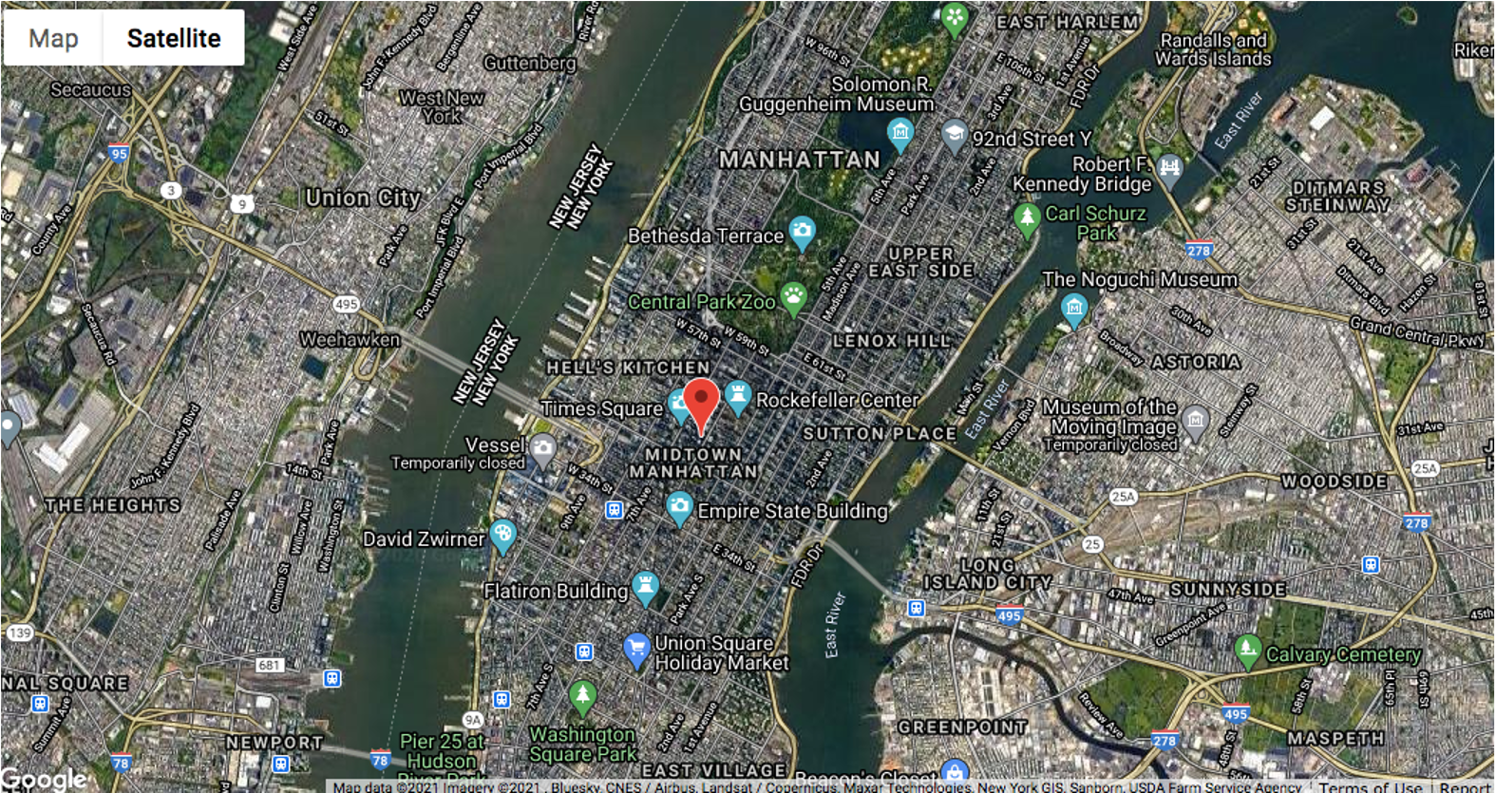
Identify The Top Threats/Risks To The District

Slide 13
Functional Requirements
Threat Matrix
High
Pandemic
Nuclear Plant Fallout
Cyber Incident
Civil Disruption
Workplace Violence
Loss of Personnel
Impact
Severe Winter Weather
Bomb Threat
HVAC Failure
Low
High
Probability

Slide 14



Design, Develop & Implement Plans
Define Assumptions
Global Level Assumptions
Plan Level Assumptions
Define Applicable Recovery Scenarios
Loss of Primary Site
Loss of Technology
Loss of Resources
Loss of Other Channels

Slide 15



Design, Develop & Implement
Define Plan Development Strategy
Business Recovery Plans
IT Disaster Recovery Plans
By Business Unit
Focus on Most Critical Areas
By Function (e.g., network, LAN/WAN)
By Application
Protect Common Elements

Slide 16






Design, Develop & Implement
Recovery Strategies
Define strategy for each plan scenario.
Business Recovery and IT Disaster Recovery.
Plans must be integrated for each strategy.
Recovery strategies may require funding for alternate work sites, backup computer systems, additional supplies, phones, etc.
Recovery strategy document must be approved by Management.

Slide 17


Design, Develop & Implement
Work from home
Internal – Use internal company sites or technology
External – Use 3rd party vendors
Hybrid – Combination of internal and external
Cost of recovery strategy increases significantly with shorter Recovery Time Objectives (RTO) and Recovery Point Objectives (RPO)
Types
Recovery
Strategies
Cost

Slide 18






Design, Develop & Implement
Alternate Work Site Agreements
Contract between the recovering unit and the alternate work site group.
Identifies contacts at the alternate site.
Identifies the recovery site.
Can be used for internal and external recovery strategies.
Identifies the resources to be used.
Manages use of alternate work sites.

Slide 19


Design, Develop & Implement
Plan Certification
Complete prior to exercising the plan
Validates completeness of data
Validates recovery strategy
Identifies opportunities for improvement
Revise the plan based on findings
Set dates for resolution
Follow up

Slide 20

Testing, Maintenance & Execution
Exercises
Controlled exercise
Validates ability to recover from the scenario
Does not require relocation to alternate work site
Desktop Walkthrough
Identifies opportunities for improvement
Scenario based
Validates plan data
Recommended as a first exercise for new plans

Slide 21




Testing, Maintenance & Execution
Exercises
Physical relocation to alternate site
Validate plan activation
Validate recovery of critical systems
Relocate to Alternate Work Site
Validate alternate work site functionality
Identify opportunities for improvement
Perform semi-annually or annually

Slide 22






Testing, Maintenance & Execution
Exercises
Maintenance Checklist
Validate plan components
Identify opportunities for improvement
Perform semi-annually at a minimum
See template
Measure plan status (red, green, yellow)
Updated plan is the deliverable

Slide 23






The Value Of Business Continuity Management
Outcomes of the Business Continuity Management Program
As part of the continuous improvement, support, and implementation of the Business Continuity Management Program, a detailed Business Continuity plan is developed to serve as a guide throughout the process. The plan includes the following elements:
Gap and Risk Assessment
Business Impact Analysis (BIA)
Recovery Time Objectives (RTOs)
Business and IT Continuity Plans
Crisis and Emergency Communication
Plans
Plan Testing, Maintenance, Continuous Improvement

Slide 24





How Can MHA Help?
Business Impact Analysis & Threat Assessment
Continuity Plan Development
Continuous Maintenance & Improvement
Conduct Testing

Slide 25


THANK YOU!
Questions?
Michael Herrera
herrera@mha-it.com
(888) 689-2290

