Slide 2
Transforming Collaborative Learning, Online
Notes:
Feedback needs to be timely, specific and meaningful to help teacher improve their classroom practice.

Slide 3
Today we’ll cover:
Collaboration – Why is it more important than ever?
Formal and Informal Collaboration Structures
Examples: Utilizing Online Resources & Tools to promote collaboration

Slide 4
Presenters
Susan Walters
Solutions Consultant
Frontline Education
Mitch Welch
Solutions Consultant
Frontline Education

Slide 5
“It may be said that the basic characteristic of human behavior in general is that humans personally influence their relations with the environment and through that environment personally change their behavior, subjugating it to their control.”
Lev S. Vygotsky
Notes:
Poll:
Over the past few months, educators and staff have had to change their behaviors, practices, and processes. How do you think this has or will have an impact on your school organization?
The climate of the environment has or will change to one of high anxiety, frustration, and negativity.
The retention rate of teachers and staff will significantly decline.
This will force our organization to take a hard look at how we communicate and support all our employees.
No change. Our organization has risen to the challenge and we are doing great!

Slide 6
How have the events of the last several months impacted – or how do you anticipate them impacting – your organization?
Notes:
Poll:
Over the past few months, educators and staff have had to change their behaviors, practices, and processes. How do you think this has or will have an impact on your school organization?
The climate of the environment has or will change to one of high anxiety, frustration, and negativity.
The retention rate of teachers and staff will significantly decline.
This will force our organization to take a hard look at how we communicate and support all our employees.
No change. Our organization has risen to the challenge and we are doing great!

Slide 7
How much emphasis is placed on collaboration in your organization's professional learning activities?
Notes:
Collaboration – “the action of working with someone to produce or create something”.
How many times are we on meetings, committees, etc., and we don’t have a clear vision of what we are producing or creating??
Poll: Thinking about your professional learning activities, how much do you think is focused on collaboration?
Rare/non-existent
Some
Heavy

Slide 8
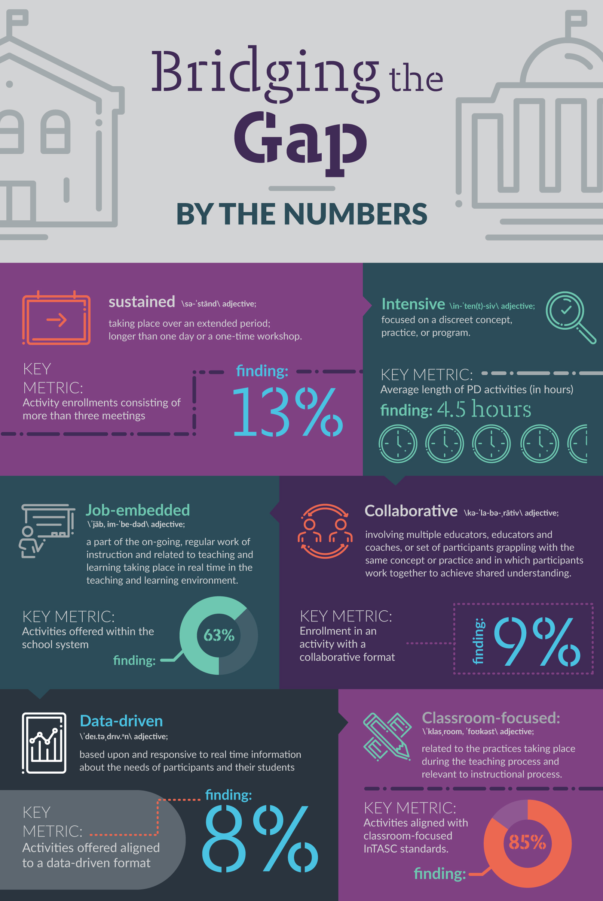
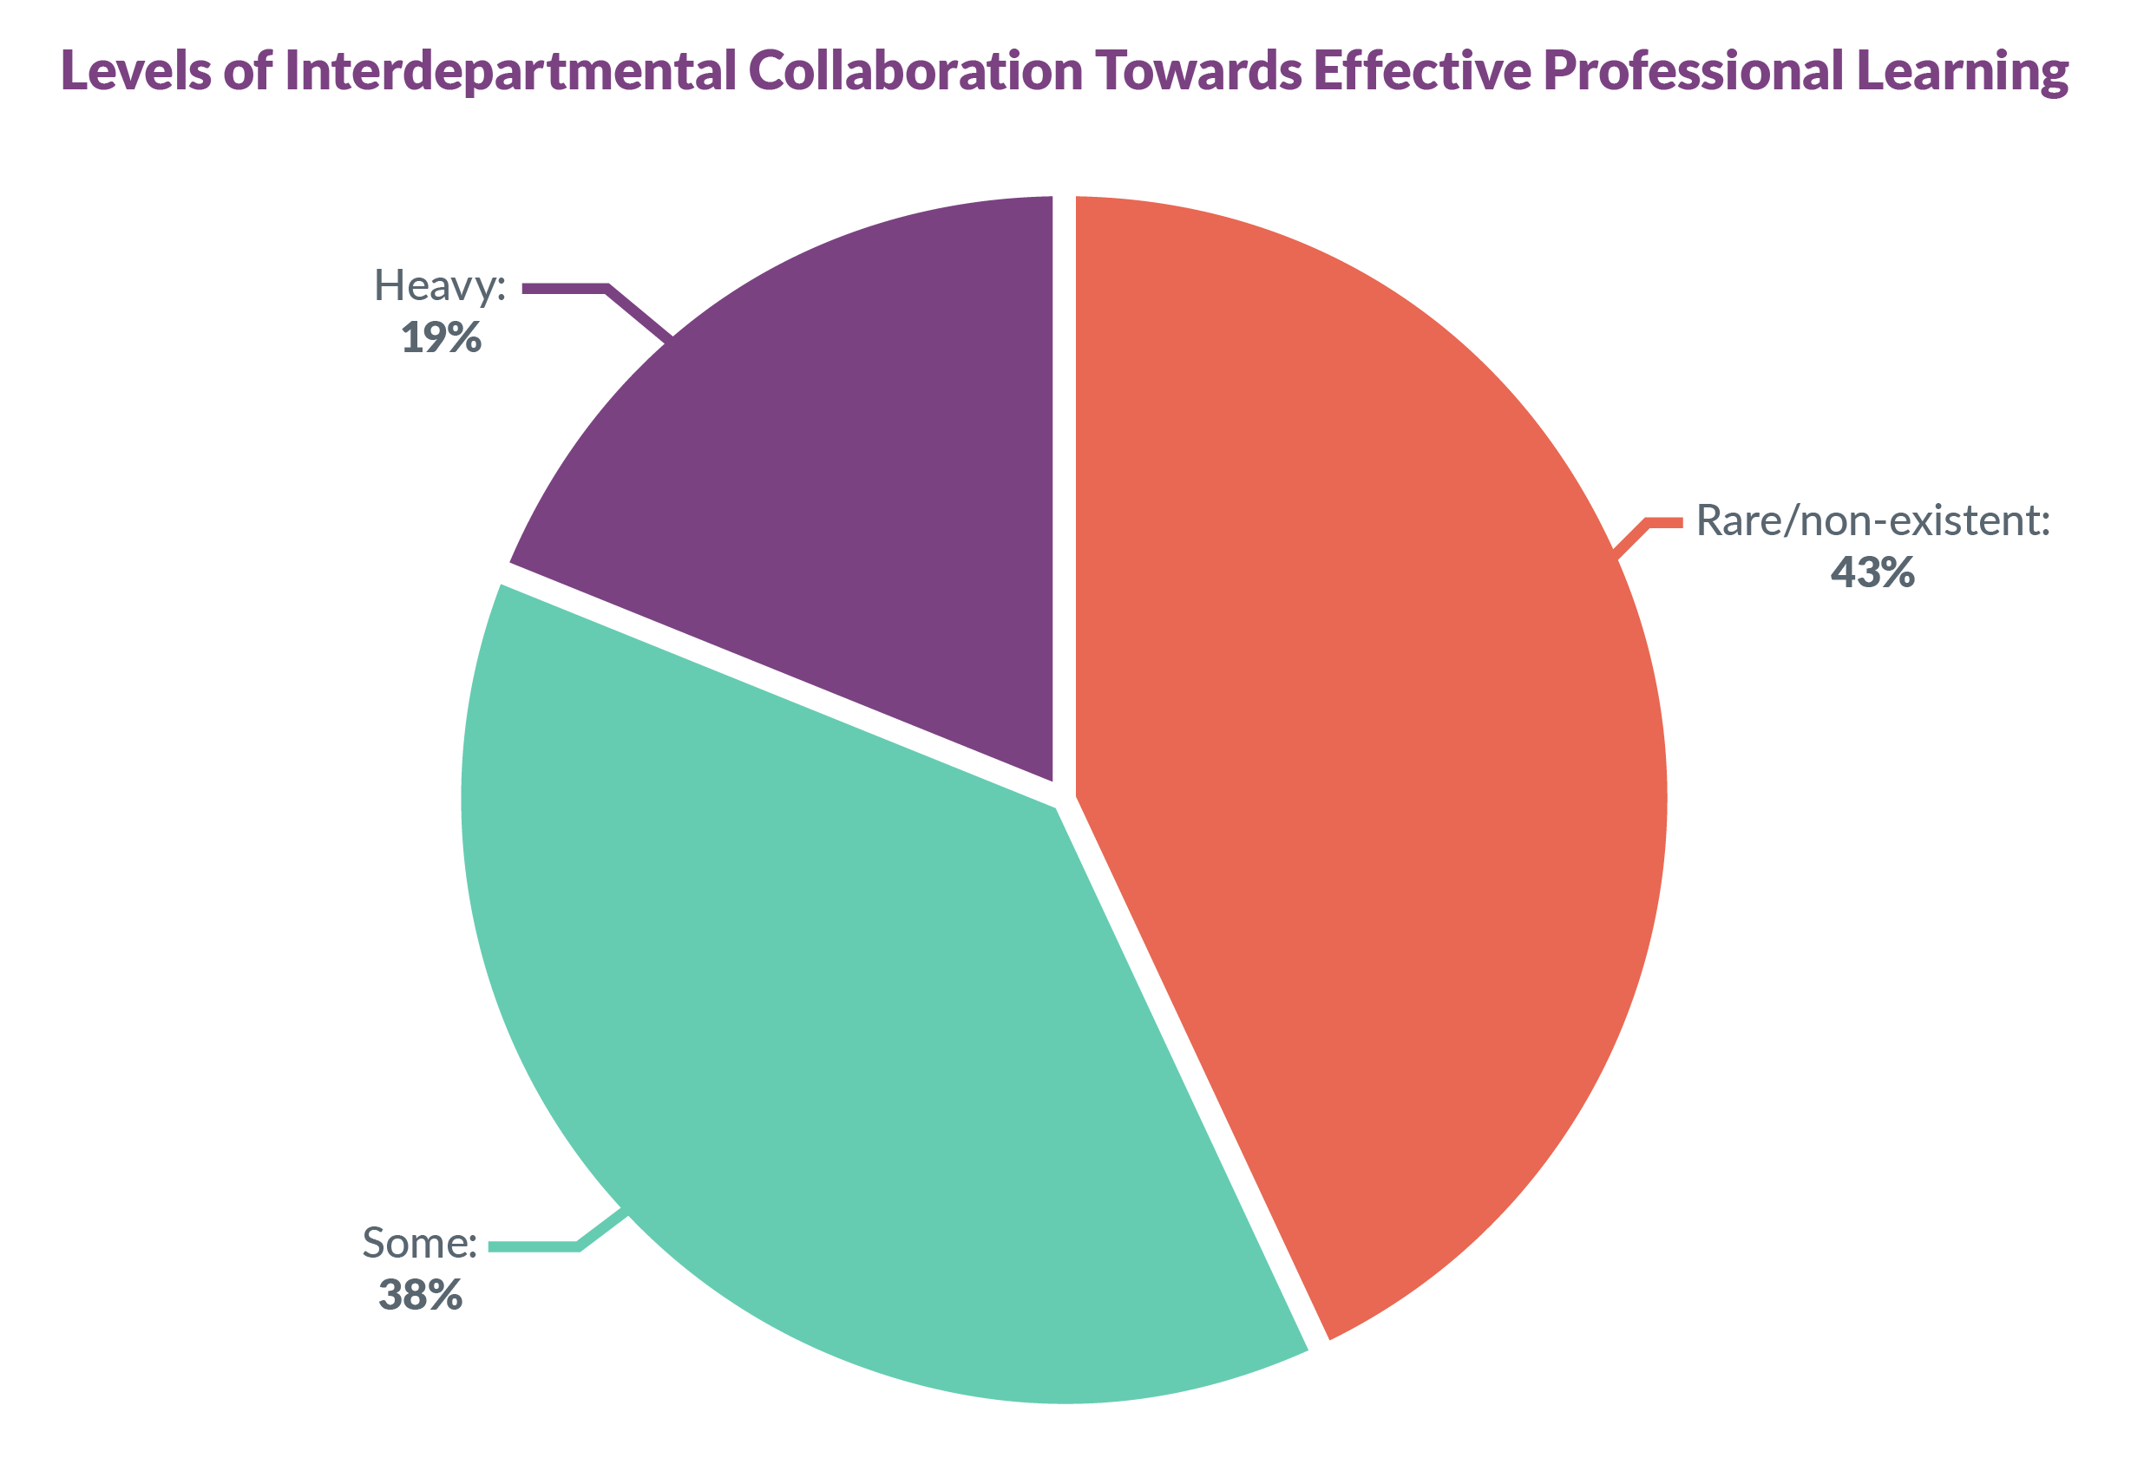
Notes:
In 2017, the Frontline Research & Learning Institute published “Bridging the Gap,” a look at how professional development activities measured up to the criteria set forth in ESSA. While learning opportunities met some criteria more often, such as “classroom-focused” and “job-embedded,” other targets were frequently missed.
From Bridging the Gap, professionally related absences found that 43% of school administrators say that interdepartmental collaboration is rare — or nonexistent — in developing more effective means for facilitating professional development. Another 38% indicated some collaboration. Only 19% of school administrators indicated that there was heavy interdepartmental collaboration towards effective professional learning.

Slide 9
Structures of Professional Learning Collaborative Learning
New Teacher Induction
Mentorships
Grade Chairs/Team Meetings
Professional Learning Communities
Conferences/Workshops
Walkthroughs
On-boarding Programs
Instructional/Technical Coaches
School Improvement Teams
Collegial Circles/Study Groups/Book Studies
Online Learning Courses

Slide 10
What resources and tools are you using to facilitate collaboration in your organization?
Notes:
Poll: What resources and tools are you using during your collaborative groups?
Google Classroom
Learning Management System (Canvas, etc.)
One Drive or Shared Document Space
YouTube/Teacher Tube
Other

Slide 11
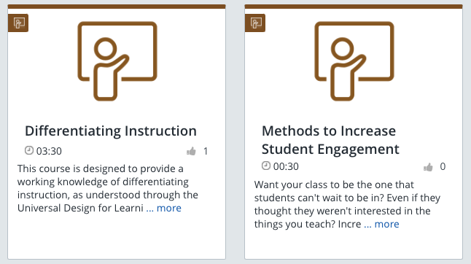
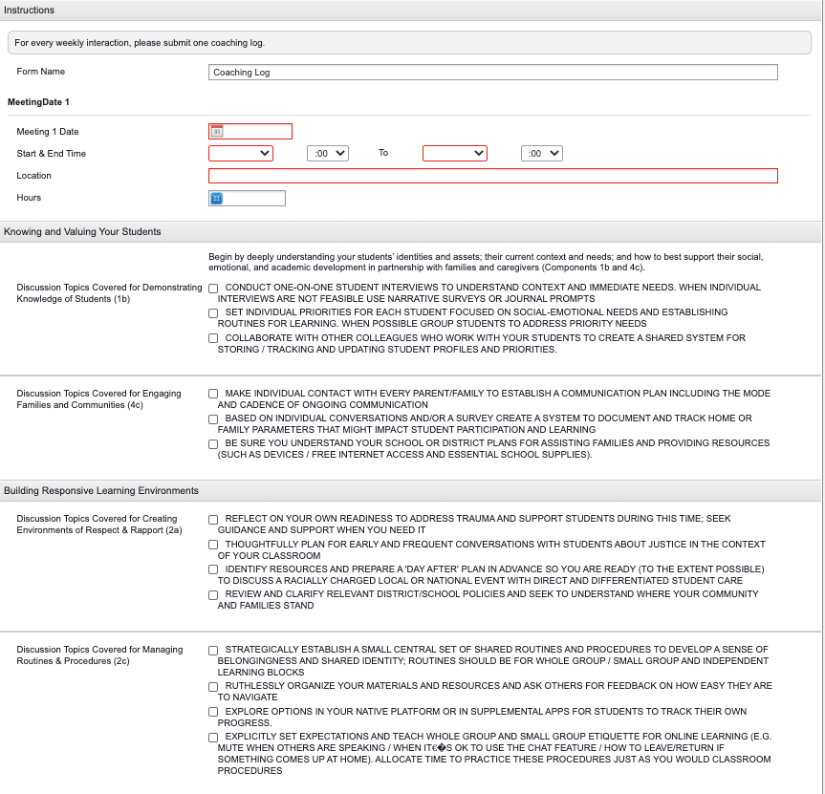
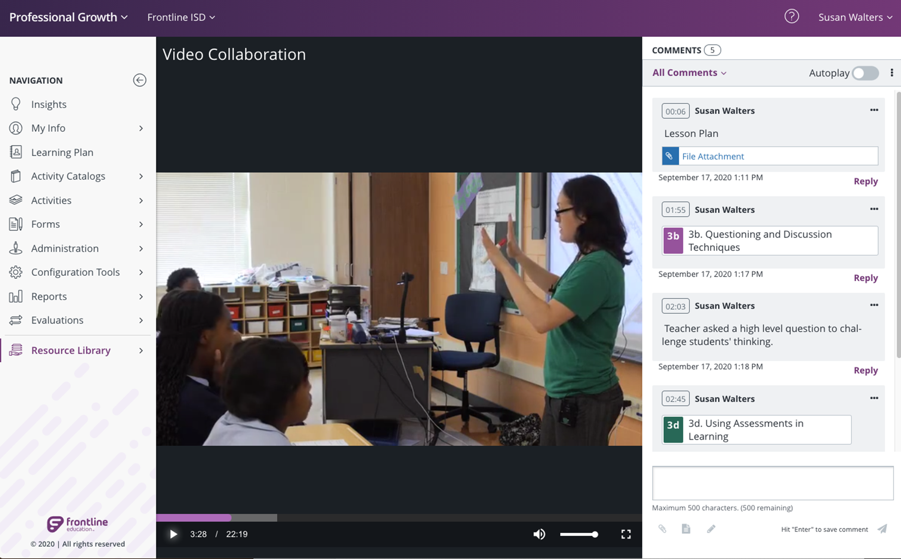
Resources and Tools to Support Collaborative Learning

Slide 12
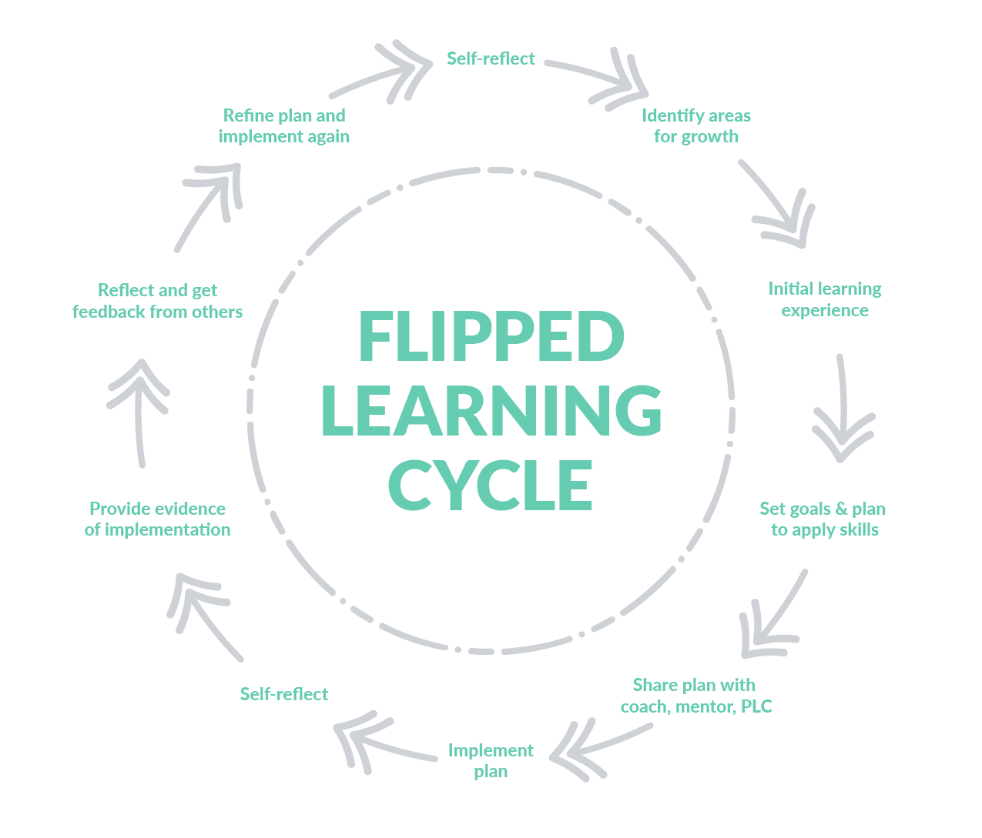
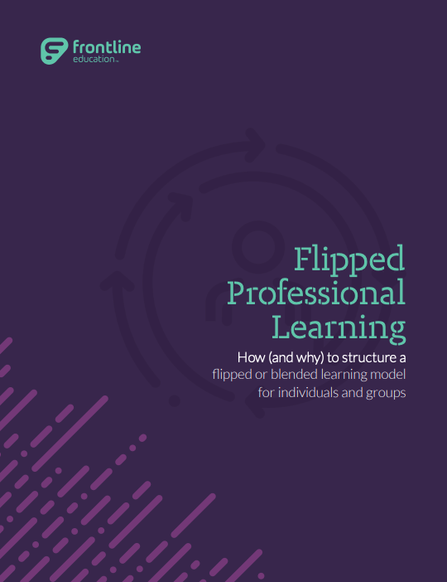
Further Learning & Reflection
FrontlineEducation.com/essa-resource-center
Notes:
Frontline Resources In Chat…

