Slide 1



Slide 2
Enhancing Instruction through
Online Feedback and Support
Notes:
Feedback needs to be timely, specific and meaningful to help teacher improve their classroom practice.

Slide 3


Today we’ll cover:
Current Landscape of Evaluations
And Observations
Formative and Summative Observation Feedback
Examples: How to Enhance Your Professional Learning Program to Provide Online Feedback and Support

Slide 4


Presenters
Susan Walters
Solutions Consultant
Frontline Education
Mitch Welch
Solutions Consultant
Frontline Education

Slide 5
Poll:
What is happening with your evaluation program in the year 2020-2021 ?
Notes:
Poll:
What is happening with your evaluation program in the year 2020-2021?
All requirements (state, district, collective bargaining agreements, etc.) are the same.
There are rumblings that requirements will change but unsure if that will happen this year.
We have opted to move to a more formative observation process that includes characteristics of online learning.
Honestly, so many other priorities and we haven’t thought about it!

Slide 6
How can we continue meeting district requirements and support employees?

Slide 7
How can we continue meeting district requirements and support employees?
Research additional tools that align with your district’s vision and goals.
Be thoughtful, consistent, and intentional in your plan of action to address
the change factor.
Start small and layer in additional characteristics of best practices in instruction. Small changes with big impact!
Notes:
*Review Stronge and show how you can modify.
*Discuss “change” factor
*Show what it looks like in EEM.

Slide 8
What tools are available if we would like to incorporate a formative process?

Slide 9
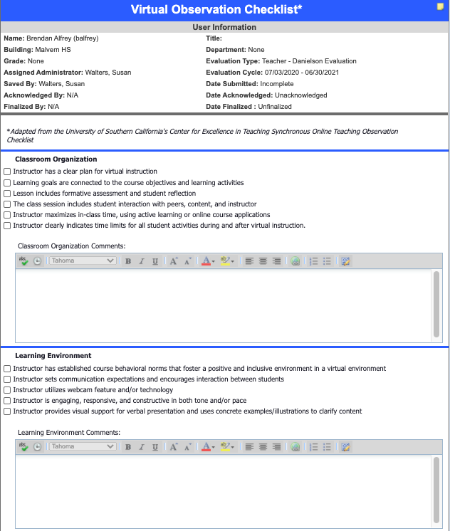

Formative Observational Walkthroughs

Slide 10

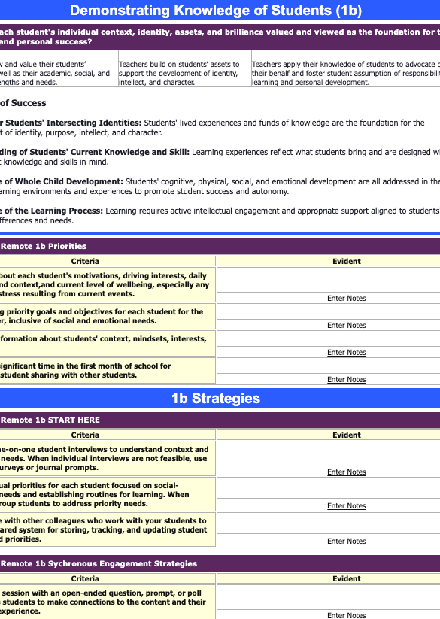
Formative Observational Walkthroughs

Slide 11
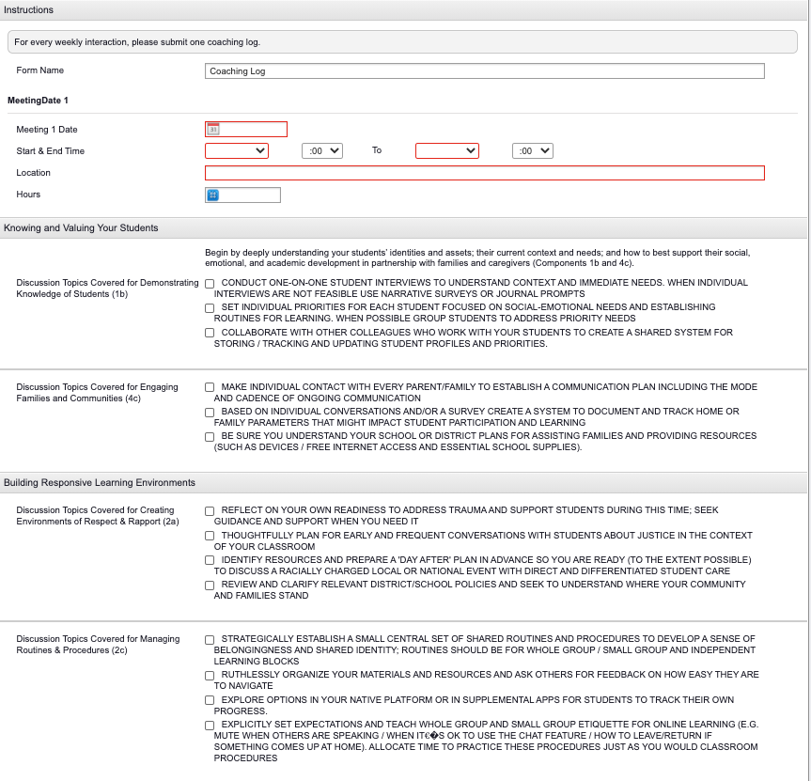
Align your Instructional Coaching/Mentoring Program

Slide 12
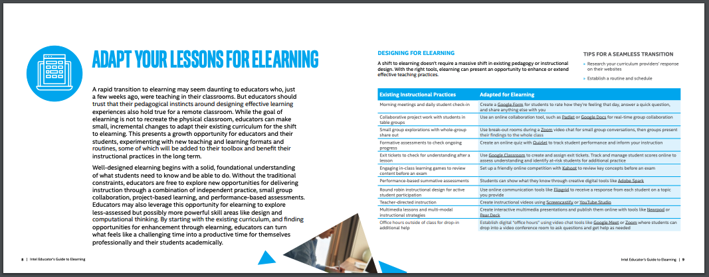


Build Best Practices of Instruction
Resources & Tutorials
Notes:
Review Danielson

Slide 13
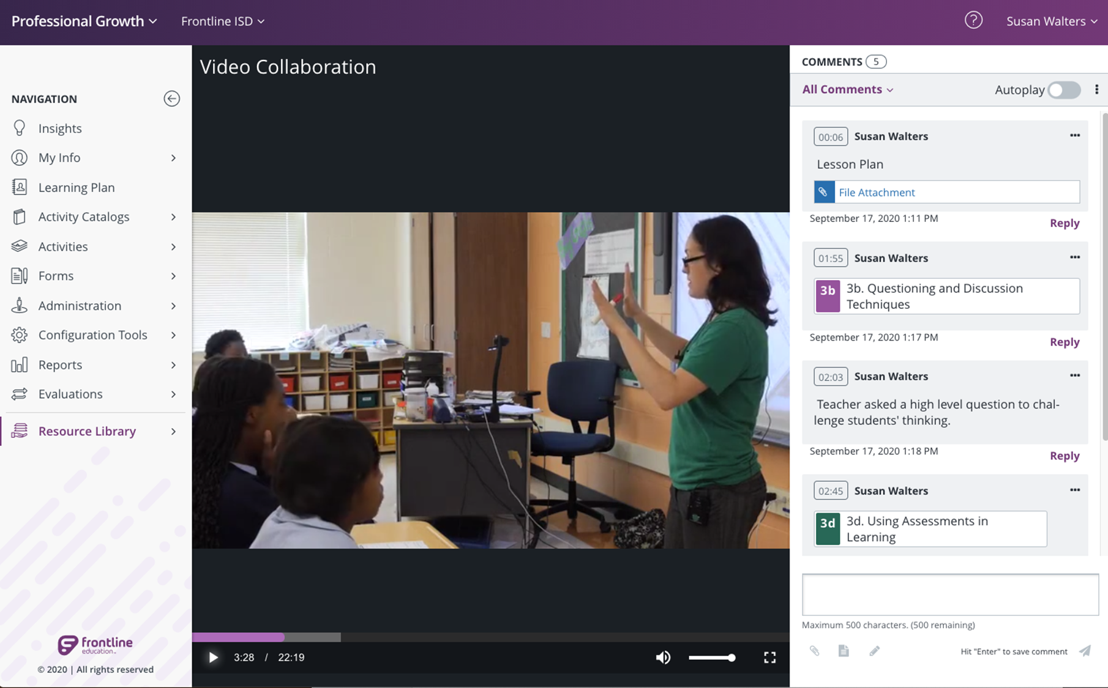
Next Webinar…
Transforming Collaborative Learning, Online
Wednesday, October 21, 2:00 Eastern

Slide 14

Further Learning
& Reflection
www.frontlineeducation.com
Notes:
Frontline Resources In Chat…

Slide 15
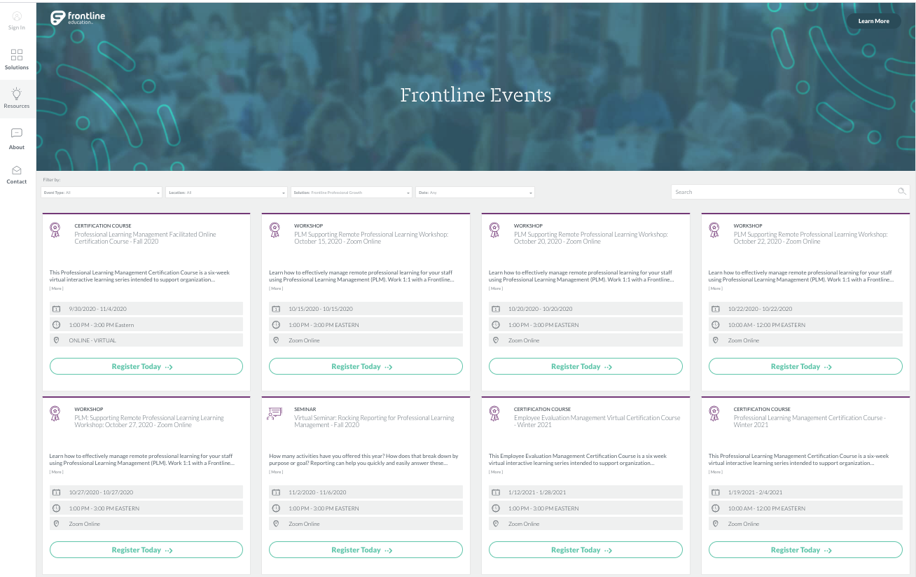
Additional
Support &
Services
www.frontlineeducation.com
Notes:
Frontline Resources In Chat…

