Slide 1
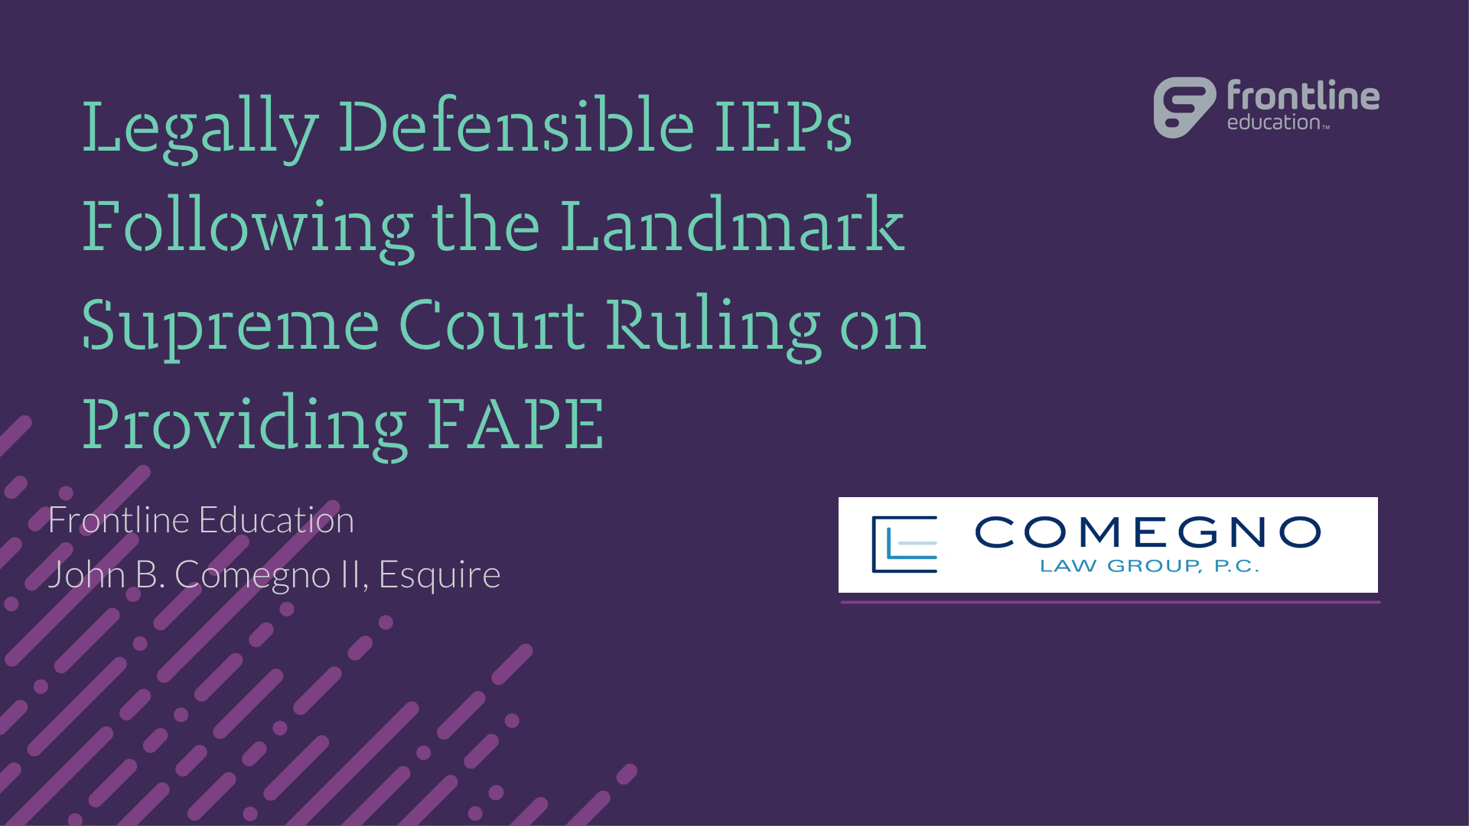

Legally Defensible IEPs Following the Landmark Supreme Court Ruling on Providing FAPE
Frontline Education
John B. Comegno II, Esquire

Slide 2
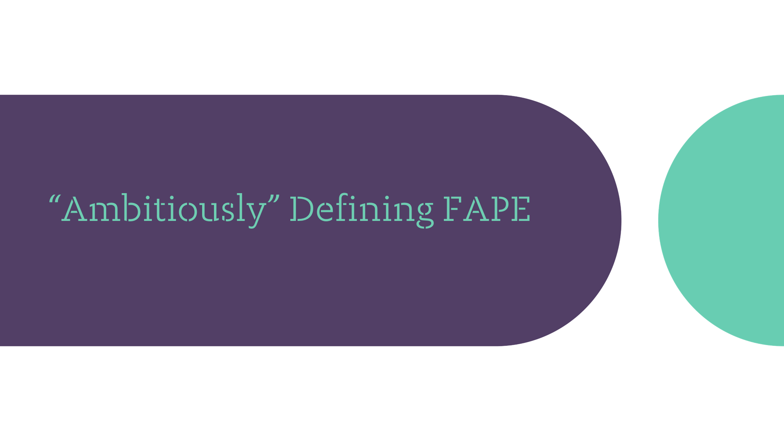
“Ambitiously” Defining FAPE

Slide 3
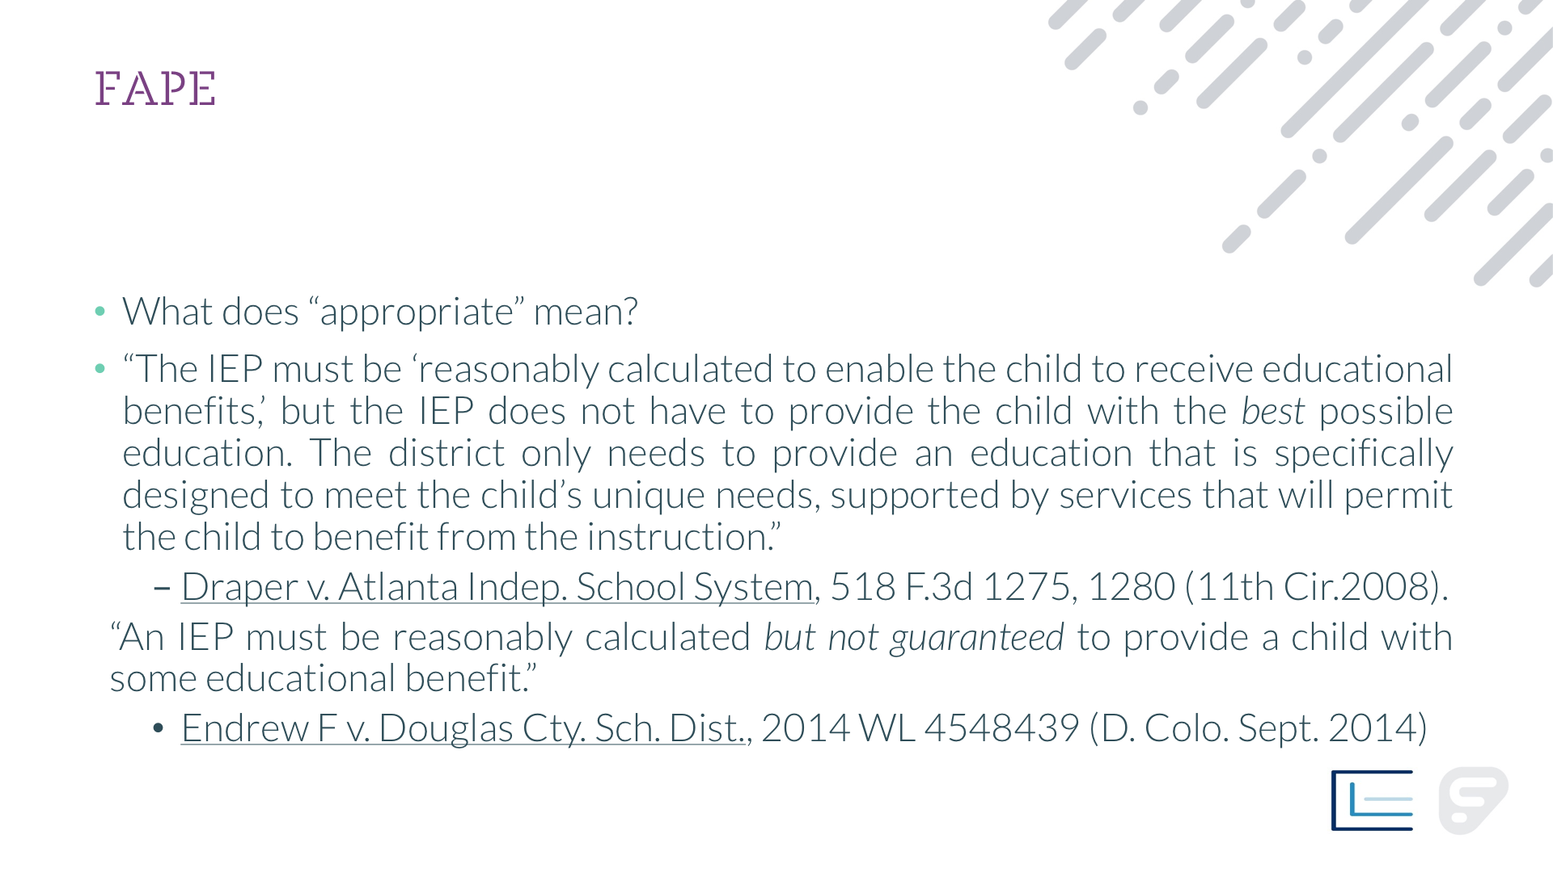

FAPE
What does “appropriate” mean?
“The IEP must be ‘reasonably calculated to enable the child to receive educational benefits,’ but the IEP does not have to provide the child with the best possible education. The district only needs to provide an education that is specifically designed to meet the child’s unique needs, supported by services that will permit the child to benefit from the instruction.”
  Draper v. Atlanta Indep. School System, 518 F.3d 1275, 1280 (11th Cir.2008).
  “An IEP must be reasonably calculated but not guaranteed to provide a child with some educational benefit.”
  Endrew F v. Douglas Cty. Sch. Dist., 2014 WL 4548439 (D. Colo. Sept. 2014)

Slide 4
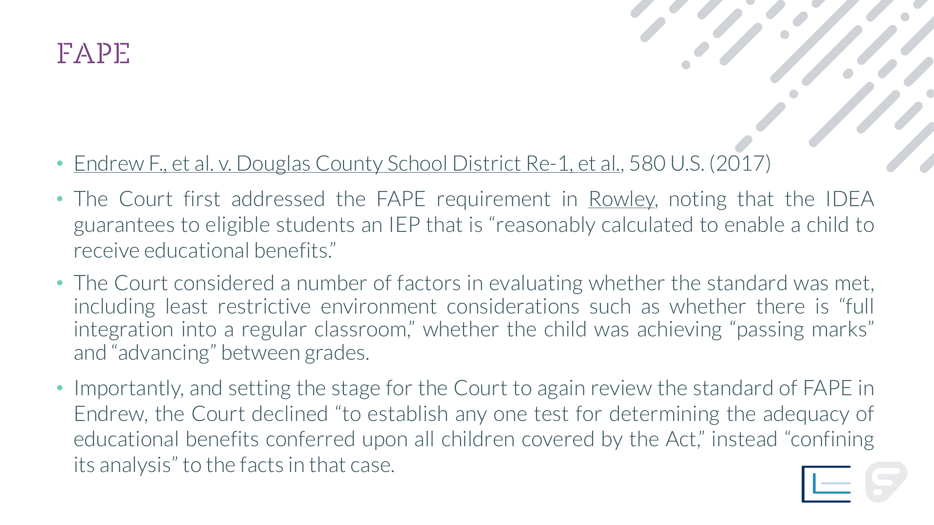
FAPE
Endrew F., et al. v. Douglas County School District Re-1, et al., 580 U.S. (2017)
The Court first addressed the FAPE requirement in Rowley, noting that the IDEA guarantees to eligible students an IEP that is “reasonably calculated to enable a child to receive educational benefits.”
The Court considered a number of factors in evaluating whether the standard was met, including least restrictive environment considerations such as whether there is “full integration into a regular classroom,” whether the child was achieving “passing marks” and “advancing” between grades.
Importantly, and setting the stage for the Court to again review the standard of FAPE in Endrew, the Court declined “to establish any one test for determining the adequacy of educational benefits conferred upon all children covered by the Act,” instead “confining its analysis” to the facts in that case.

Slide 5
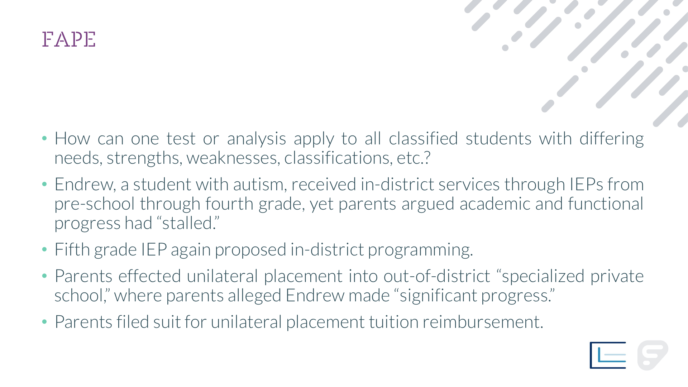
FAPE
How can one test or analysis apply to all classified students with differing needs, strengths, weaknesses, classifications, etc.?
Endrew, a student with autism, received in-district services through IEPs from pre-school through fourth grade, yet parents argued academic and functional progress had “stalled.”
Fifth grade IEP again proposed in-district programming.
Parents effected unilateral placement into out-of-district “specialized private school,” where parents alleged Endrew made “significant progress.”
Parents filed suit for unilateral placement tuition reimbursement.

Slide 6
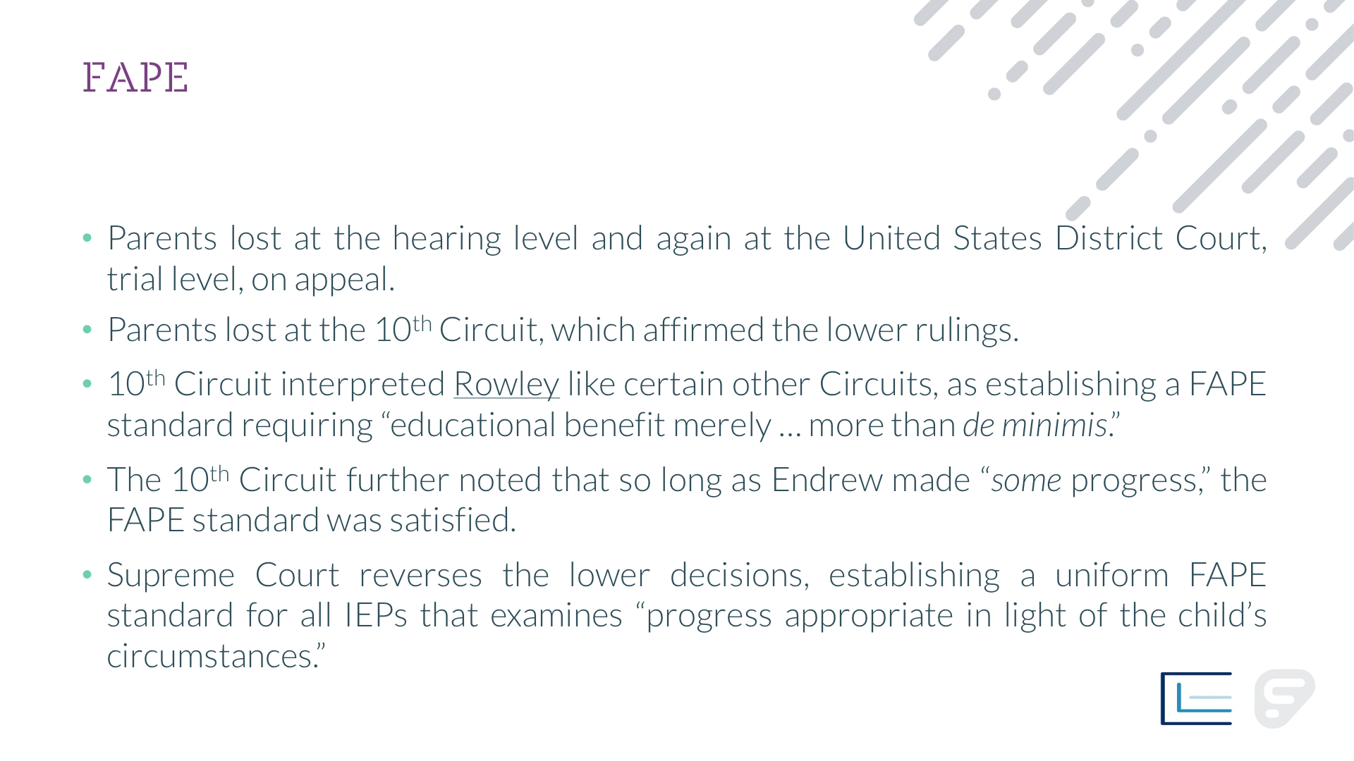
FAPE
Parents lost at the hearing level and again at the United States District Court, trial level, on appeal.
Parents lost at the 10th Circuit, which affirmed the lower rulings.
10th Circuit interpreted Rowley like certain other Circuits, as establishing a FAPE standard requiring “educational benefit merely … more than de minimis.”
The 10th Circuit further noted that so long as Endrew made “some progress,” the FAPE standard was satisfied.
Supreme Court reverses the lower decisions, establishing a uniform FAPE standard for all IEPs that examines “progress appropriate in light of the child’s circumstances.”

Slide 7
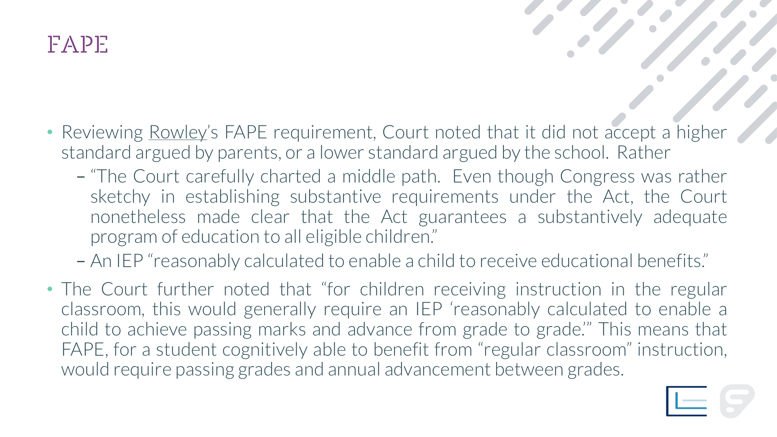
FAPE
Reviewing Rowley’s FAPE requirement, Court noted that it did not accept a higher standard argued by parents, or a lower standard argued by the school. Rather
  “The Court carefully charted a middle path. Even though Congress was rather sketchy in establishing substantive requirements under the Act, the Court nonetheless made clear that the Act guarantees a substantively adequate program of education to all eligible children.”
  An IEP “reasonably calculated to enable a child to receive educational benefits.”
The Court further noted that “for children receiving instruction in the regular classroom, this would generally require an IEP ‘reasonably calculated to enable a child to achieve passing marks and advance from grade to grade.’” This means that FAPE, for a student cognitively able to benefit from “regular classroom” instruction, would require passing grades and annual advancement between grades.

Slide 8
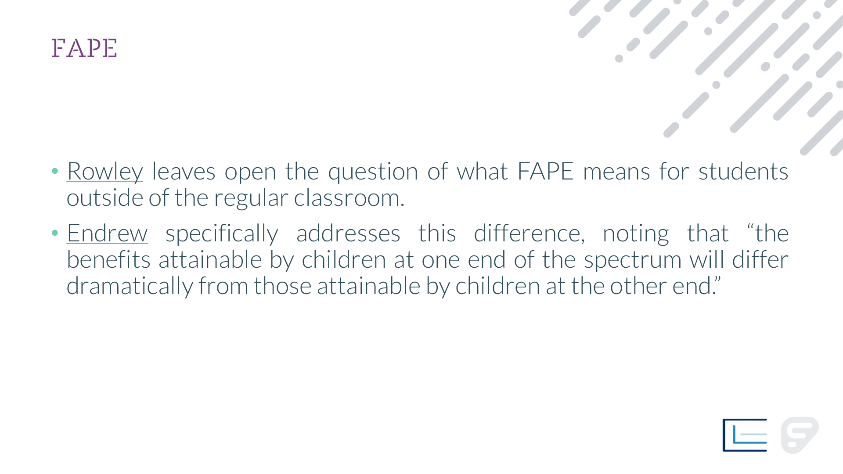
FAPE
Rowley leaves open the question of what FAPE means for students outside of the regular classroom.
Endrew specifically addresses this difference, noting that “the benefits attainable by children at one end of the spectrum will differ dramatically from those attainable by children at the other end.”

Slide 9
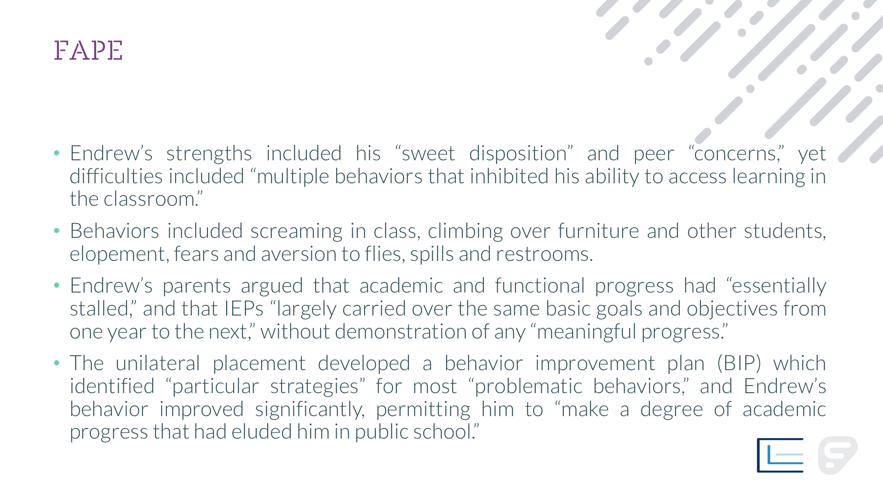
FAPE
Endrew’s strengths included his “sweet disposition” and peer “concerns,” yet difficulties included “multiple behaviors that inhibited his ability to access learning in the classroom.”
Behaviors included screaming in class, climbing over furniture and other students, elopement, fears and aversion to flies, spills and restrooms.
Endrew’s parents argued that academic and functional progress had “essentially stalled,” and that IEPs “largely carried over the same basic goals and objectives from one year to the next,” without demonstration of any “meaningful progress.”
The unilateral placement developed a behavior improvement plan (BIP) which identified “particular strategies” for most “problematic behaviors,” and Endrew’s behavior improved significantly, permitting him to “make a degree of academic progress that had eluded him in public school.”

Slide 10
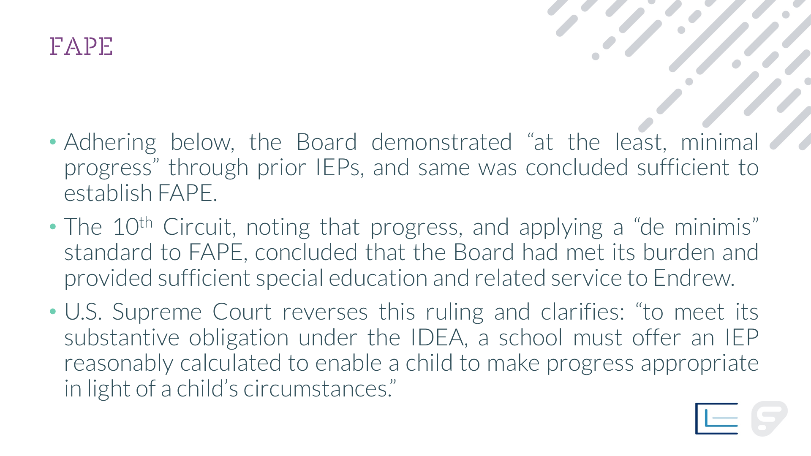
FAPE
Adhering below, the Board demonstrated “at the least, minimal progress” through prior IEPs, and same was concluded sufficient to establish FAPE.
The 10th Circuit, noting that progress, and applying a “de minimis” standard to FAPE, concluded that the Board had met its burden and provided sufficient special education and related service to Endrew.
U.S. Supreme Court reverses this ruling and clarifies: “to meet its substantive obligation under the IDEA, a school must offer an IEP reasonably calculated to enable a child to make progress appropriate in light of a child’s circumstances.”

Slide 11
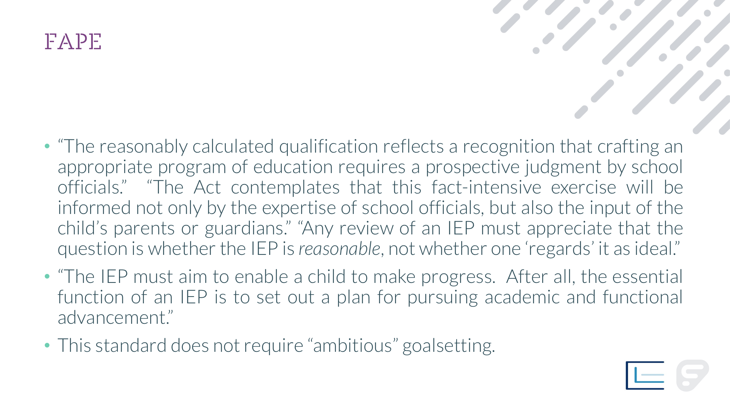
FAPE
“The reasonably calculated qualification reflects a recognition that crafting an appropriate program of education requires a prospective judgment by school officials.” “The Act contemplates that this fact-intensive exercise will be informed not only by the expertise of school officials, but also the input of the child’s parents or guardians.” “Any review of an IEP must appreciate that the question is whether the IEP is reasonable, not whether one ‘regards’ it as ideal.”
“The IEP must aim to enable a child to make progress. After all, the essential function of an IEP is to set out a plan for pursuing academic and functional advancement.”
This standard does not require “ambitious” goalsetting.

Slide 12
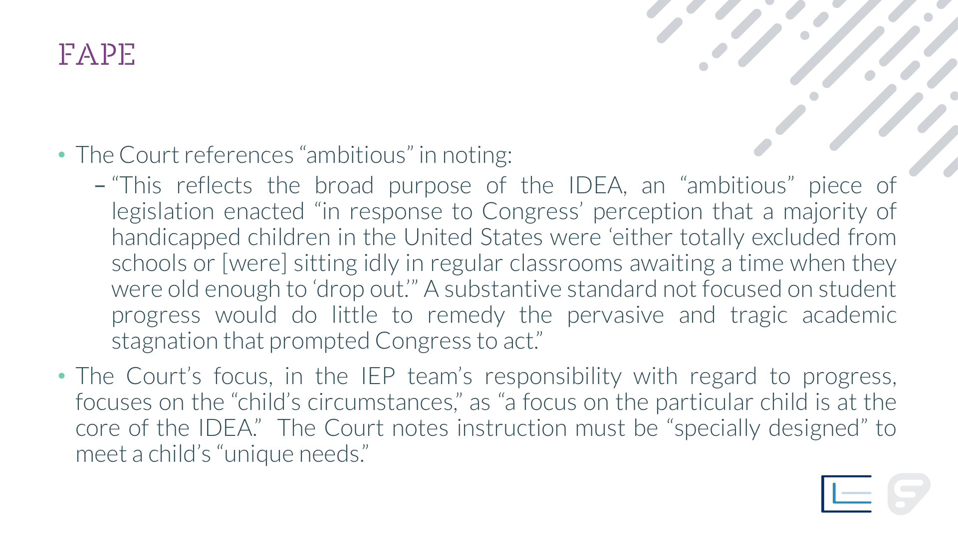
FAPE
The Court references “ambitious” in noting:
  “This reflects the broad purpose of the IDEA, an “ambitious” piece of legislation enacted “in response to Congress’ perception that a majority of handicapped children in the United States were ‘either totally excluded from schools or [were] sitting idly in regular classrooms awaiting a time when they were old enough to ‘drop out.’” A substantive standard not focused on student progress would do little to remedy the pervasive and tragic academic stagnation that prompted Congress to act.”
The Court’s focus, in the IEP team’s responsibility with regard to progress, focuses on the “child’s circumstances,” as “a focus on the particular child is at the core of the IDEA.” The Court notes instruction must be “specially designed” to meet a child’s “unique needs.”

Slide 13
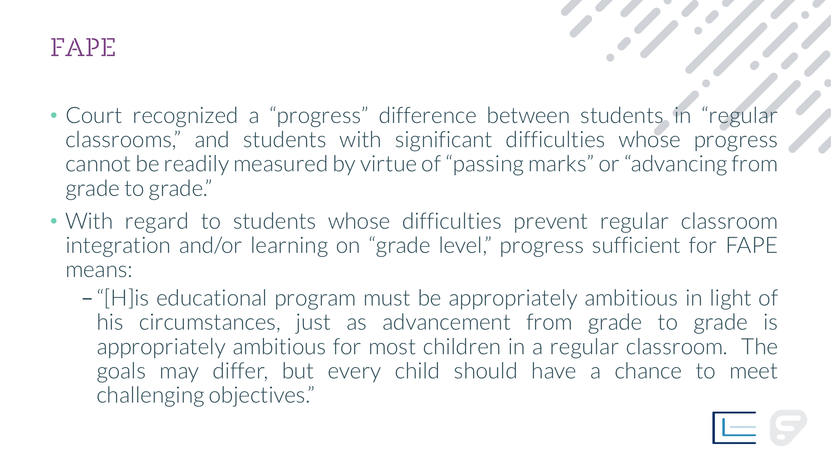
FAPE
Court recognized a “progress” difference between students in “regular classrooms,” and students with significant difficulties whose progress cannot be readily measured by virtue of “passing marks” or “advancing from grade to grade.”
With regard to students whose difficulties prevent regular classroom integration and/or learning on “grade level,” progress sufficient for FAPE means:
  “[H]is educational program must be appropriately ambitious in light of his circumstances, just as advancement from grade to grade is appropriately ambitious for most children in a regular classroom. The goals may differ, but every child should have a chance to meet challenging objectives.”

Slide 14
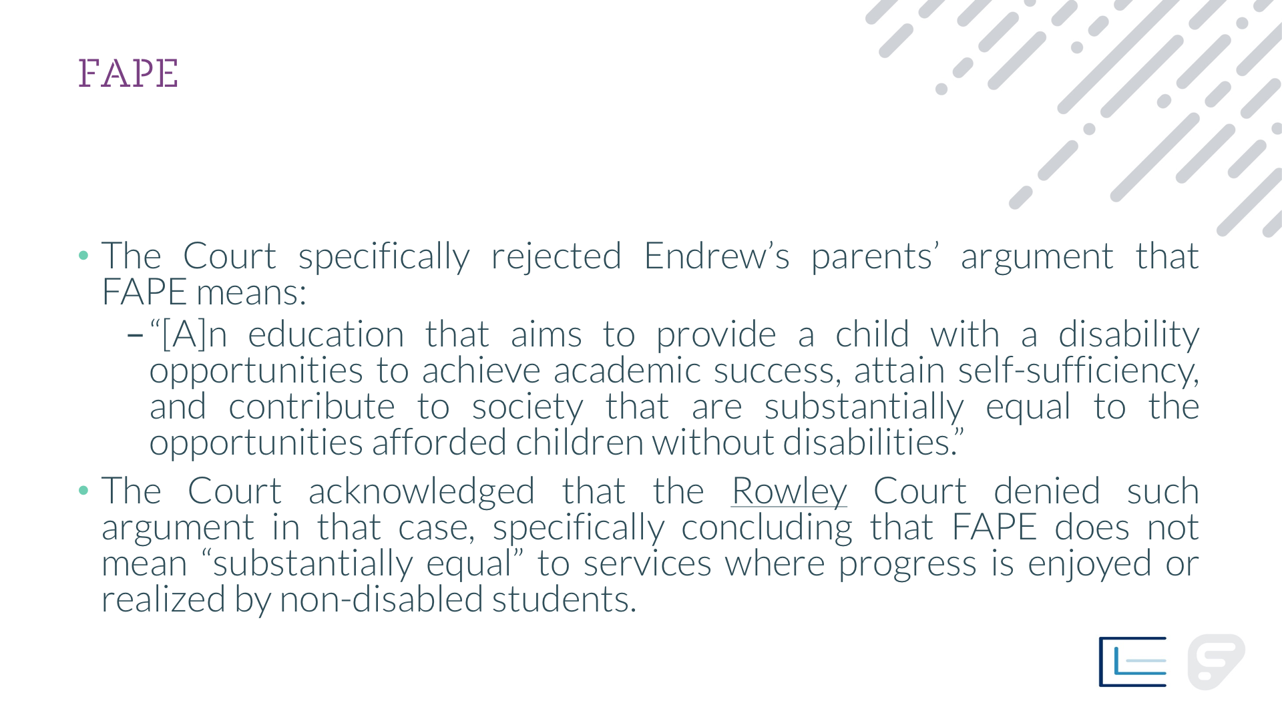
FAPE
The Court specifically rejected Endrew’s parents’ argument that FAPE means:
  “[A]n education that aims to provide a child with a disability opportunities to achieve academic success, attain self-sufficiency, and contribute to society that are substantially equal to the opportunities afforded children without disabilities.”
The Court acknowledged that the Rowley Court denied such argument in that case, specifically concluding that FAPE does not mean “substantially equal” to services where progress is enjoyed or realized by non-disabled students.

Slide 15
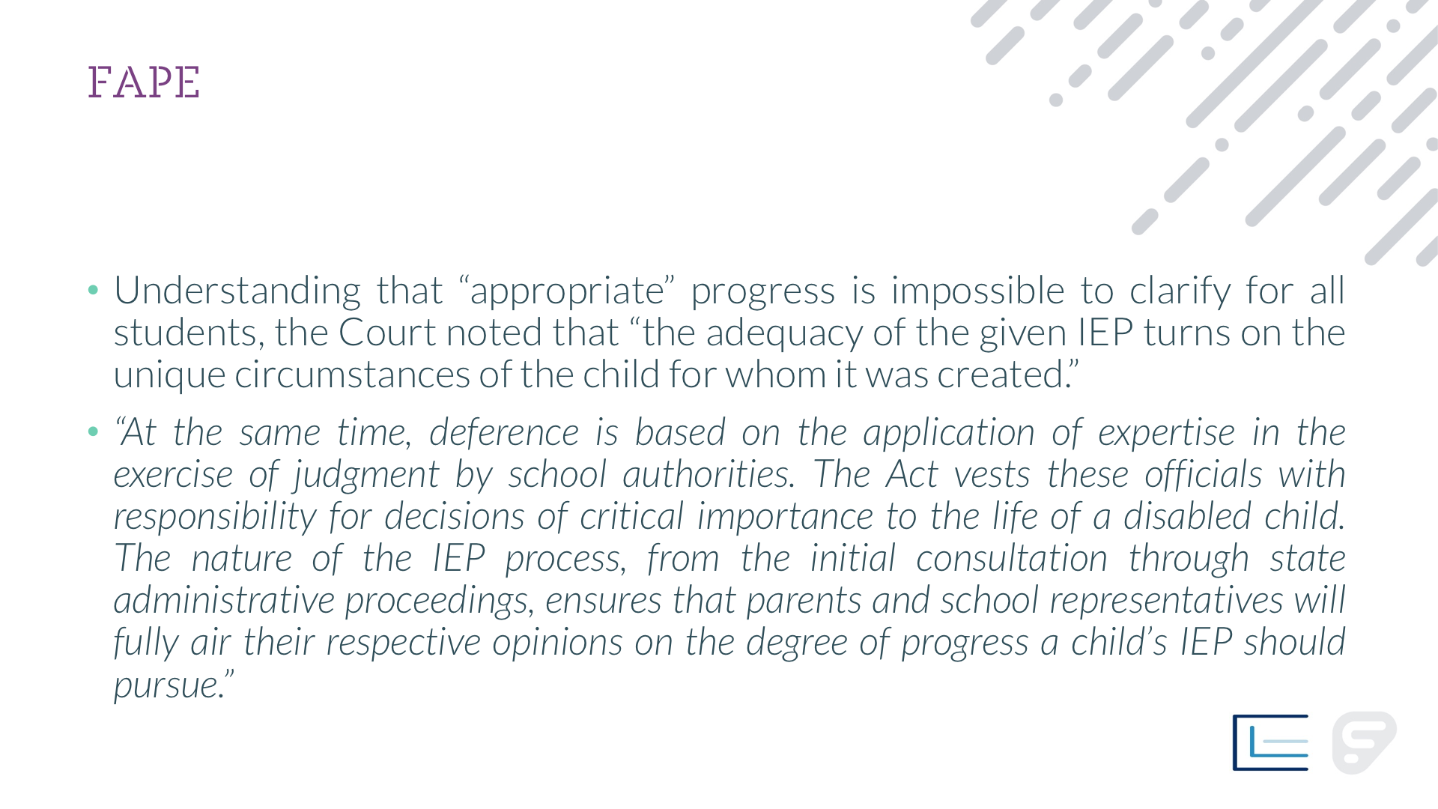
FAPE
Understanding that “appropriate” progress is impossible to clarify for all students, the Court noted that “the adequacy of the given IEP turns on the unique circumstances of the child for whom it was created.”
“At the same time, deference is based on the application of expertise in the exercise of judgment by school authorities. The Act vests these officials with responsibility for decisions of critical importance to the life of a disabled child. The nature of the IEP process, from the initial consultation through state administrative proceedings, ensures that parents and school representatives will fully air their respective opinions on the degree of progress a child’s IEP should pursue.”

Slide 16

John B. Comegno II, Esquire
jcomegno@comegnolaw.com
856.234.4114

